Slide 1
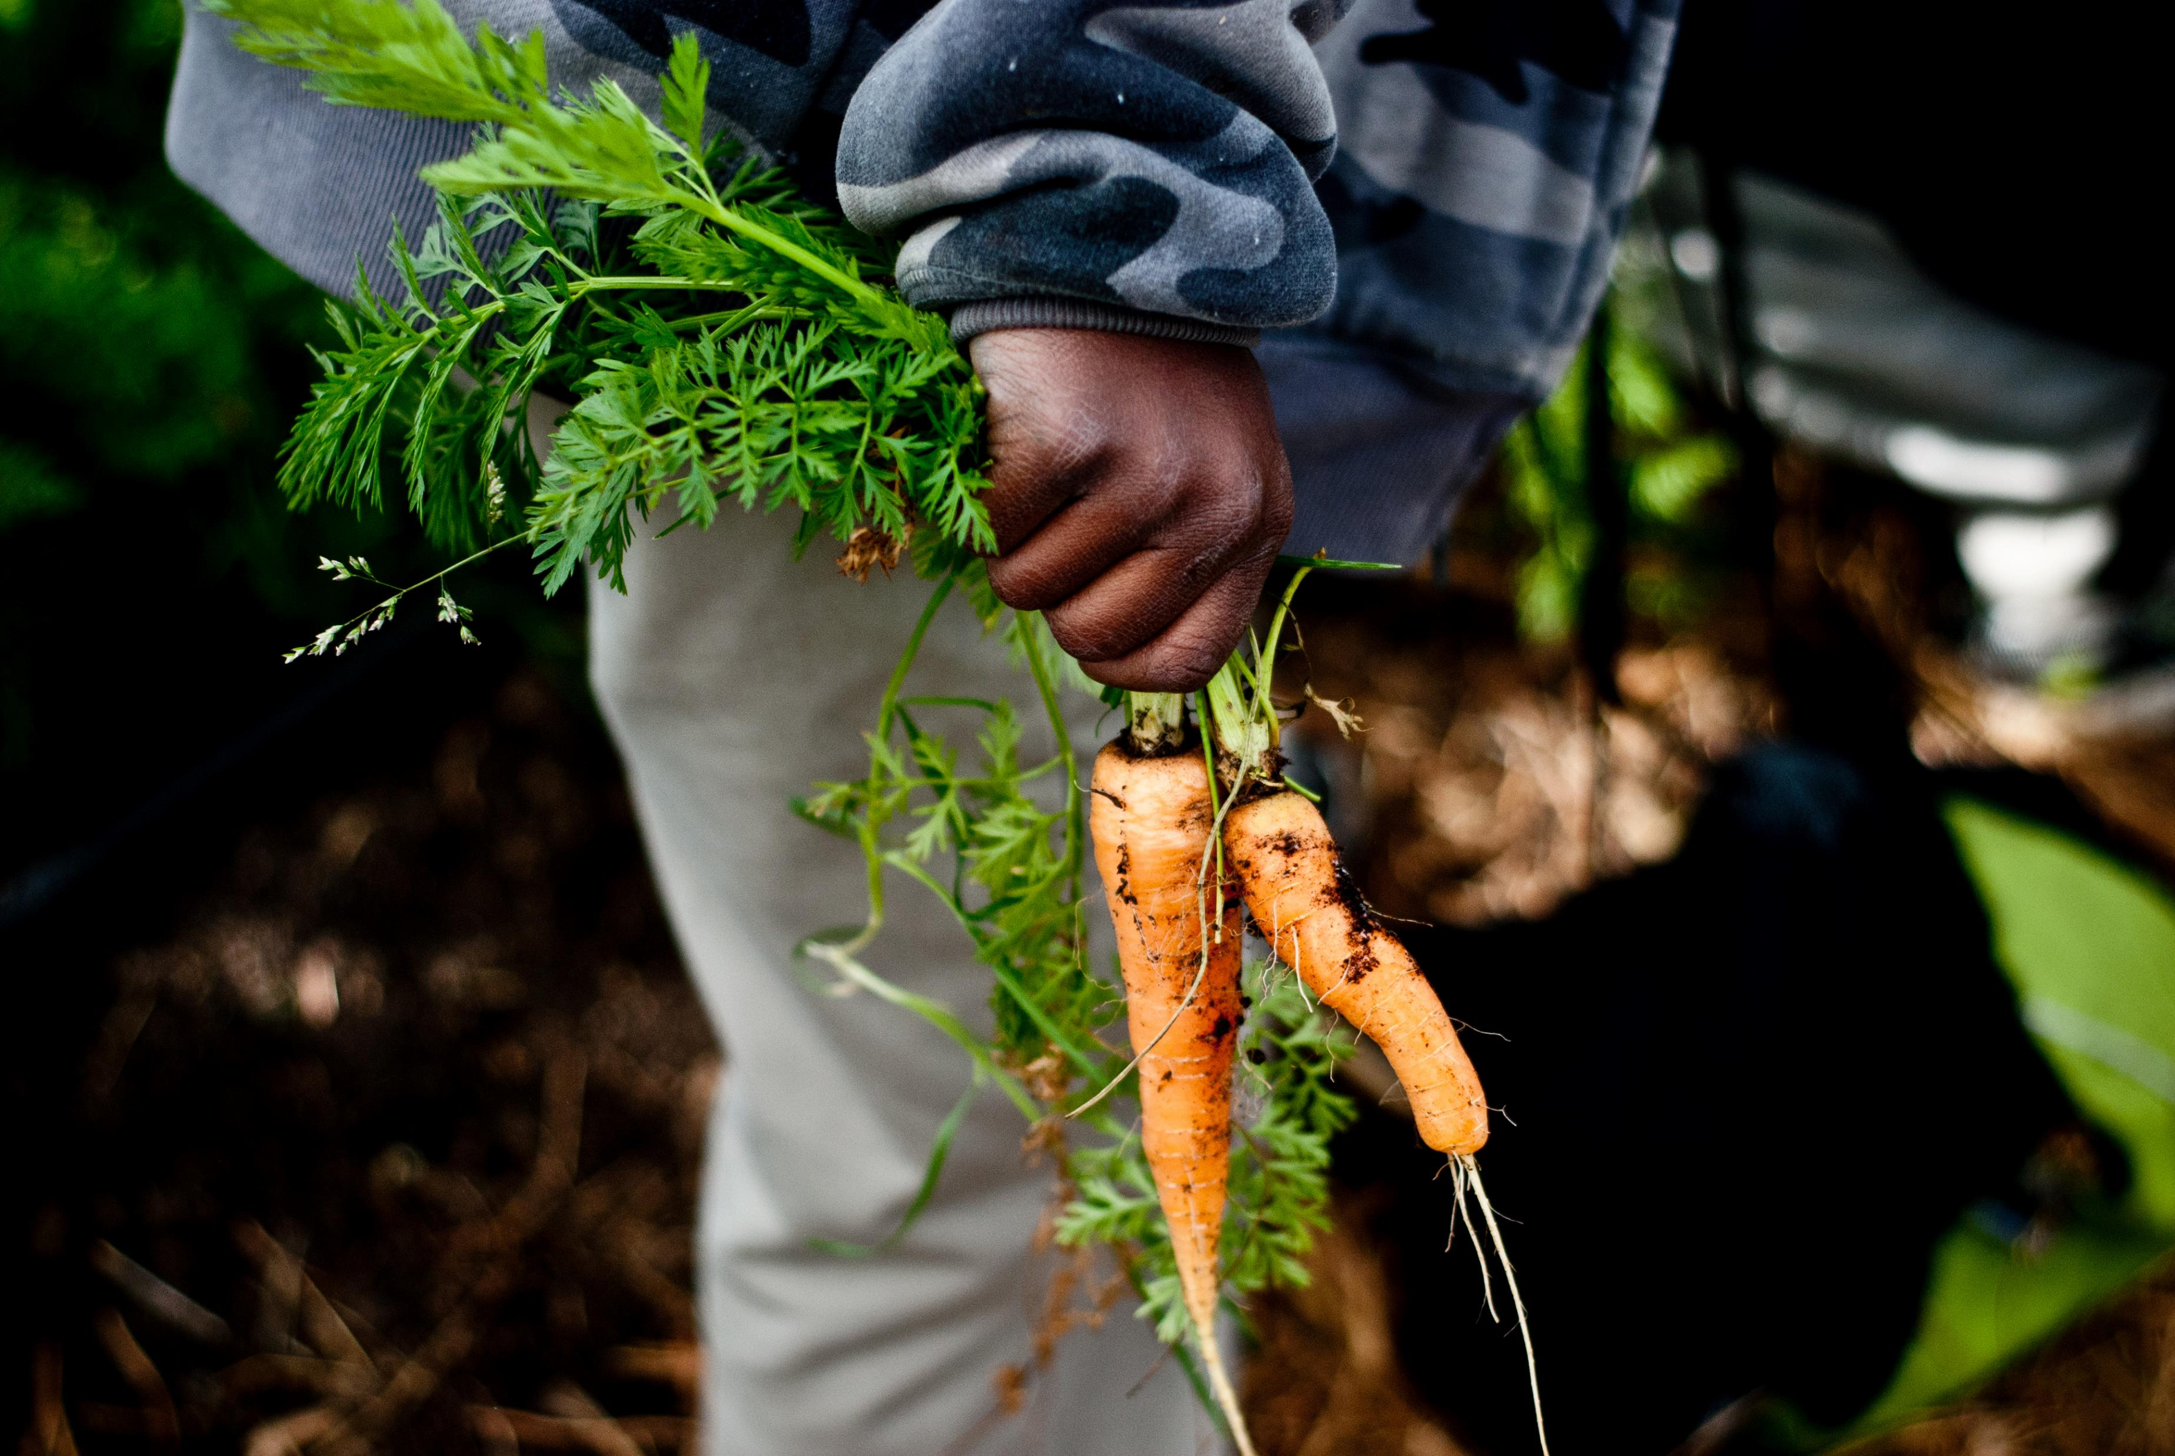
Education and Outreach:
Removing Barriers to USDA GAP Programs
GAP Pilot stakeholder training

Slide 2
Cooperative Agreement Objectives
Develop and pilot a strategy to address barriers to USDA GAP Programs
  GroupGAP
  Socially disadvantaged and historically underserved growers
Promote the utilization of USDA GAP Programs with the new strategy
  Toolkits as resources to provide education and outreach
  Partnership model for delivery
Photo credit: Michael Howard, Eden Place Farms
Notes:
The NASDA Foundation partnered with USDA-Agricultural Marketing Service (AMS) to address barriers and bring awareness to the Good Agricultural Practices (or GAP) Programs. Barriers were determined through surveys Michigan State University collected from producers, buyers, technical service providers and educators for their "Buyer Acceptance Project".
The data from the project served as the starting point for us –
Our first objective for the cooperative agreement was to develop and pilot a strategy to address the identified barriers to GAP programs, including GroupGAP.
The main barriers were communication or clarity of the GAP standards, program expectations, audit costs and grower mistrust.
Our Target Audience are socially disadvantaged and historically underserved growers.
These are growers who have been subjected to racial or ethnic prejudices because of their identity as a member of a group without regard to their individual qualities. Those groups include African Americans, American Indians or Alaskan natives, Hispanics, and Asians or Pacific Islanders.
Our second objective was to promote GAP programs with an education and outreach strategy. To accomplish this, we created toolkits as resources and developed the following partnership model to implement the program.

Slide 3
Partnership Model
Education and Outreach: Removing Barriers to USDA GAP Programs
Notes:
Our partner model includes representatives from state departments of agriculture, cooperative extension, and non-governmental organizations. Each of these organizations bring their own expertise to the partnership. Extension and NGOs often have established relationships with growers. States can often aid growers with business development. We will cover many of these resources later on in the presentation.
This model was based on successes from Virginia’s joint efforts between the Department of Agriculture & Consumer Services and Virginia State University to aid their small producers, as well as from a GAP audit we observed in Georgia where Fort Valley extension and an NGO were providing both technical and financial assistance the grower.
By partnering extension and NGOs with state departments of agriculture, the collaboration will facilitate states build those beneficial relationships with their growers as well.

Slide 4
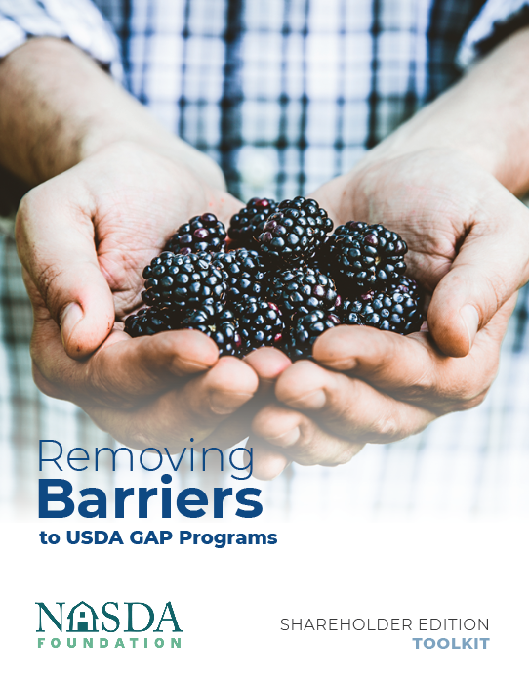
Stakeholder Toolkit
Designed as a resource for our stakeholders outlining the NASDA Foundation’s education and outreach program to address barriers to USDA GAP Programs
  Build and Assess Partnerships
  Implement the Grower Toolkit
  Highlight GAP Funding and Marketing
  Guide for Program Implementation
Notes:
The Stakeholder Toolkit was created to serve as a guide on how to develop partnerships between state departments of agriculture (SDA), cooperative extension (extension), and non-government organizations (NGOs) with the goal of presenting effective GAP education and outreach to socially disadvantaged and underserved growers.
This toolkit references available funding opportunities for stakeholders to share with growers to obtain GAP certification, lists marketing resources and benefits of the program.

Slide 5
Grower Toolkit
Designed for growers as a resource of information about USDA GAP Programs,
and GroupGAP
  Grower GAP Needs
  Key Information
  Misconceptions
  Cost Breakdown
  Training and Technical Assistance
  Important Contacts
Notes:
The Grower Toolkit was developed to help answer questions a grower may have about USDA GAP certification and determining their GAP needs. It also provides key information to clarify the purpose and value of GAP certification, addresses misconceptions, breaks down audit costs and variables, highlights available training and resources for technical assistance, and provides important contacts.
Today we will discuss the differences between the USDA GAP standards, including GroupGAP. We will review how to pursue GAP certification, but we will not delve into the specific technical GAP requirements. You are able to follow along with the printed toolkit.
The Grower toolkit is intended to complement the Stakeholder toolkit for program implementation.

Slide 6
The GAP Audit Program
The USDA GAP Audit Program was developed as a MARKET ACCESS TOOL for producers to meet annual food safety/good agricultural practices audits required by buyers to ensure specific food safety practices are being followed based on buyer specifications and/or industry best practices.
  Voluntary and are conducted by a USDA-certified auditor
  Verify that fruits and vegetables are produced, packed, handled, and stored to minimize risks of microbial food safety hazards
  Occur on a scheduled basis at least once a year during harvest or post-harvest activities
Notes:
Let’s get into content of the Grower Toolkit; remember, this content was specifically compiled to address the barriers - communication and clarity of programs being one the most notable of the barriers.
The USDA GAP Audit Program was developed as a market access tool for producers to meet annual food safety/good agricultural practices audits required by buyers to ensure specific food safety practices are being followed based on buyer specifications and/or industry best practices.
USDA GAP audits … (Read slide – first 2 bullets; place emphasis on the italicized, colored words)
USDA audits generally occur on a scheduled basis at least once a year during harvest or post-harvest activities; unannounced verification audits may also take place, depending on the scope of the audit and the length of the production period.
We will review several of the USDA GAP certification options; regardless of the type, all audits address hazards, identify routes of contamination, implement good agricultural practices, and document activities. The main differences are the level of complexity, stringency, and cost.

Slide 7

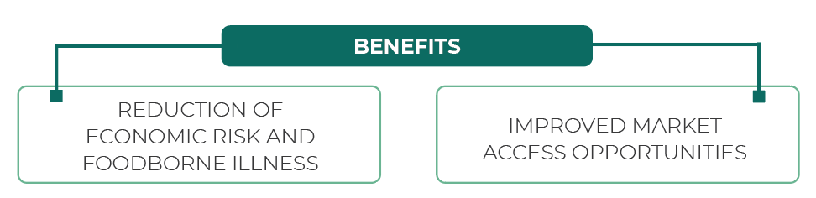
GAP CERTIFICATION DOES NOT GUARANTEE THAT FOOD IS FREE OF CONTAMINATION
Actions are being taken to reduce the risk of loss and outbreaks originating from a farm.
Opens markets for producers to major supermarket chains, school systems, restaurants, and other market outlets.
Notes:
Having your GAP certification does not guarantee that food is free of contamination; however, it does confirm that actions are being taken to reduce the risk of economic losses and foodborne illness outbreaks originating from a farm. GAP certification also opens markets for producers to expand sales to major supermarket chains, school systems, restaurants, and other market outlets. Many retailers and foodservice buyers now require third-party GAP certification as a condition of contract.

Slide 8
Process Audits
Best agricultural practices to verify that fruits and vegetables are produced, packed, handled, and stored in the safest manner possible to minimize risks of microbial food safety hazards
Good Agricultural Practices (GAP)
Harmonized GAP (HGAP)
  Allows growers to demonstrate to buyers that they are implementing specific preventative measures/requirements from the Produce Safety Rule (PSR)
Harmonized GAP Plus+ (HGAP Plus+)
  Acknowledged as equivalent to the GFSI Technical Equivalence Requirements
Notes:
As mentioned, USDA GAP audits are voluntary and performed by a USDA-certified auditor. The 3 audit standards shown are known as process audits and increase in complexity. The most basic standard is a
Good Agricultural Practices (GAP) audit
All GAP audits focus on the use of best agricultural practices to verify that fruits and vegetables are produced, packed, handled, and stored in the safest manner possible to minimize risks of microbial food safety hazards
The Harmonized GAP (HGAP) audit
allow growers to demonstrate to buyers that they are implementing specific requirements from the Produce Safety Rule (PSR). This GAP audit service is aligned with the PSR to demonstrate that all the metrics used in the USDA program meet the Rule’s ultimate goals of increasing food safety. However, the USDA HGAP Audit Program is not a substitution for a PSR compliance inspection conducted by a regulatory agency
Harmonized GAP Plus+ (HGAP Plus+)
The USDA audit service acknowledged as equivalent to the GFSI Technical Equivalence Requirements. Many retail, food service, and institutional buyers require their suppliers to undergo a food safety audit conducted against one of the GFSI recognized certification programs.
Additionally, there is a Mushroom GAP program that is a commodity specific audit performed throughout the production and distribution of mushrooms.
And California and Arizona Leafy Green Marketing Agreements (LGMA) are audits on leafy greens in California and Arizona.

Slide 9
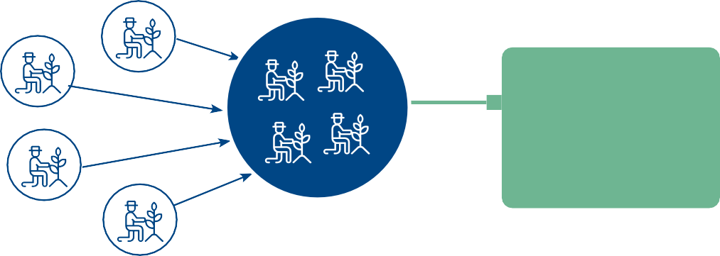
USDA System Audit: GroupGAP
GroupGAP allows individual farmers to certify their practices together as part of a centrally-managed group to address food safety cooperatively.
Certify to either GAP, Harmonized GAP, or Harmonized GAP Plus+ audit standards
GROWERS SEEKING INDIVIDUAL
CERTIFICATION
GroupGAP
INDIVIDUAL GROWERS JOINING TOGETHER TO FORM A GroupGAP GROUP
Notes:
GroupGAP is the system audit service offered by USDA.
Historically, GAP certification to reach larger markets has been out of reach for many small and mid-sized farms, beginning farmers, and socially disadvantaged farmers because of the cost. The USDA GroupGAP Certification Program provides another way for growers of all sizes and grower groups to achieve GAP certification.
Established in 2016, GroupGAP allows individual farmers to certify their practices together as part of a centrally-managed group. A group consists of producers and/or supply chain partners, that may include food hubs or cooperatives.
GroupGAP provides an umbrella of support, that allows the group and its participants addressing food safety cooperatively. Groups certify to the audit standards of either GAP, Harmonized GAP, or Harmonized GAP Plus+.
Explain graphic

Slide 10
GroupGAPRequirements
A collection of independent farms organize to create a Group.
Develop and implement a shared Quality Management System (QMS) and food safety practices.
A Group Manager takes responsibility for implementation of the Group’s QMS.
Internal auditor(s) performs audits of all the group members’ farms.
USDA audits the Group’s QMS, internal records and a ratio of farms. If the group passes, they will be issued a GroupGAP Certification.
Notes:
In GroupGAP, a collection of independent farms organize to create a food safety system. Members identify the food safety audit standard (GAP, HGAP, HGAP Plus+) best suited to the requirements of their buyers. The Group then works to develop and implement a shared Quality Management System (QMS) and food safety practices.
• A GroupGAP group must have a Group Manager who takes responsibility for implementation of the Group’s QMS. This manager could be a member of the group, an employee of the central entity (if one exists), a facilitator, or an external contractor.
• The Group is required to have an internal auditor(s) who then performs audits of all the group members’ farms to ensure compliance with the chosen GAP program standard. This auditor can be the Group manager, group member(s), a group employee, or an external contractor.
• USDA will perform an annual system audit of the Group’s QMS, and annual GAP audits of a representative sample of farms. If the Group demonstrates compliance with its QMS and food safety audit standards, the Group will be issued a GroupGAP Certification. Group members can share the certification with buyers to gain more profitable market access.

Slide 11

Forming a Group
Is GroupGAP right for you?
  Can you gather a group of fellow specialty crop producers?
  Would your group be willing to share responsibility for applying food safety practices to increase your market opportunities?
  Can you identify individuals to fill the key roles?
  Can you agree to be audited as one body?
Develop rules in the QMS
  Policies and corrective actions
Notes:
Help your growers determine whether they can form a group; once decided, they will need to determine the rules for the group’s QMS. There are policies and corrective actions that are agreed upon at the beginning to make it easier to address problems in the future.
Later in the presentation, we will talk about resources available to growers – one of those resources is assistance with developing a QMS.

Slide 12
Potential Benefits of Participation in
GroupGAP
MARKET ACCESS
  Opportunities
  Makes food safety certification accessible for small producers
  Opens new doors to larger, more stable and more profitable markets
Notes:
Market Access
GroupGAP makes food safety certification accessible for small producers and opens new doors to larger, more stable and more profitable markets. Certified growers have opportunities to distribute to local markets, such as colleges/universities, community organizations, corporate cafeterias, early childcare, eldercare facilities, hospitals, school districts/school food authorities, restaurants, retailers, prisons, and food distributors.
Buyers can aggregate groups of producers through a central entity, such as a GroupGAP co-op or food hub. Aggregation helps buyers to meet growing consumer demand for food with verifiable commitments to growing standards and food safety by pooling broad bases of local producers who meet those standards.

Slide 13
Potential Benefits of Participation in
GroupGAP
SHARED USE SAVINGS
  Operations
  Allows for cost and labor savings from standardization – bins, production equipment and forms
  Technical Support
  Allows for cost savings with technical assistance providers – facilitators and auditors
Notes:
SHARED USE SAVINGS
Operations
GroupGAP allows for cost and labor savings from standardization. Growers who utilize the same bins, boxes or other production equipment can facilitate bulk purchasing of these items. Creating standardized forms and tracking systems, such as shared water testing results, as part of the group QMS and food safety plan also provides the ability to track and target cost-saving improvements.
Technical Support
GroupGAP allows for cost savings with technical assistance providers. Members share costs for a facilitator and auditors which reduces the individual producer’s financial burden.

Slide 14
Potential Benefits of Participation in
GroupGAP
FOOD SAFETY CULTURE
  Compliance
  Creates and reinforces a network-wide culture of food safety with a built-in community for learning and support.
  Environment for Learning
  Provides a welcoming environment for new members and allows all members to learn from each other and improve their practices.
Notes:
FOOD SAFETY CULTURE
Compliance
GroupGAP creates and reinforces a network-wide culture of food safety with a built-in community for learning and support. Food safety compliance becomes more deeply embedded in an organization’s values and practices by increasing producer knowledge and personal investment in food safety issues. The ability for producers to work together enhances the degree of food safety compliance and improves audit pass rates.
Environment for Learning
Participation in a GroupGAP group provides a welcoming environment for new members and allows all members to learn from each other and improve their practices.

Slide 15
COSTS
Audit Fees – Individual Producer
The audit rate is $132 per hour. Producers are charged for the actual hours that USDA invests to complete the audit process
  All travel time
  Preparation time to review food safety plans
  Time of on-site audit
  Administrative time to review, certify and post audit results
A typical GAP audit averages $900 - $1600.
Unannounced or follow-up audits are charged on the same hourly basis. A typical unannounced audit costs $275 - $575.
The Harmonized GAP Plus+ service requires payment of an annual $250 fee to maintain GFSI certification.
Notes:
You want your growers to know upfront that to save on the expense of an audit, they need to be prepared with all documentation so that they are not wasting time or money. They also need to realize that they (or their buyer) choose(s) which products to certify ahead of time. For example, if a producer grows 3 different products but only wants one certified, this will reduce the time the auditor is onsite.
Here is a breakdown of audit fees for an individual producer
(Read slide to end of bullets) – Starting October 1st, the audit rate $132/hour.
The cost of an audit is variable depending on the size of the operation, the diversity of crops and processes being audited, and the distance the auditor needs to travel. These costs could be reduced by coordinating the audits – having multiple growers in the same area ready for audits on the same day, which reduces the auditor travel time for each individual grower.
Therefore, a typical GAP audit averages $900 - $1600, although it could possibly fall outside of this range.
(Read slide)

Slide 16
COSTS
Audit Fees – GroupGAP Members
ACTIVITY | NUMBER OF HOURS | FEES
Initial Application Review and Fee | 8 | $1056 (one-time fee)
USDA On-Site Producer Audits USDA System Audits USDA Follow-up Audits | Actual audit time, including associated desk and on-site audit activity, and auditor travel time | $132/hour (variable)
Continued Participation Fee | 2 | $264
Group Member List Change Fee (if needed) | 1 | $132
Notes:
Audit Fees for GroupGAP certification are harder to quantify
On-site producer farm audits are performed by the USDA on a representative number of farms, specifically on the square root of the number of group members. For example, based on a group
size of 36 growers, 6 members’ farms will have an on-site or external audits per year. The USDA also performs a system audit on the group, which looks at the implementation and adherence to the group’s
QMS, including a review of all the internal audit records. This audit is charged at the current rate for the time to prepare the audit checklist, the auditor travel time, the time on-site, and the time to
write the audit report.

Slide 17
COSTS
Audit Fees – GroupGAP Members
ACTIVITY | COST | DESCRIPTION
Auditor Training | $900, plus travel costs | One time fee per internal auditor. Currently held virtually.
QMS Writing | 40-80 hours of staff time $10,000-$20,000 for consultant | Resources are available for QMS writing, but Groups may choose to use a consultant.
QMS Management | 40-400 hours of staff time | Will depend on the size of the Group, complexity of the QMS, and other factors.
Internal audits (farm and QMS) | 1-6 hours of staff time per farm | Groups who choose to train internal Group staff to perform internal audits will only incur travel costs and staff time. Other groups may choose to use a consultant to perform this function.
Notes:
Seeking certification through the GroupGAP program has been promoted as cost saving when compared to seeking certification as an individual grower because group members pool resources and share costs of the audit requirements. Here is a further breakdown of what you might expect. As mentioned, GroupGAP requires several upfront investments – the USDA Application Fee ($920), the internal auditor training ($900), and group member QMS training (variable). Most fees are one-time expenses, reducing the expense of certification in subsequent years. The table in this slide identifies the approximate costs for all activities. Group size, use of consultants, travel time between member farms, and QMS complexity are just several factors that influence group expenses.
I want to highlight that there is no minimum number of farms required to pursue GroupGAP. However, there may be a break-even or minimum number of group members for GroupGAP participation to be cost effective. Cost savings will depend on the size of the group, size of the farms, distance between farms, as well as other variable factors. The more opportunities to share costs among a group lowers the cost for the individual grower.
And while GroupGAP may not work for every grower, there are many grower communities who would benefit from participation including growers in close proximity

Slide 18
GAP Certification …
NOT for every farmer?
Small growers, especially socially disadvantaged and underserved growers, may find it difficult to obtain contracts:
  Can not verify to buyers that they are using best industry practices and do not have the resources to seek GAP certification
  Do not have the volume - buyers can buy in greater quantities for less money
  Will not accept a USDA GAP audit (the buyer)
  Growers who do not need GAP certification because they do not have a buyer and are not required to be certified by food safety regulations, will often not see the value of the cost, time and record-keeping commitments.
Notes:
Why is GAP Certification important? Certification allows growers to demonstrate that their food is produced and handled in a safe manner.
Read slide
You may get push-back… Therefore, educating growers that GAP has many benefits, which includes increased market access and improved food safety, is essential. The USDA GAP programs do give growers opportunities to better their business and profitability.
Many growers ARE interested in the improved business opportunities and increased market access that USDA GAP certification may provide.
But as Stakeholders, how do you help them? One major way is to present them with opportunities to fund their certification.

Slide 19
New Funding Opportunity
USDA Announces Assistance for On-Farm Food Safety Expenses for Specialty Crop Growers
6/17/2022
Notes:
The expense of certification is another major identified barrier that limits participation in USDA GAP programs by socially disadvantaged and underserved growers. Expenses should be shared openly with growers. It is important for states and other organizations to research funding opportunities to determine how they can financially support socially disadvantaged and underserved growers. As such, we advise growers to follow up with their state departments of agriculture to determine if cost-share programs, providing financial assistance for small farmers, are an option in their states. The following slides highlight several opportunities.
Federal programs and grants are available, such as the new Food Safety Certification for Specialty Crops (FSCSC) Program provides assistance to specialty crop growers who incur eligible on-farm food safety program expenses in 2022 and 2023. The Farm Service Agency (FSA) will oversee the program and issue reimbursements. For more information, view the FSCSC FactSheet which has been provided as an insert in the Toolkit or contact your local FSA county office. Farmers.gov/food-safety.

Slide 20
GAP Funding Resources
  Harmonized GAP Assistance Program CT, DE, HI, ME, MD, MA, NV, NH, NJ, NY, PA, RI, UT, VT, WV, WY
  Farmers Market and Local Food Promotion Program (implemented as FMPP and LFPP)
  Regional Food System Partnerships
  Specialty Crop Block Grant Program (implemented as SCBGP and SCMP)
  Urban Agriculture and Innovation Production Competitive Grants (closed for current 2022-23 year)
  NIFA Urban, Indoor and Emerging Agriculture Program (closed for current 2022-23 year)
Notes:
There are many grant opportunities available that will support GAP activities for both Stakeholders and growers. Grants vary in who can apply and who is awarded funding; these specific programs will benefit growers interested in GAP certification in your state.

Slide 21
USDA Risk Management Agency (RMA) Funding Assistance
Liability Insurance: Many buyers and retailers require liability insurance, which is unrelated to GAP but is another expense growers may have to consider.
Press Releases
  USDA INTRODUCES NEW INSURANCE POLICY FOR FARMERS WHO SELL LOCALLY
  RMA MAKES IMPROVEMENTS TO WHOLE-FARM REVENUE PROTECTION
Notes:
Many buyers and retailers require liability insurance, which is unrelated to GAP but is another expense growers may have to consider. The RMA is a great source of assistance and has introduced a new insurance policy for small farmers who sell locally; see press release below for more information. The policy will be available beginning with the 2022 crop year. Additionally, Risk Management Agency revised the plan of Whole- Farm Revenue Protection (WFRP) insurance to make it more flexible and accessible to producers beginning in crop year 2022.
USDA INTRODUCES NEW INSURANCE POLICY FOR FARMERS WHO SELL LOCALLY
RMA MAKES IMPROVEMENTS TO WHOLE-FARM REVENUE PROTECTION

Slide 22
GAP Funding Resources – New York (example)
  USDA Specialty Crop Block Grant (SCBG) This funding is available for GAP audits only, plus any HGAP audits not covered by the USDA AMS-RMA funding described in bullet 2. SCBG grant is available for up to $2,000 for 1st and 2nd time audits, and up to $1,000 for subsequent audits.
  USDA Agricultural Marketing Services- Risk Management Agency (AMS-RMA) funding is available through USDA’s Audit Services Branch in form of subsidy. This funding is for HGAP audits only. This funding covers: cost of audit, travel expense and USDA audit review.
  Funding for New York’s GAP Toolkit attendees ($300+)
  4. Additional Information?
    “Good Agricultural Practices New York Agriculture and Markets” https://agriculture.ny.gov/food-safety/good-agricultural-practices
Notes:
During the NY meeting, here were some state-specific funding opportunities that were presented to growers.

Slide 23

Marketing Resources
USDA Agricultural Marketing Service
  Connect growers to consumer outlets
  Information on food hubs, cooperatives and the USDA Farm to School Program
  Local food directories
North American Agriculture Marketing Officials (NAAMO)
Domestic Market Programs
  Retail/Wholesale Partnerships
Notes:
Additionally, AMS offers several resources for assisting growers who are interested in aggregating, processing and distributing their products. These resources connect growers to consumer outlets. Aggregation resources include information on food hubs, cooperatives and the Farm to School Program. Distribution resources include local food directories
Distribution through the USDA Farm to School Program, or local school programs, may provide an ideal opportunity for small, socially disadvantaged and underserved growers.
Make sure to utilize partners that can assist you: The North American Agricultural Marketing Officials (NAAMO). The purpose of NAAMO is to provide its’ members with a forum to network, collaborate, and share insights to enhance the development, marketing and promotion of North American food and agricultural products. NAAMO is a great source to see what your partners in other states are doing and can greatly assist with connections throughout the country.
In Virginia, we have utilized our VA Grown domestic marketing program to offer newly GAP certified growers an opportunity to sell their products at retail grocery stores. We have partnered with a number of retailers that now buy produce from socially disadvantaged and historically underserved growers. We also have found success with GroupGap certification through the creation of growers’ associations. We have one such association, The Southside VA Grower’s Association, that has become a key supplier for one of the larger Mid-Atlantic grocery retailers. While we have had some success, more funding is needed from our partners, such as the USDA, to continue the efforts to help socially disadvantage and historically underserved growers overcome the many obstacles to success.
Virginia also has a food hub partner that assists with helping socially disadvantaged and historically underserved growers become GAP certified and also assists them in finding ways for them to sell their products once they become certified. It’s partners like these that are needed to help entice growers to become GAP certified

Slide 24
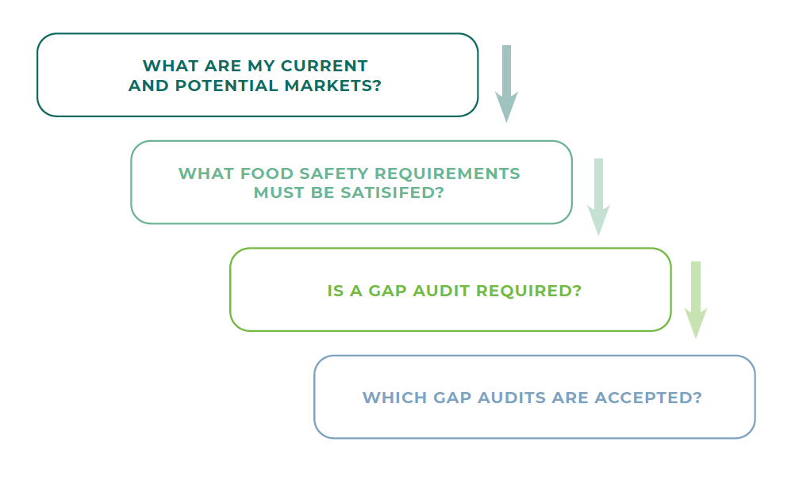
Determining a Grower’s GAP Needs
Does the BUYER require GAP certification?
  Open and clear communication with buyers
  Identify market requirements BEFORE planting
Notes:
We’ve talked about the differences in the standards, the benefits of having a GAP audit and the expenses associated with audits… now let’s discuss how to determine a grower’s GAP needs.
First, it is important growers identify their market requirements ahead of planting to successfully sell their harvest. ALL market sectors are looking for some level of food safety practices to be in place. How are growers to know if their farm operations need a GAP certification to show their commitment to industry best practices?
As with any market decision, it’s important to have a discussion with the current and/or prospective buyers. Ask them what their specific food safety requirements are and whether they require GAP certification
These questions will help them make decisions about GAP and specific GAP products.

Slide 25
Determining a Grower’s GAP Needs
Which specific audit does the buyer require?
No ‘one size fits all’ standard - communicate with buyers, understand requirements, and develop a well-aligned food safety program.
Will your buyer accept a GroupGAP certification?
Notes:
WHICH SPECIFIC AUDIT DOES the BUYER REQUIRE?
In addition to meeting food safety standards, buyers are also looking for a wide array of product characteristics such as product variety, quality, consistency, availability, volume, price, and deliverability.
Again, Since there is not a ‘one size fits all’ standard across all market sectors, it is imperative that growers communicate with their buyers, understand the requirements, and develop a well-aligned food safety program.
To meet food safety requirements, buyers will communicate the GAP standard they will accept. Growers can also determine if buyers will accept GroupGAP certification.

Slide 26
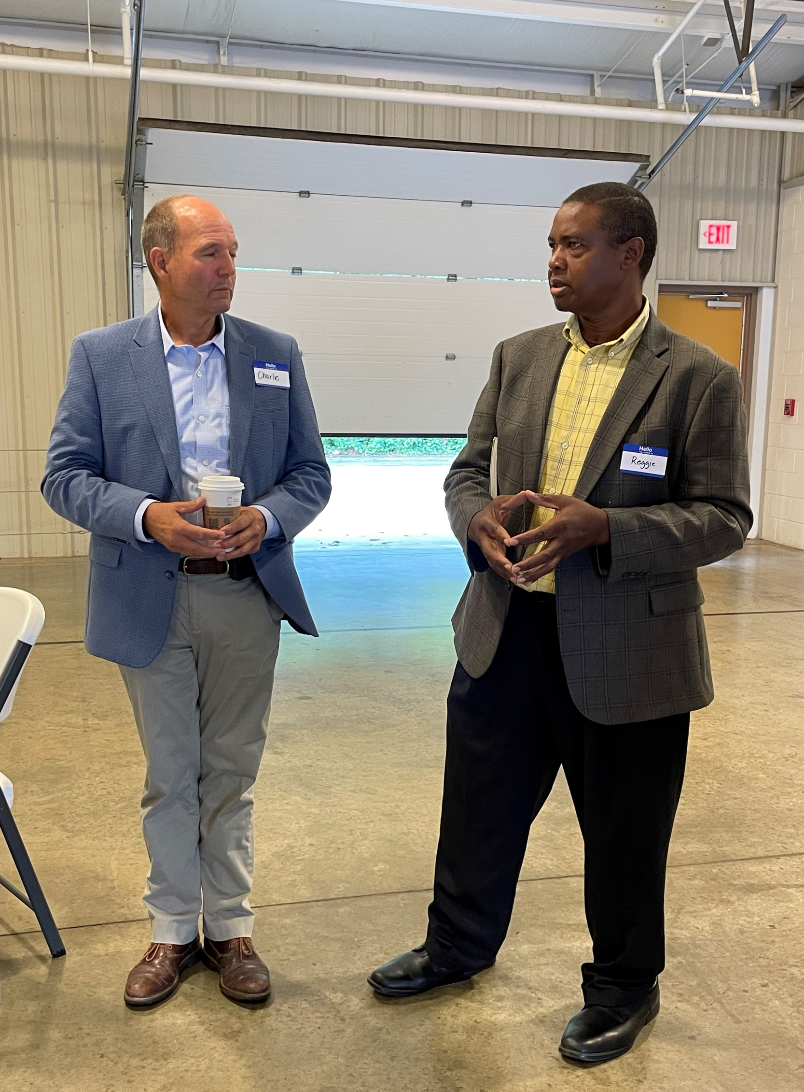
Resources
available to growers
Notes:
If your growers have determined that their buyer requires GAP certification, the next step is to contact the right people. Each of these organizations have their unique roles and responsibilities to provide specialized assistance to growers.

Slide 27


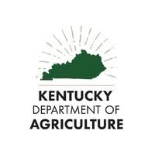
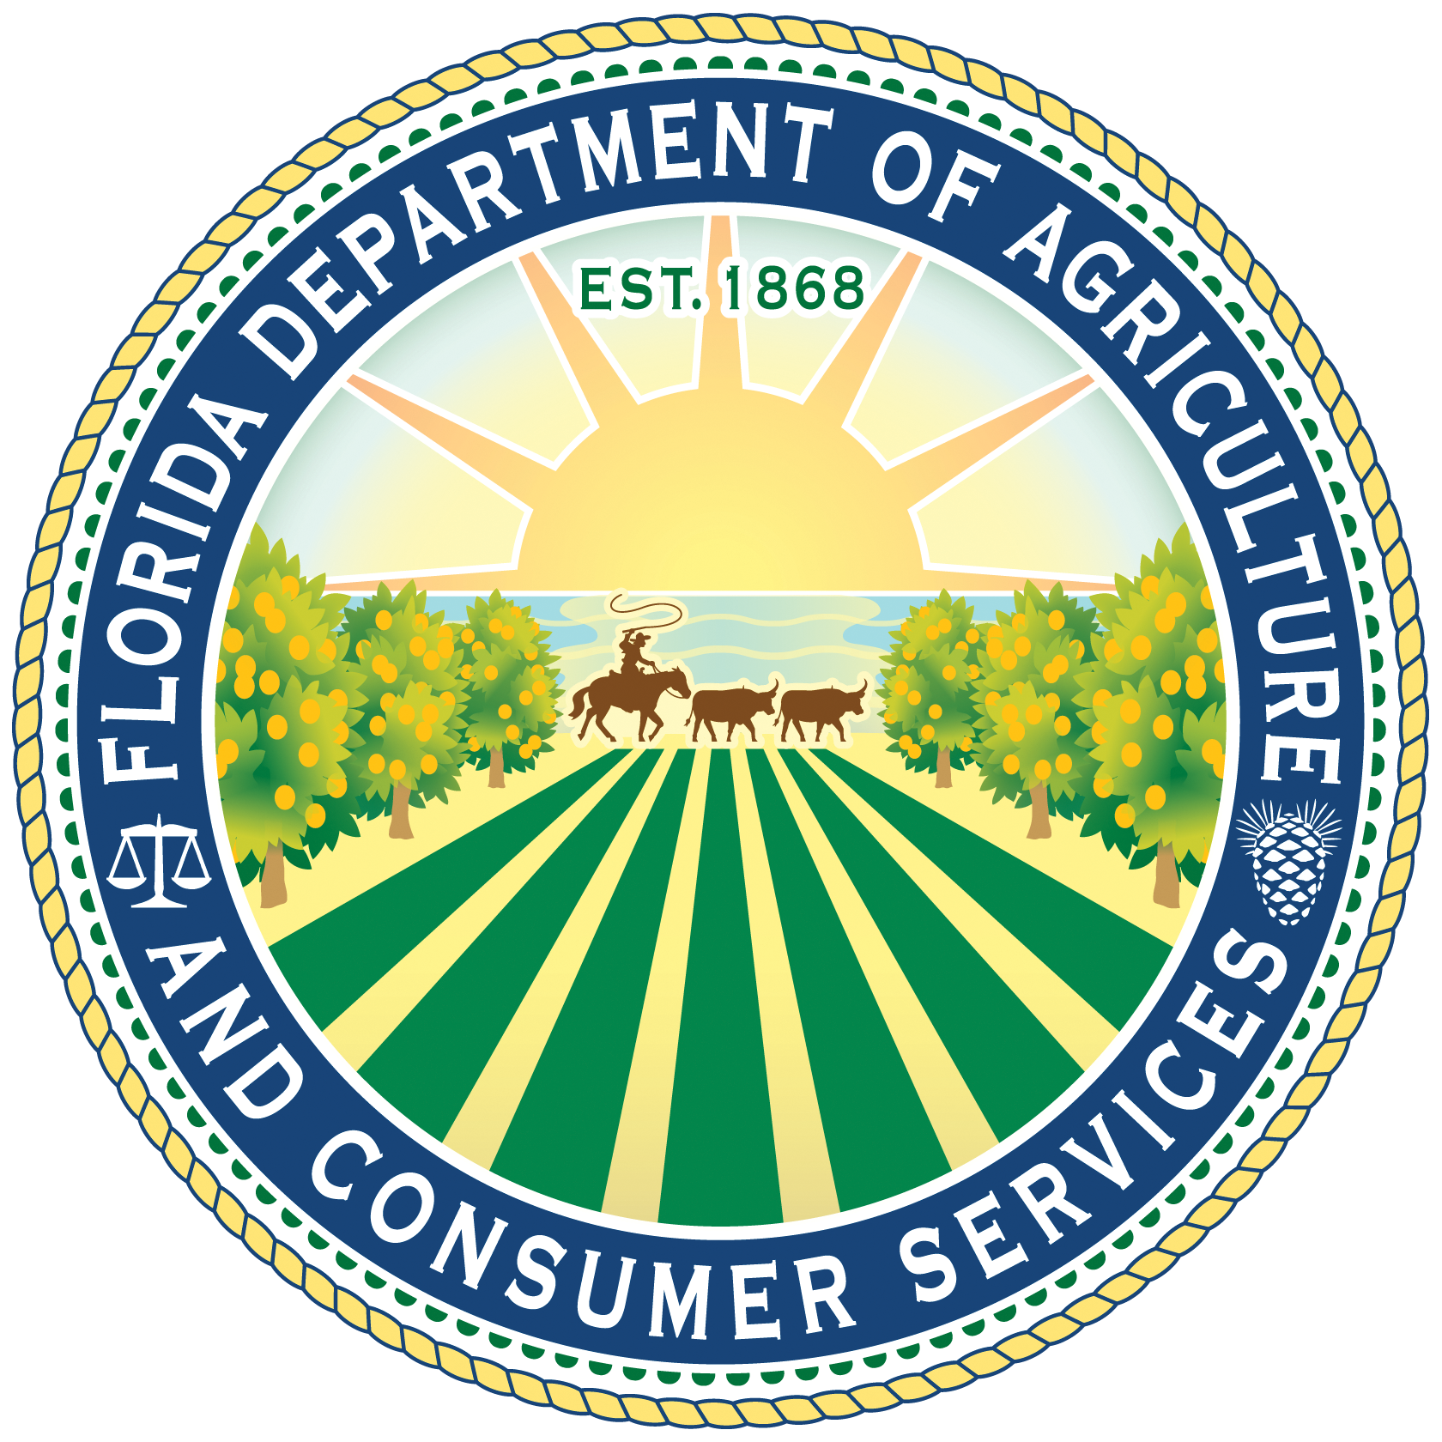
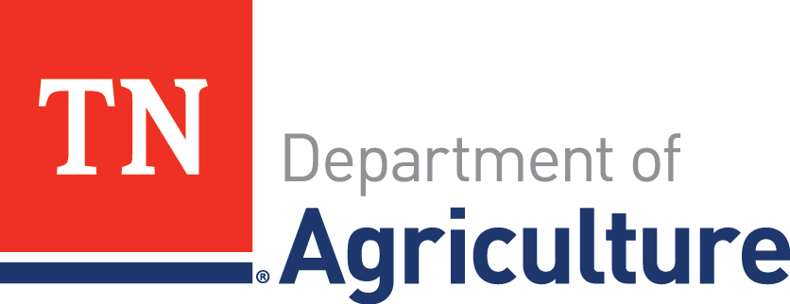

STATE DEPARTMENTS OF AGRICULTURE
Financial assistance programs to pursue GAP certification
Marketing programs to connect growers and buyers
Pilot state participants:
Notes:
Many STATE DEPARTMENTS OF AGRICULTURE
have programs that offer financial assistance to pursue GAP certification or have marketing programs to connect growers and buyers.
We would like to thank these state departments of agriculture who participated in the GAP pilot program.
Florida Department of Agriculture and Consumer Services
Illinois Department of Agriculture
Kentucky Department of Agriculture
New York Agriculture and Markets
Tennessee Department of Agriculture
Texas Department of Agriculture
Virginia Department of Agriculture and Consumer Services

Slide 28







COOPERATIVE EXTENSION
Land-grant universities and colleges
Food and produce safety experts provide technical assistance
Walk growers through the GAP process
Notes:
CONTACT COOPERATIVE EXTENSION
For GAP assistance, contact Cooperative Extension at the land-grant universities and colleges in your state. Each state is different, but many academic institutions have a food or produce safety specialist who can provide technical assistance to walk growers through the GAP process.

Slide 29
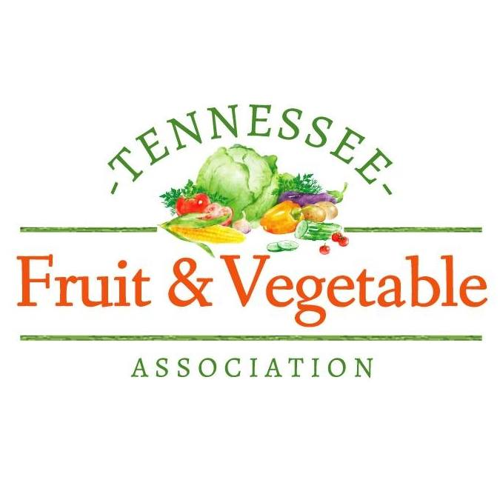


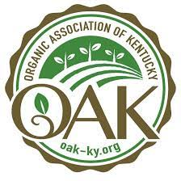
NON-GOVERNMENT ORGANIZATIONS (NGOs)
Specialize in farming and sustainability
Technical or financial assistance
Walk growers through the GAP process
Notes:
CONTACT NON-GOVERNMENT ORGANIZATIONS (NGOS)
Another beneficial resource are non-government organizations or non-profits specializing in farming and sustainability. NGOs are often able to provide technical and financial assistance regarding GAP programs and are willing to walk growers through the process step-by-step.

Slide 30

Technical Assistance
Provided by Extension and NGOs
Food Safety Modernization Act Compliance Training
    Produce Rule and Preventative Controls
GAP Preparedness Training
  Food Safety Plan Writing
  Quality Management Systems
GAP Audit Certification Mentoring & Training
Risk-Based On-Farm Food Safety Principles & Assessments
Production & Marketing Knowledge & Skills
Direct Market Training
Opportunity to Connect with Other Growers
Notes:
Receiving Training
Many university and college Cooperative Extension departments and NGOs offer mentoring and training programs. We can provide you with specific training, can show you how to conduct on-farm risk assessments, assist you in developing food safety plans specific to farm operations, and guide you through preparing for a GAP audit – all the technical components of the GAP audit process. We may even be present during your audit to ease any concerns!
Additional GAP resources are listed in the Toolkit –

Slide 31
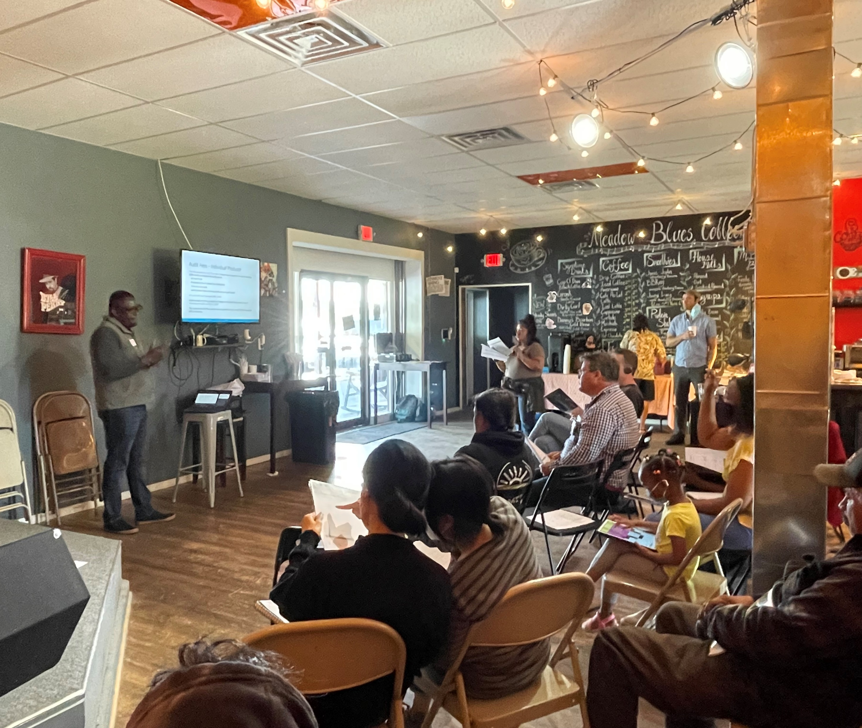
New York
Grower Meeting Testimonial
May 17, 2022
17 Growers attended from 11 farms
Cooperative Extension educators presented the Grower Toolkit
Notes:
New York GAP Pilot Grower Meeting Testimonial
17 Growers from 11 Farms attended the GAP Pilot Grower Meeting at Chester Agricultural center on May 17th, 2022.
4 Cornell Cooperative Extension educators took the growers through the Toolkit presentation with detailed explanation, illustrations, and practical examples on every area including the Q&A session which most growers left with what they need to know so far as preparation and passing GAP Audit, maintaining their certificate by complying with the audit regulations.

Slide 32

Post-New York
Grower Meeting
Post-meeting
  4 farms are preparing for their GAP audit
  Several farms followed up for technical assistance
Overall survey results increased growers’ knowledge of USDA GAP Programs and how it will help them improve access to market and reduce foodborne illness and economic risk.
Notes:
Post meeting, 4 farms began preparing for their GAP Audit this year (2022) and some farms also got in touch with extension to help with their farm food safety plan writing, SOPs writing, LOGs, etc.
Overall survey results increased growers’ knowledge of USDA GAP Programs and how it will help them improve access to market and reduce foodborne illness and economic risk.

Slide 33
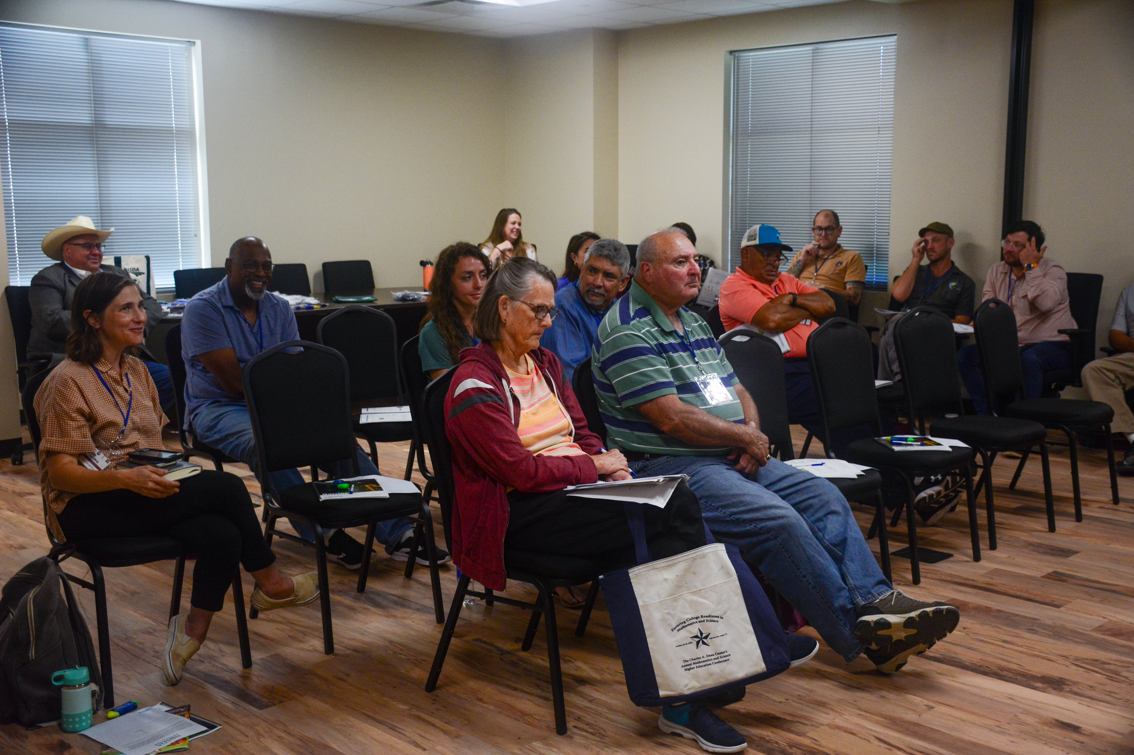
Misconceptions

Slide 34

USDA GAP Misconception #1
The FSMA Produce Safety Rule and USDA GAP are the same and GAP certification exempts a grower from a regulatory inspection by the FDA.
Having a USDA GAP certification does not exempt a grower from a regulatory inspection.
Notes:
We’ve put together a misconceptions section – common ideas about the GAP programs that seemed noteworthy to address and clarify.
Having a GAP certification does not exempt a grower from a regulatory inspection. The Food Safety Modernization Act Produce Safety Rule is a law, governed by the FDA, while Good Agricultural Practices programs are voluntary food safety programs overseen by either 3rd party certification agencies or USDA AMS. Having a GAP certification IS a great way to demonstrate that a farm is adhering to effective food safety practices.

Slide 35
USDA GAP Misconception #2
Pursuing GAP certification is ONLY for growers who want to sell to large retailers.
GAP certification is for any grower interested in accessing more market opportunities.
Notes:
GAP certification is for any grower interested in accessing more market opportunities. Those opportunities may include large box retailers, but also may include local colleges/ universities, community organizations, corporate cafeterias, early childcare, elder care facilities, hospitals, school districts/ school food authorities, restaurants, prisons, and food distributors.

Slide 36
USDA GAP Misconception #3
Private third-party certifiers are more likely to have an unbiased auditor who are more willing to work with growers to resolve non-conformances in GAP audit findings.
All GAP program auditors, whether federal, state or private, are held to the same standard of training and integrity, regardless of which certifying body for which they audit. The process for addressing non-conformances is the same regardless of the auditor or the agency.
Notes:
All GAP program auditors, whether federal, state or private, are held to the same standard of training and integrity, regardless of which certifying body for which they audit. The process for addressing nonconformances is the same regardless of the auditor or the agency.

Slide 37
USDA GAP Misconception #4
GroupGAP is another USDA audit standard like GAP, HGAP or HGAP Plus+.
GroupGAP is a certification option for any group of production locations and secondary activity locations that agree to operate under a shared quality management system and seek certification under one of the USDA GAP audit services (either GAP, Harmonized GAP or HGAP Plus+).

Slide 38
USDA GAP Misconception #5
Not every farm is audited under GroupGAP, and if one member in the group fails an audit, the whole group fails.
Failure of an on-site audit by a group member does not necessarily affect the outcome of the GAP audit.
Notes:
Every farm is audited by the internal auditor assigned and agreed upon by the QMS the group established. USDA auditors will audit a representative number of the group’s farms as well as the QMS plan and documentation to ensure the group is in compliance with its system. Failure of an on-site audit by a group member does not necessarily affect the outcome of the GAP audit.

Slide 39
USDA GAP Misconception #6
GroupGAP is ONLY for groups of growers who are close friends and neighbors that practically grow together already.
Although GroupGAP may work for friends and neighbors, GroupGAP can work for any group of growers, regardless of existing connections or long-standing relationships. The only required relationship is the agreement to adhere to the same QMS.

Slide 40
USDA GAP Misconception #7
GroupGAP growers are forced to blindly trust all other members of their group.
Growers who have agreed to seek GroupGAP certification must have trust amongst their members. This is of the utmost importance when forming a group. However, the QMS system has checks and balances in place to verify members are complying with food safety and group requirements (trust but verify).
Notes:
Growers who have agreed to seek GroupGAP certification must have trust amongst their members. This is of the utmost importance when forming a group. However, the QMS system has checks and balances in place to verify members are complying with food safety and group requirements (trust, but verify). All group members agree to follow and implement the QMS, as well as acknowledge the corrective actions in the event food safety standards are not met. Corrective actions could range from simply removing a farm's unsafe product from distribution to group dismissal.

Slide 41
The Grower Toolkit
How will it benefit my farm?
What do I do first?
Is there anyone to help?
Notes:
At the end of the day, we want your growers to be able to answer these questions confidently.
We developed this toolkit with growers in mind and we hope that we were able to clearly communicate the entirety of the USDA GAP Program, including key terms, differences in the audit standards, specifics of GroupGAP, expenses and available financial assistance, misconceptions, how to pursue an audit and what to expect during the audit, as well as resources to guide them.

Slide 42
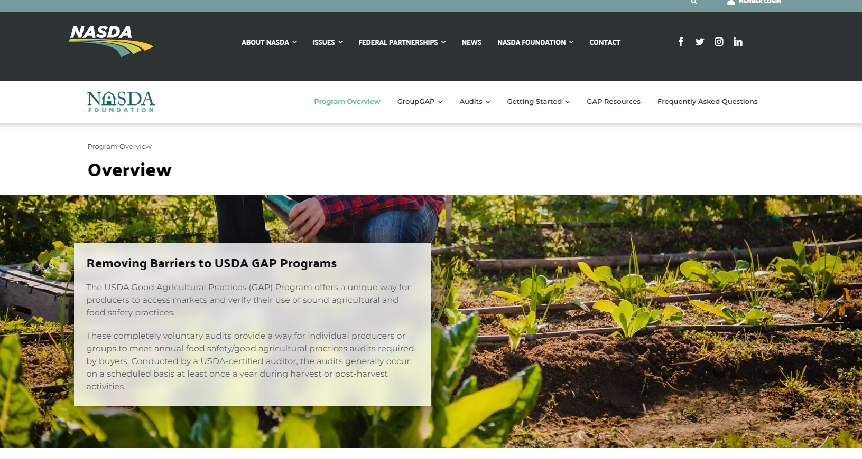
Notes:
A dynamic and interactive version of the grower toolkit has been launched under Foundation projects on the new NASDA website.

Slide 43

Q&A

Slide 44

Thank You

