Slide 1
Who’s the Target?
Notes:
Good Morning. Now I’m going to talk about who is the target. I’m going to discuss OpDom statuses and different partnership and renting agreements to determine where crops and livestock should be reported.

Slide 2
Operator Dominate (Op Dom)
Operator Dominant is a concept for list frame maintenance and sampling.
Op Dom helps us determine who the “target” is:
Person Name
Operation Name
Person and Operation Names
Notes:
First, we need to determine who our target is. Operator dominate status or “Op Dom” is how we maintain our list frame to determine who the target is. The target could be the person name, operation name, or a combination of the two.

Slide 3
How to Find Op Dom
Paper Listing:
19
300080240
DCMS=220
County ID=151
Polk
Op County ID=151
Polk
300080240
0
Doe Farms Inc
John Doe
123 Doe Lane
Anytown, XX 12345
(111) 555-1234
(111) 555-6789
( ) -
CAPI Screen:
123 Doe Lane
Anytown, XX 12345
Notes:
Op Dom Status will always be provided for you on paper listings and in CAPI. Your CAPI screen may look slightly differently than this. If you do not have Op Dom as an option in your CAPI screen, update by clicking on the gear icon and tapping the eye to make it visible.

Slide 4
How to Find Target Name
Paper Listing:
19
300080240
DCMS=220
County ID=151
Polk
Op County ID=151
Polk
300080240
0
Doe Farms Inc
John Doe
123 Doe Lane
Anytown, XX 12345
(111) 555-1234
(111) 555-6789
( ) -
CAPI Screen:
123 Doe Lane
Anytown, XX 12345
Notes:
We will also always provide a name. Operation name will always be listed on top; person name will be listed on bottom.
In this example, John Doe is the person name and Doe Farms Inc is the operation name. If there is only a person’s name listed, it means there is no known operation name.

Slide 5
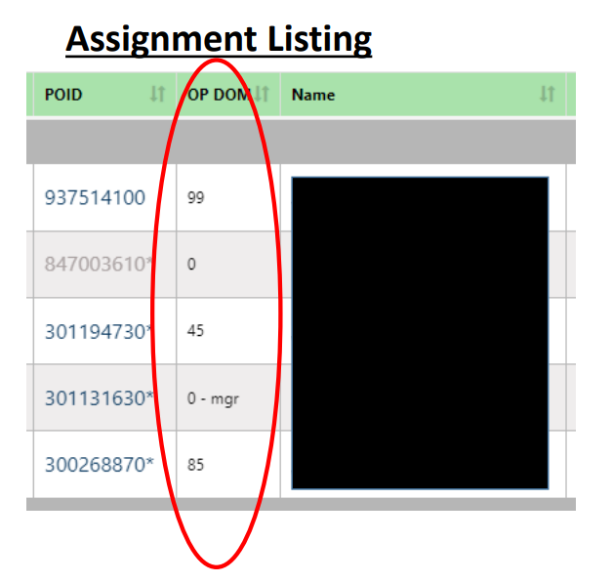
Op Dom Status
Op Dom = 0
Target Name = Person Name
Individual Operator
Partnership
Op Dom = 85 or 45
Target Name = Person Name
Multiple Operations
Op Dom = 99
Target Name = Operation Name
Managed Operation
Notes:
NASS breaks operations into 3 Op Dom statuses.
0 – the target is the person’s name. These can be individual or partnership operations
85/45 – the target is still the person but the person has multiple operations
99 – the target is the operation name. The operation is managed.

Slide 6
Op Dom = 0
Target is the person name listed
Can be an individual operation or partnership operation
Target needs to report for all operations that he or she are making day-to-day decisions.
Notes:
We’re going to dive into each type.
The most common is Op Dom=0; which accounts for 97% of the Upper Midwest Region’s records. If OD=0, the target is the person name listed on your paper form or in CAPI. OD=0 can be an individual or partnership operation. We’ll talk more about partnership operations in a little bit.
Some people listed as OD=0 are involved in multiple farming operations. For example: an operator may tell you “I farm crops individually and feed cattle with my parents.” If this is the case, please leave detailed notes so we can ensure data is reported properly in the future. Once the office knows about these situations, we can leave you comments on how to report situations in the future. For example: “Only report crops on this record, all cattle reported on parent’s record.” OR “Target is also in partnership with parents for cattle only, report all crops and livestock on this record.” These comments are very helpful for you and the office to ensure we don’t duplicate data, and everything is reported accurately.

Slide 7
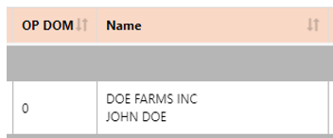
Op Dom = 0-mgr
If it has: 0 – mgr
Decisions are made by a hired manager
Target is both the Operation name and Operator
John Doe
Farm Management Company
0 - mgr
Notes:
The last situation we can have for OD=0 is 0-MGR or managed. This is typically when a management company is making the day-to-day decisions for operator; most of these for the UMR are CRP type situations. In this case, John Doe is the operation name, however, John Doe is our target. Farm Management Company is making the day-to-day decisions for John Doe and most likely other farmers. We need to contact Farm Management Company to collect John Doe’s information.

Slide 8
Op Dom = 85/45
Target has more than one operation for which they make decisions for.
Enumerators need to ensure the data is correct for each operation.
85 Operation
OD=85
Primary Record
It can be a managed operation
Example
OD=85
AS=00
Operation Name: Sunny Farms
Target Operator: Jim Nelson
45 Operation
OD=45
Remaining operations
Not a managed operation
Example
OD=45
AS=00
Operation Name: Three Little Pigs Farm
Target Operator: Jim Nelson
Notes:
Next status is OD 85/45. This only accounts for only 2% of Upper Midwest Region’s records.
On 85/45 operations the person name is still our target but there are 2 or more operations. The 85 is considered the parent record and all other operations are 45. The 85 is the only operation that can be managed like we discussed on the previous slide; however, these are rare.
For the example here, Jim Nelson is our target for both records but we are asking him to separate the data between “Sunny Farms” and “Three Little Pigs Farm.”
Why do we have 85/45s?
1- we will only have an 85/45s if requested by the operator. These records could be merged to an OD=0 or split to 85/45 to ease reporting for the operator.
2- these are typically operations that an operator has an individual and a partnership they want reported separately or if they want crops and livestock reported separately. The office tries to have good comments on these to let you know what is expected on each operation. Ex: “All crops are reported on Sunny Farms. Three little pigs farm is hogs only.”

Slide 9
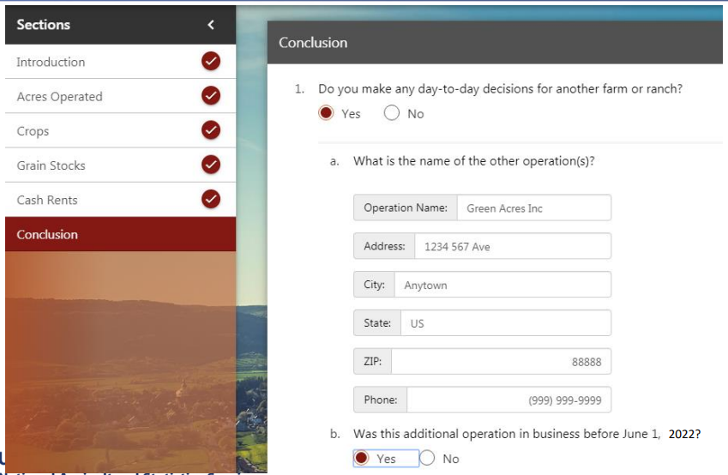
Op Dom = 85/45, CAPI
Notes:
Target informs us that they are making day to day decisions for another farm or ranch. How do we collect new additional operations?
Conclusion Section in CAPI – Please complete as much information as possible.
Was this new additional business in operation before June 1?
For all new operations, we want to verify if the operation already exists on the list frame so complete names and addresses are a big help!
This section only needs completed for NEW operations. If it’s a known 85/45, we don’t need to report it here.

Slide 10
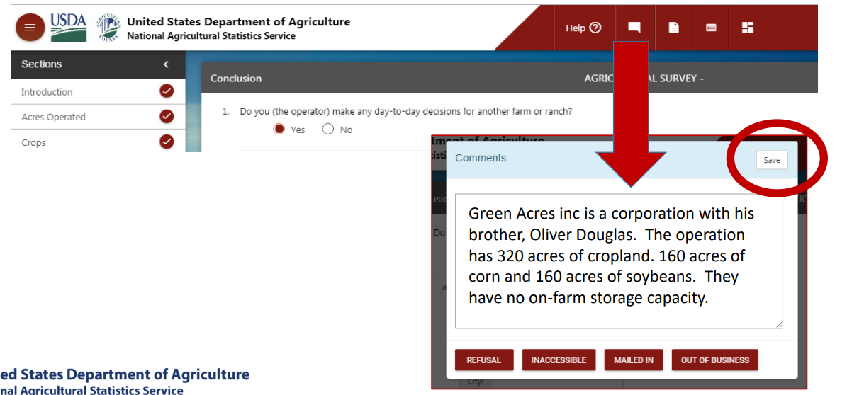
Op Dom = 85/45, CAPI
Notes:
When adding a new record, we also want a detailed comment. As mentioned earlier, this helps us leave detailed notes for you for future data collection. This also helps ensure we don’t duplicate the data. For this example, we may already have Green Acres Inc with Oliver Douglas as the target, this comment allows us to ensure we don’t duplicate data.

Slide 11
Op Dom = 99
Operation Name is the Target
Person listed could be a manager for the operation
Person listed may not make the day-to-day decisions (accountant)
Operations could require multiple different individuals to be contacted for various surveys.
Examples: Multi-State Corporations, Universities Farms, Large livestock operations
Notes:
The last type of OD status is OD 99. These only account for only 1% of Upper Midwest Region’s records and most are large livestock and vegetable operations or university farms.
Op Dom 99 is for "Special Handling" situations. It is used when more than one Managed operation exists or data collection complexities exists.
For 99s, the operation name is our target. The person listed could be an owner, manager, or accountant. This means the person listed may not be the contact for surveys. You need to read all comments to ensure you contact the correct person. Ex: “Contact John for crop information, call Joann in the office for labor surveys.” If there is ever an update to the contact, please make sure you leave a detailed comment.
For 99s, the address listed will usually be to an office and may not be near the actual farming operation. This could sometimes be in another state. Good contact name/phone information is very important to contacting these operations.

Slide 12
Who is it?
Operator: Person responsible for all or most of the day-to-day decisions for the crops and/or livestock
Landlord: Person/business who owns land that is rented to someone else.
Manager: Person who is paid a salary/wage to operate land for another person or business. Makes day-to-day decisions but others may supervise.
Partnership: Land operating arrangement where two or more people contribute a combination of land, labor, equipment, etc. Each person participates in day-to-day decisions and shares in profits or losses.
Notes:
The next two pages, I’m just going to review some terms you may hear from the office.
The operator is the person responsible for all or most of the day-to-day decisions for the crops and/or livestock. This is who we generally will talk to for our surveys.
A landlord is a person/business who owns land that is rented to someone else. We do not collect data from landlords. If someone reports to be a landlord only, complete the screening questions to verify no crops, livestock, CRP, storage, or gov’t payments. If landlord only, operator should be made out of business.
Manager is a person who is paid a salary or wage to operate land for another person or business. A manager will make day-to-day decisions under the goal and directives of their boss. A manager may be considered the operator for survey purposes.
A partnership is arrangement where two or more people contribute a combination of land, labor, equipment, etc. Each person participates in day-to-day decisions and shares in profits or losses. For our surveys, either person could be considered the target. Regardless of the partnership status, the target needs to be involved in the operation to complete the survey.

Slide 13
Renting Arrangements
Cash Rent: Renter pays a fixed dollar amount in rent.
Share Rent/Share Cropping: Landlord may share input costs while renter provides labor and remaining input costs. The landlord is paid by a percentage of the crops or sale of crops at the end of production.
Hybrid Lease: Combination of cash rent and share rent. Landlord receives a fixed rent payment while sharing in some of the profits, loss, and decision making.
Notes:
There are 2 different renting agreements: cash rent and share rent.
Cash rent is a where the renter pays the landlord a fixed dollar amount. This could be per acre, per animal until, or building.
Share rent or share cropping is when the landlord will contribute to some of the input costs while the renter provides labor and remaining input costs. Rather than a fixed cost, the landlord either receives either a portion of the crops or crop sales at the end of production.
A hybrid lease is a combination of cash rent and share rent.
In all these instances, the person renting out the land is considered a landlord and should NOT report the data for the land being rented out.
If you come across a share rent or hybrid rent arrangements, please leave a comment. These are very helpful to the office and can help when contacting the operator in the future to ensure we are consistent with our reporting.

Slide 14
Who should report the data?
Notes:
We’re going to go over a few examples. I will not ask for volunteers for answers, I will give everyone 10-15 seconds then reveal the answer.
I will not point out who the target is but how each would be considered if they were the target.

Slide 15
Who should report the data?
Riley rents all his ground to Peyton for $250/acre. Riley does not have any other crops, livestock, CRP, or storage.

Slide 16
Who should report the data?
Riley rents all his ground to Peyton for $250/acre. Riley does not have any other crops, livestock, CRP, or storage.
Riley: out of business
Peyton: reports all crops and cash rent surveys
Notes:
If Riley was the target, he would be updated to out of business with a comment that he is a landlord only and include Peyton’s contact information if known.
Peyton is renting the ground. For survey purposes, you wouldn’t note anything different. Crops and all surveys on the land needs to be reported on Peyton’s operation.

Slide 17
Who should report the data?
Eldon is share renting all his cropland to Colton. Eldon receives a portion of the crops to feed his beef cows.

Slide 18
Who should report the data?
Eldon is share renting all his cropland to Colton. Eldon receives a portion of the crops to feed his beef cows.
Colton: Crops
Eldon: Beef Cows and Storage
Notes:
Since cropland is being rented to Colton. Colton needs to report cropland acres, planting intentions, and production on his operation.
Eldon would report crops STORED on his operation and beef cattle.

Slide 19
Who should report the data?
Addy feeds the hogs for Big Pig Feeders.

Slide 20
Who should report the data?
Addy feeds the hogs for Big Pig Feeders.
Addy: is considered a contractee only
Big Pig Feeders: Hogs owned
Notes:
For the hog survey, hogs should be reported by Big Pig Feeders
Addy is still considered to be in business since she is a hog contractee but should only be considered the target for surveys like ARMS and Census.

Slide 21
Who should report the data?
Alexius rents all her land to Ethan on a share-rent agreement. Alexius receives a portion of the crop sales each year.

Slide 22
Who should report the data?
Alexius rents all her land to Ethan on a share-rent agreement. Alexius receives a portion of the crop sales each year.
Alexius: Out of business
Ethan: Crops
Notes:
If Alexius was the target, she would be considered a landlord only and should be made out of business.
Ethan should report all crops on his record.

Slide 23
Who should report the data?
MiKayla is the target listed in CAPI. On the September Ag Survey, MiKayla reported turning everything over to her partner, Kelsey.
Notes:
I’m changing the examples a bit to how you would see them on your listing:

Slide 24
Who should report the data?
Mikayla is the target listed in CAPI. On the September Ag Survey, Mikayla reported turning everything over to her partner, Kelsey.
Mikayla: Out of Business
Kelsey: All operation data
Notes:
Mikayla has turned everything over to Kelsey so Mikayla needs to be made out of business. Data does not need to be collected for the current survey. Leave notes to explain the situation.

Slide 25
Who should report the data?
Kendall was the manager for Veggies Inc, an Op Dom 99. Kendall left Veggies Inc and the new manager is Mallory.

Slide 26
Who should report the data?
Kendall was the manager for Veggies Inc, an Op Dom 99. Kendall left Veggies Inc and the new manager is Mallory.
Veggies Inc: No data changes. Update name and comments if needed.
Notes:
Kendall was a hired manager. Data should be reported like usual. Person name and comments need to be updated to reflect the new manager.

Slide 27
Review
Op Dom status tells us who the target is.
The target could be the person, operation name, or a combination of the two.
For NASS surveys, we want to talk to the person making day-to-day decisions for the operation.
Landlords only need to be made out of business.
People renting out land on a share-rent basis is a landlord.
Notes:
Op Dom status tells us who the target is.
The target could be the person, operation name, or a combination of the two.
For NASS surveys, we want to talk to the person making day-to-day decisions for the operation.
Landlords only need to be made out of business.
People renting out land on a share-rent basis is a landlord.

Slide 28
Questions???

