Slide 1

Remote Log-on and Cisco Jabber Training
June 2025
CEC HelpDesk: (877) 873-0783

Slide 2
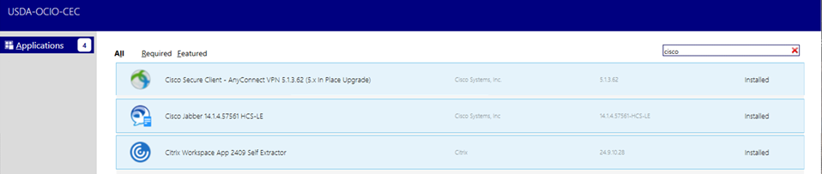
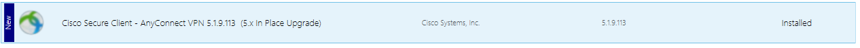
Needed Remote log-on applications
Three Software Center “Applications” need to be installed and managed by the user
  Note: CEC is not needed to install these applications – installed by the user.
Open Software Center “Applications tab” and download/install the following applications:
  Cisco Jabber – Phone application
  Cisco Secure Client - Any Connect (eVPN – remote virtual network)
  Citrix Workspace – NASS Citrix application
Restart Laptop after applications are installed
Future Jabber, eVPN or Citrix problems?
  Always check Software Center “Applications” for a possible newer version that must be installed by you.

Slide 3
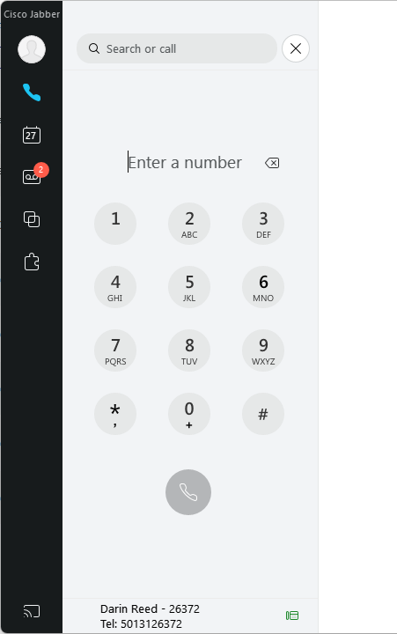
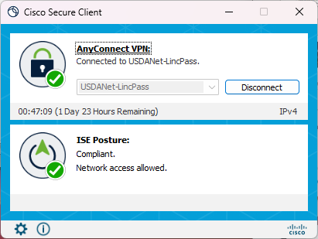
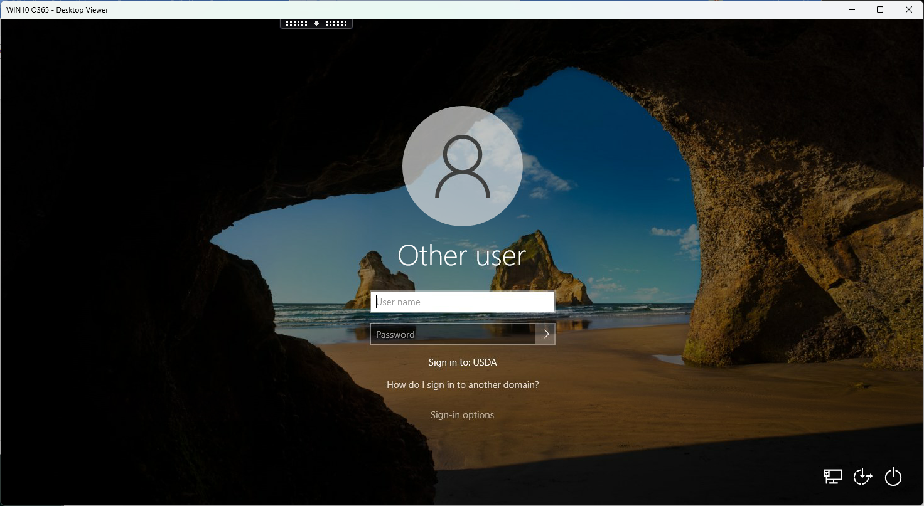
What is Cisco Jabber?
What is eVPN?
What is Citrix?
Cisco Jabber is a VOIP phone application that allows phone calling through your laptop.
  Cisco Jabber also works with your in-Citrix Finesse application to auto dial Blaise records
Cisco Secure Connect (eVPN) allows you to remotely connect to the USDA network.
Citrix Workspace allows you to connect to the NASS network.

Slide 4

Remote network sign-on
When you are in the office, and you connect your laptop to the “wired” LAN, all you need to do is enter Pin number to sign on
But…When you sign-on to the laptop in a remote environment (using WIFI) you must click the network sign-in icon.
  Ensures correct USDA network connection
  Enables most updates to be sent to the laptop
Daily login for remote laptop use is:
  Restart laptop
  Enter correct Bit Locker pin
  Hold down Ctrl-Alt Delete, click on OK
  Click on lock and Key icon
  Enter your Pin number
  Enter your Pin number a second time

Slide 5
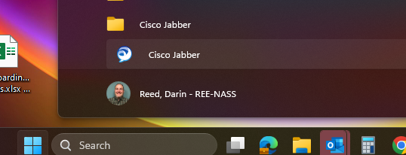
Cisco Jabber sign-in after install
To initially sign in to Jabber, you must locate it in your applications on the laptop
  Click on windows icon on task bar at the bottom of your screen
  Scroll to find Cisco Jabber folder, click and then click on Cisco Jabber application.
  Note: Jabber will automatically re-start with your laptop after initial sign in.

Slide 6
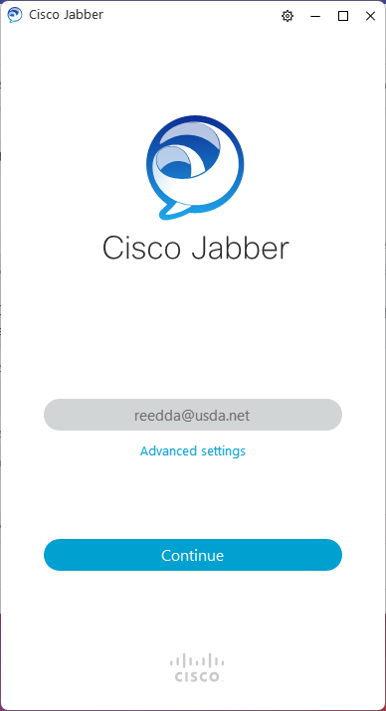
Sign in after install
After clicking on Cisco Jabber, a sign-in window pops up
Type in your username
  “Username”@USDA.net
  Username might be only “six digits” or “First.Last name”
  Your Supervisor will have your Username

Slide 7
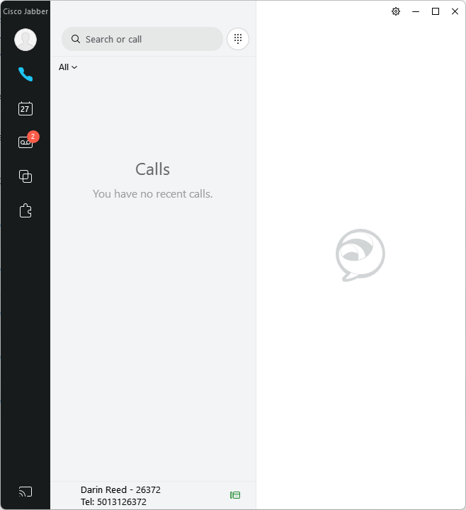
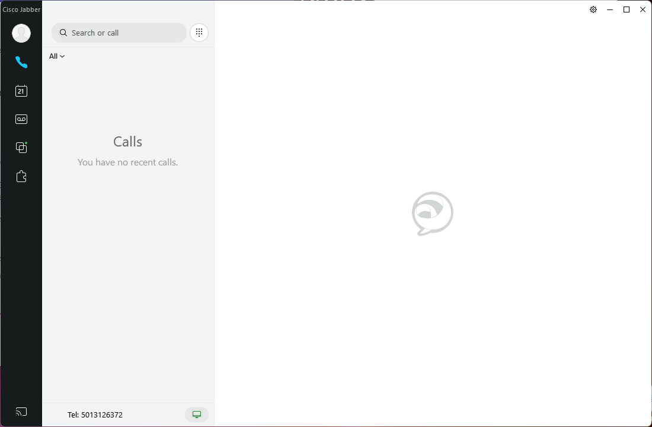

Jabber Window
Calls Menu
Settings access or
Manual Dial
Active Connection
Agent line must be selected
  Note: Some personnel have two jabber lines one personal and one agent
  Bottom left of Jabber window
  Click on your name and select Agent Line (005555XXXX)
  Agent line in Jabber must match the Agent line in Finesse

Slide 8
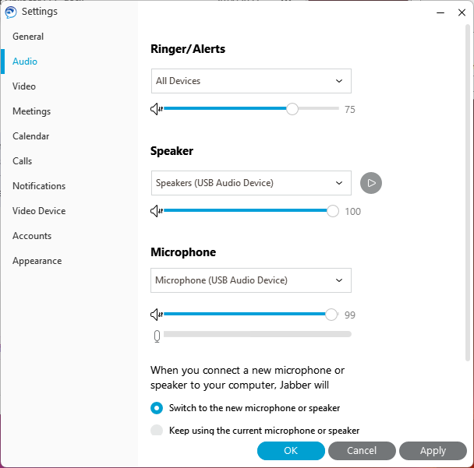
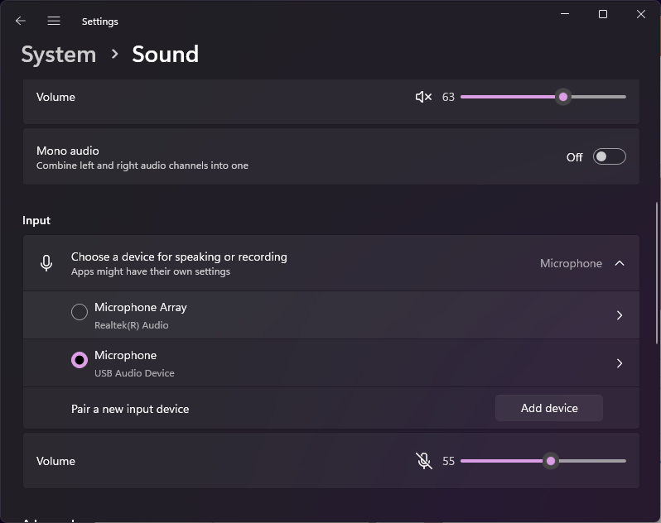
Sound Settings
Check sound settings every day
  Note: Your USB headset must be plugged into laptop or docking station first
  Ensure Speaker is set to USB
  Ensure Microphone is set to USB
  Click OK
  Note: Your laptop’s sound settings can override the jabber sound settings so, make sure the laptop sound settings aren’t muted like this.

Slide 9
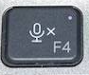
Jabber Troubleshooting
Make sure to use your Jabber Agent Line for Finesse.
  Jabber Agent line # (005555XXXX) number must match agent line used in Finesse to work with Blaise autodial function.
  Personal line (phone line next to your name) will not work properly with Finesse and Verint applications.
Make sure your using Jabber application on Laptop desktop and not in Citrix.
Make sure your Jabber application is green. If its red, then reset Jabber.
Ensure headset is properly plugged into laptop or docking station.
Make sure the cord switch controls are set properly (if your headset has one)
  Mute switch
  Volume dial
Make sure Jabber audio settings are set for the USB headset:
  Microphone and Speaker.
Make sure the laptop sound settings are set correctly
  Right click on speaker at the bottom right of screen to open sound settings
  Ensure Speakers are not off
  Ensure Microphone not muted
Make sure the Laptop’s master microphone mute key is not on.
  F4 on some of the laptop keyboard is the master mute button. If the tiny F4 light is on, microphone is muted.
Make sure the Cisco Jabber application you are using is the most current (Software Center – Applications)

Slide 10
Remote Laptop – Daily Use

