Slide 1


How To Use Google Drive & Google Sheets
Share Files
Collaborate with Others
Safe and Accessible
Basic Features of Google Sheets
Automatically saves changes
Navigating Google Drive and Sheets
Menu bar
Toolbar
Version history to track changes

Slide 2
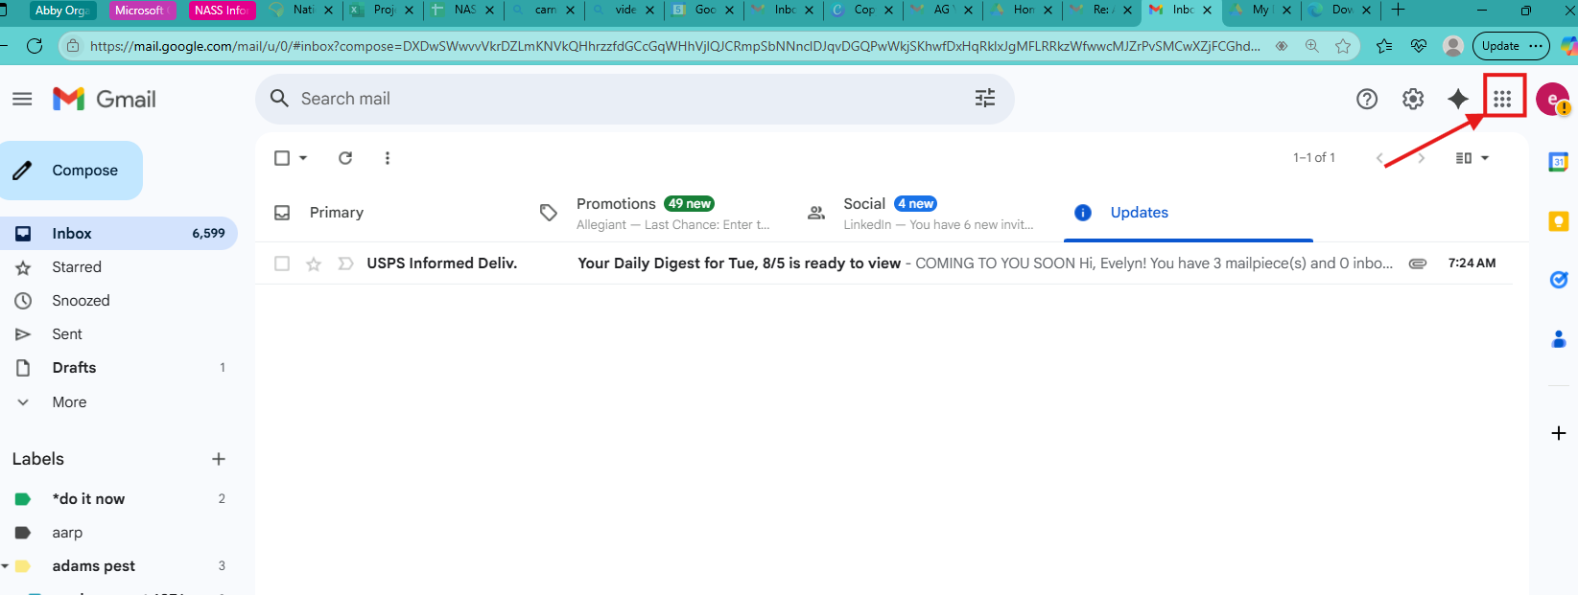

Accessing Google Sheets Using Google Drive
1. Open your Gmail app
2. Click the ‘Waffle’ or ‘Google App Launcher’ icon to see various google products
Including
GOOGLE DRIVE
& GOOGLE SHEETS
Click on icon

Slide 3
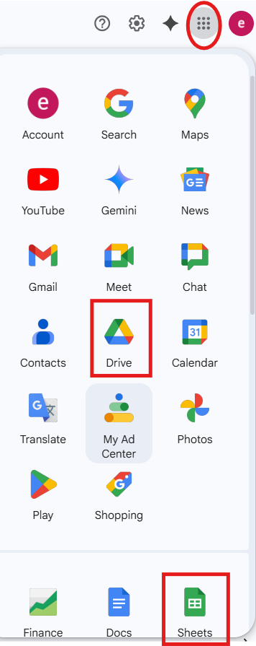
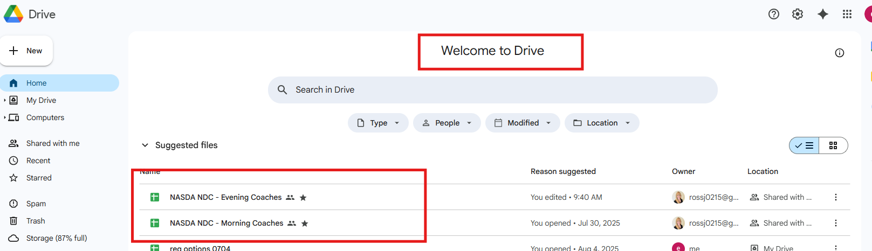
To locate and open a file, one option is to use Google Drive [from the Google App Launcher]:
Click on Google DRIVE. You will see the ‘Welcome” page. Your documents (in this case Google Sheets) will be listed for viewing and updating as needed.

Slide 4
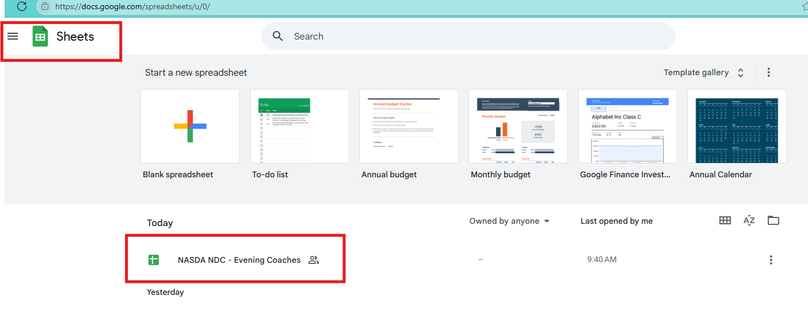
Another option to locate a file (Google Sheets):
Click on “Sheets” from the Google App Launcher.
You will see the ‘Sheets” page. Your documents will be listed for viewing and updating as needed.

Slide 5
Google Sheets Can Be:
Bookmarked
Starred
Moved & Shared
Downloaded
Notes:
Google Docs allows users to bookmark, star, download, and move documents within Google Drive and to other locations.

Slide 6
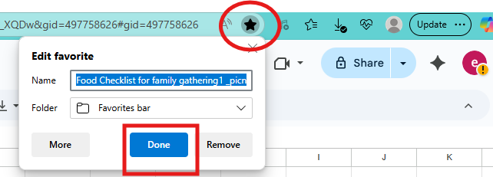
How to Bookmark a Google Document
Bookmark Icon
Open the Google Sheet: Navigate to the Google Sheet you want to bookmark in your web browser.
2. Click the Star Icon: In the address bar of your browser, click the star icon (bookmark icon).
This will create a bookmark for the current page.
3. Choose Bookmark Location: A dialog box will appear, allowing you to name the bookmark
and choose where to save it (e.g., the bookmarks bar or a specific folder).
4. Select your preferred location and click ‘Done’.

Slide 7
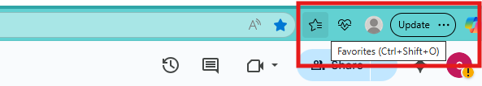
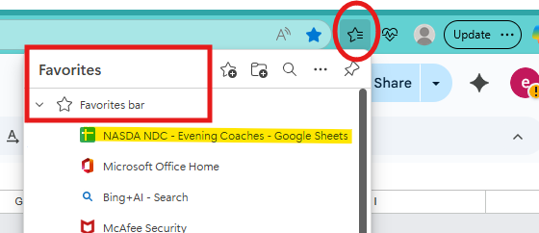
Bookmarks Continued
5. Access Your Bookmark: To access your bookmarked Google Sheet, simply click on the bookmark from your bookmarks bar [Favorites] or the folder where you saved it.
Favorites Icon
Favorites List of Bookmarks

Slide 8
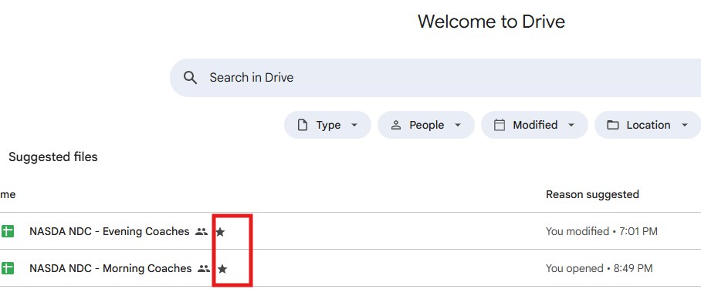

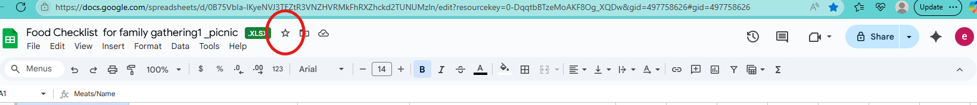
Starred Files in Google Drive
1. Open Google Drive or Sheets
2. Navigate to the location [or file name] of the
Google Sheet that you want to “Star”
3 Click the star (turns blue)

Slide 9
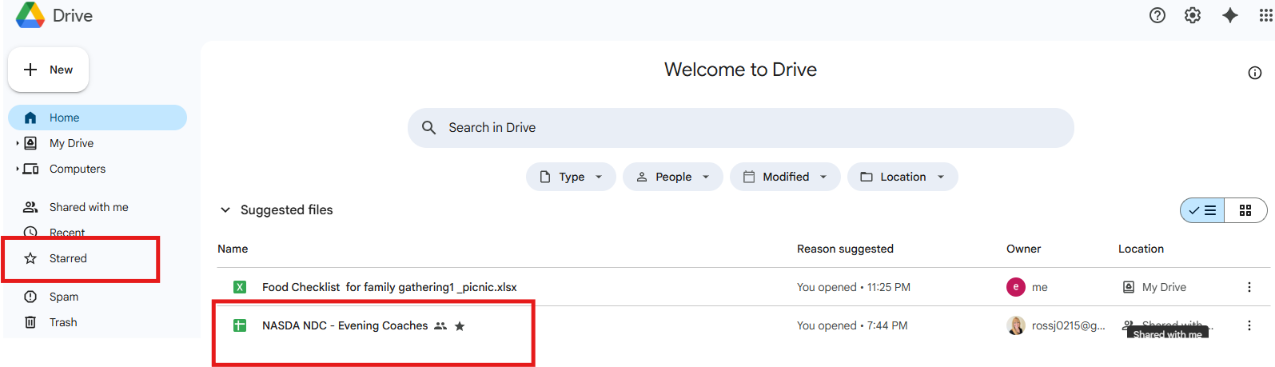
Starred Continued
1.Once ‘Starred”, open Google Drive and click on the Starred tab in the left bar menu.
2.You will see all your starred documents in one place.
*This feature allows you to easily access and manage important files and folders that you have marked as important
Notes:
In Google Drive, the "Shared With Me" section is a filter that displays files and folders shared with you by others. It is not a folder but a list of shared content, which can be filtered at the top of the screen for quick access (Search in Drive). The "Recent" feature shows files that have been recently shared with you, allowing you to stay updated on collaborative efforts.

Slide 10
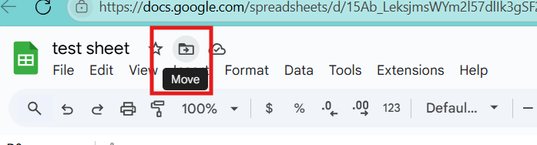
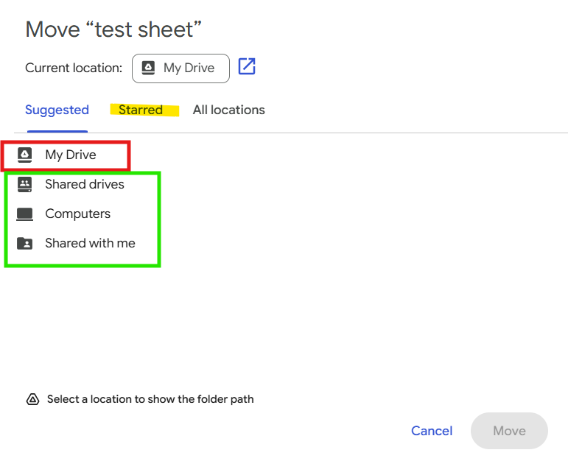

Moving a Google Sheet or File to a Different Folder
1.Locate the “Move” icon next to the file name.
2. Click the icon.
You will see several locations (folders) to which a file can be moved.
(Note: The current location “My Drive” is usually shown).

Slide 11
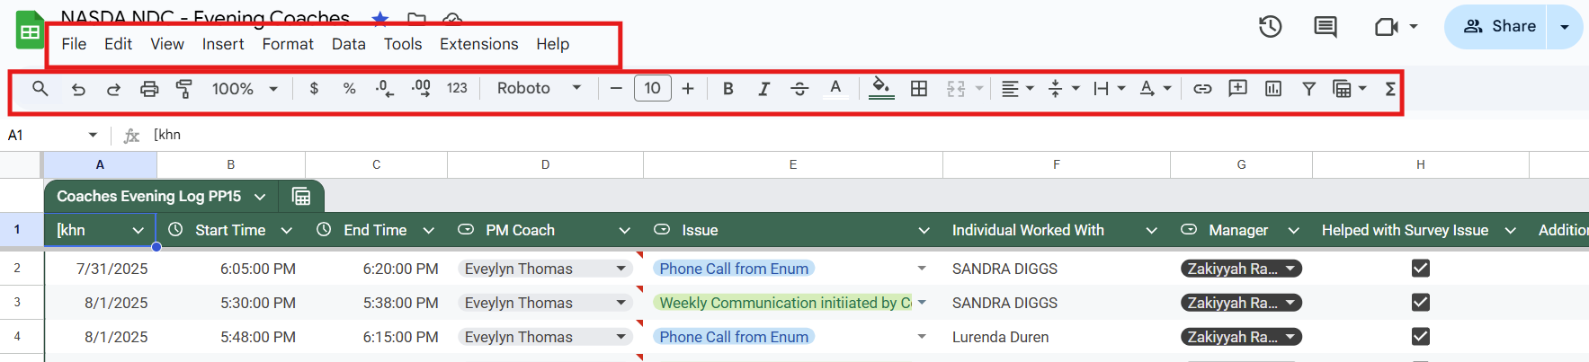
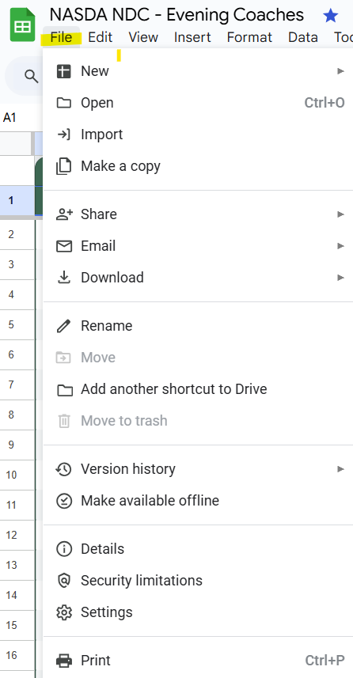
Basic Parts of a Google Sheet
Menu bar: usually at the top of the application and contains a list of menu titles, such as File, Edit, View [see example Context Menu]. When you click on one of these titles, a drop-down menu appears showing a list of commands or options related to that particular category.
Toolbar: usually below the menu bar and consists of icons or buttons that represent frequently used commands or functions.
Menu Bar
Toolbar
Context Menu

Slide 12
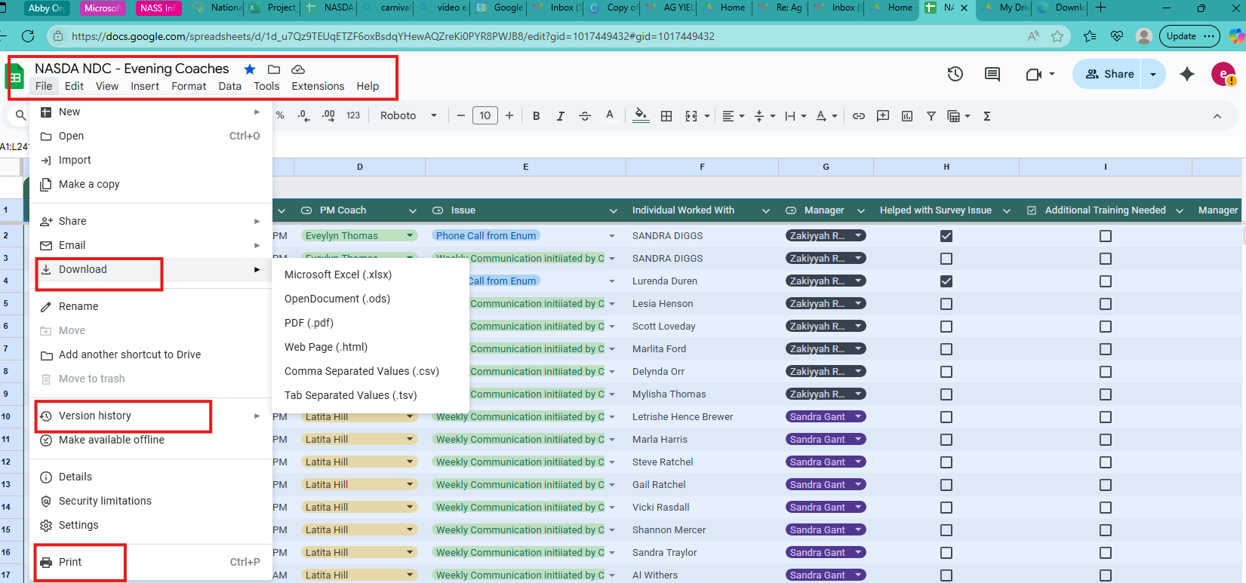
Other Options Available in Drive and Sheets
Download:
Open the file you want to download
2. Click on File to get the
context menu
3. Choose download
4. From the drop-down
chose which type of file,
for example, Microsoft
Excel or PDF.
Version History [Owner]:
A feature that automatically records snapshots of a document whenever changes are made.
Print: allows you to print the current sheet or selected cells

Slide 13
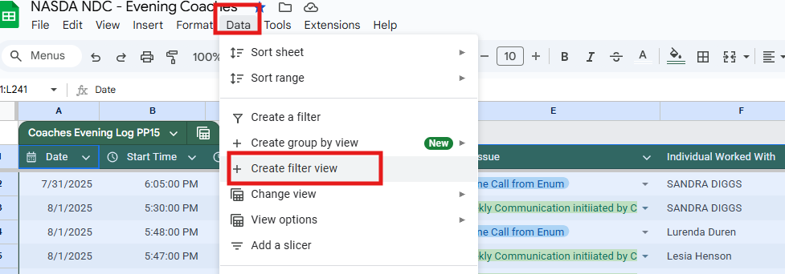
Using a Data Filter – Allows Multiple Users To Filter Data Simultaneously
Create a Filter View:
1.Go to ‘Data” on menu
bar.
2. Select ‘Create filter
view

Slide 14
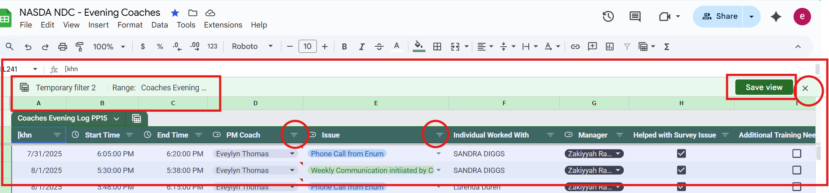
Filter views allow multiple users to filter and sort the sheet without changing what other users see
3. You will see FILTER icons appear in the header row. You can click on these icons to set your own filter criteria.
Option: You can name/save a particular view for easy access later. Close View: When done, click the ‘X’ to close the filter view.
Filter icons
Close View
Shows you are in filter view.
Note the change in background color from the original sheet.
Notes:
Filter view allows you to filter your data without affecting how others see the sheet.

Slide 15
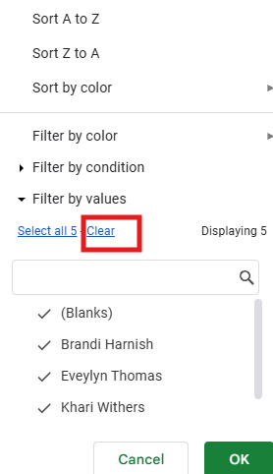
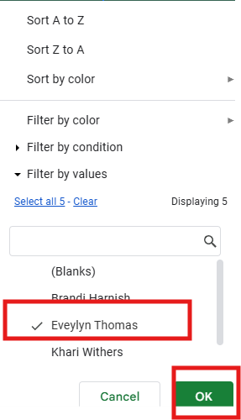
Create Your Own CUSTOMIZE View
Example: Filter by Coach
1. Select your filter type by
using the filter icon
(additional options include
by color, condition or
values)
2. You can type a name in the
‘search’ box or click ‘clear’
and select one or more
items from the list.
3. Click ‘OK” once you have
selected the desired filter
setting. You will see the
results of the filter right
away
Note: you can have multiple filters within the same filter view.

Slide 16
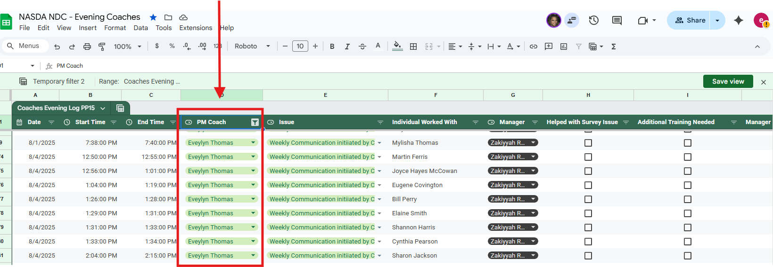
Results of Filter View by a specific Coach’s name

Slide 17
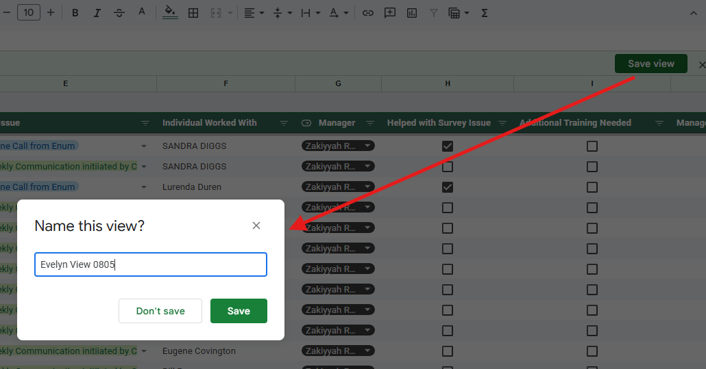
Saving the Filter View
1. Click ‘Save View’
2. You will see a dialogue box –
Name this view?
You will be prompted to name
the view.
3. Create a name for the current
filter view
Click ‘Save”
4. You can now access the saved ‘view’ from the Data menu under Change Views
Option: You do not have to save any filter views – Click ‘Don’t Save’ in this case

Slide 18
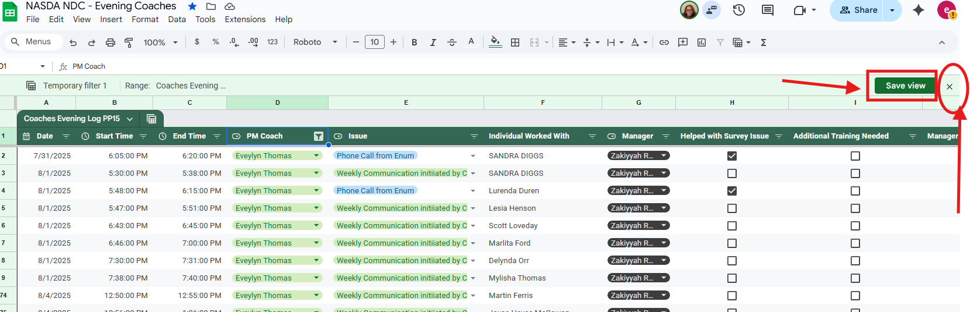
Save/Rename the Selected View
Close the Filter View to Return to Original Document

Slide 19
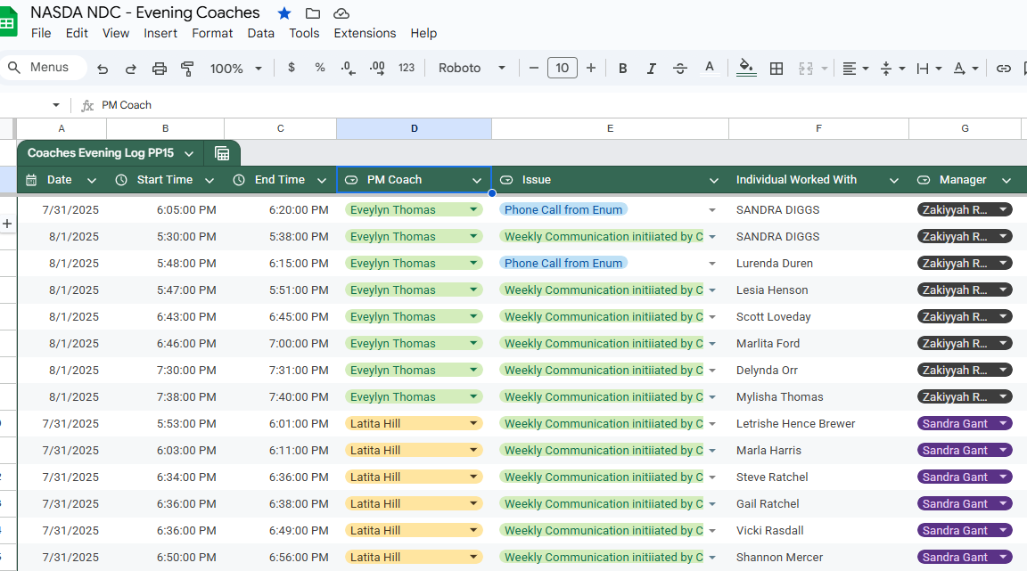
Success!!! – Collaboration, Teamwork and Information Sharing- All At The Same Time
You have successfully returned to the original document.

Slide 20

Questions????

