Slide 1
January Survey’s 2026

Slide 2
Performance Acknowledgments
Extra Effort on Hours PP25
Janet B.
Gloria C.
Arlene H.
Lynette M.
Cynthia R.
Princ G.
Melissa M.
Angela N.
Laura R.
Ken W.
Mikiya R.
Yolanda R.
Susan J.

Slide 3
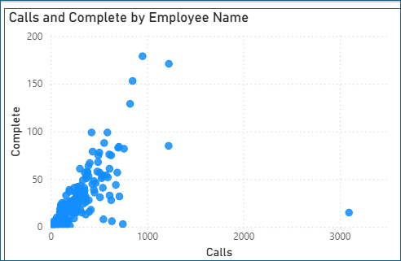
December Crops APS – CAPI Calling
Shout Outs: Sherry, Arlene, Cher, Peter

Slide 4
Enumeration Tips
My introduction: Hi, my name is ________, calling on behalf of USDA-NASS, and am following up on the [SURVEY NAME] Report recently mailed out. I was wanting to know if you haven’t had the opportunity to send the report back, you and I could do it over the phone, and get your form checked in.

Slide 5
Enumeration Tips
How long is this going to take?
It really depends what you have, but typically this report has been taking approx. 5 minutes.
Tip: Be honest, quick, accurate, and listen. Have pen and paper ready.
If Respondent says I just received in the mail today/yesterday.
Yes, our turnaround times are quick; some farmers find it easier and more convenient to report over the phone. This report has been taking approx. 5 minutes. I’d sure be happy to help you out if you’d like.
Tip: Offer to be helpful, take the pressure off their busy day, take a task off their plate.
The form was received and tossed it in the trash.
I totally understand you were waiting for my phone call. I am just joking but more than happy to assist you as this report increases transparency in market trends and supply and demand and assure regional/state level data is available.
Tip: Read the tone of the respondent. Regardless thank them and wish them a good rest of their day.

Slide 6
Enumeration Tips
The respondent has not received the form in the mail.
Confirm the mailing address. Offer to complete it over the phone and get the report checked in.
Tip – Respect their position. Some are concerned about identify theft. Understand their reluctance, speak with confidence, be professional and courteous.

Slide 7
Enumeration Tips - Refusals
Respondents remember when an enumerator has been rude to them.
I do respect your position and am sorry that occurred.
Respondent refuses but gives you a bit of time.
I understand your reluctance but please consider doing these reports down the road. As these number help their county/state governments with disaster and insurance payments.
Respondent is on the fence
Would you like to give it a try and answer the questions you are comfortable with?

Slide 8
Please take your Refusals
The average refusal rate for any survey is 20%.
This means I expect you to have 20% (more or less) for each survey.
1000 dials
You should have 200 refusals
And if practicing patience, kindness, attention to tone, calling during good calling hours, etc. about 200 completes.

Slide 9
Enumeration Tips
Each respondent is different
Use your ‘Internal Barometer’
Adjust for each interview.
Enjoy the challenge and don’t get discouraged
Admit you do not know and ask if they would be willing to share.
Never loose your positive tone. Never loose your confidence. And always know these farmers and ranchers benefit from what you are doing.

Slide 10
NDC – Daily Closure Time
NDC will remain open 2 p.m. to 4 p.m. CST, Monday-Friday until notified

Slide 11
Data Collection Requirements
F9 Notes required for all warnings
For surveys where it is asked ‘Do you make day-to-day decisions for another operation’
Leave all data collected in a note on that record
E-mail Jodie the Fips, POID, and Last Name.

Slide 12
NDC Workload - 2026
The NDC calling calendar for 2026 can be found HERE.
Enumerators should always look to this link when trying to determine workload or time-off.
The NDC has part-time work through mid-June 2026
Enumerators should pay attention to their 375 per quarter limit January through March.
NASDA will NOT be offering overtime beginning in January.

Slide 13
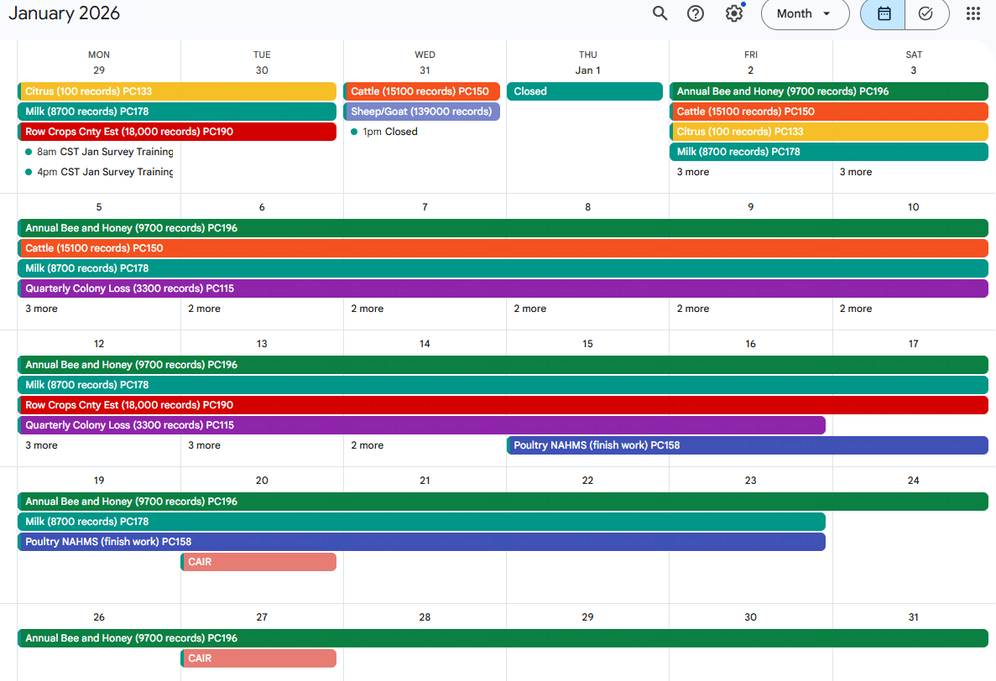

Slide 14
January Calling – Project Codes
Citrus – 133
Milk – 178
Row Crops CE – 190
Cattle – 150
Sheep and Goats – 155
Annual Bee & Honey – 196
Quarterly Colony Loss – 155
Farm Feeder – 485
Poultry NAHMS - 158

Slide 15
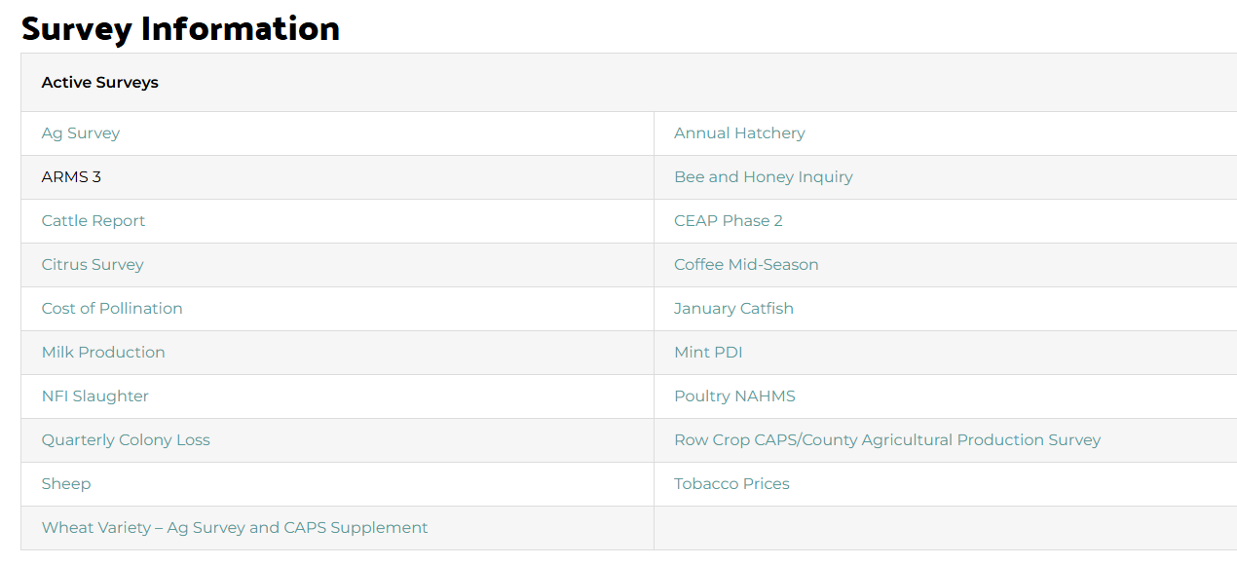
Survey Training
All Survey Trainings have been posted HERE.

Slide 16
Questions?

