Slide 1
NASDA Training
Check in for READI
2/25/26

Slide 2
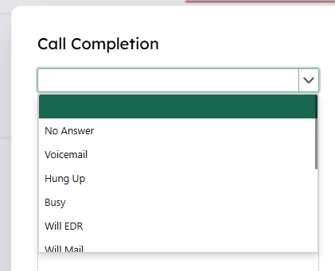
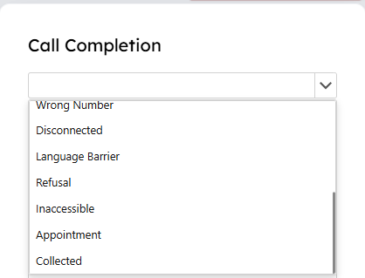
READI Call Attempts Completions

Slide 3
Call Result: Will EDR
If the respondent says they will fill it out on the web (EDR):
Do not complete the questionnaire!
Select “Will EDR” in the Call Result
The system will not deliver this record again until near the end of the survey and only if it is not checked in yet.

Slide 4
Call Result: Will Mail
If the respondent says they will fill it out and mail it back:
Do not complete the questionnaire!
Select “Will mail” in the Call Result
The system will not deliver this record again until near the end of the survey and only if it is not checked in yet.

Slide 5
Call Result: Wrong Number or Disconnected
If the number is disconnected or not the right person at the number:
Do not complete the questionnaire
Select the correct call result for each number.
Try all available numbers
If all numbers are exhausted and all results are either disconnected or wrong number, the record will be removed from the calling pool and sent to disconnect research.
When a new number is found it will be sent back to the calling pool.

Slide 6
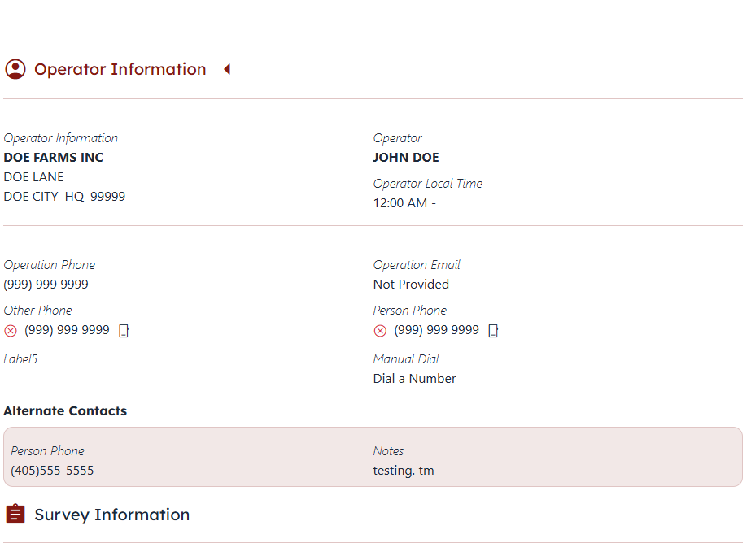
Disconnected Numbers Displayed

Slide 7
Call Result: Language Barrier (Coming soon)
If the number is to a respondent of a different language:
Do not complete the questionnaire
Select the Language Barrier call result
The record will be removed from the calling pool and a Survey Admin or AD will redirect this record.

Slide 8
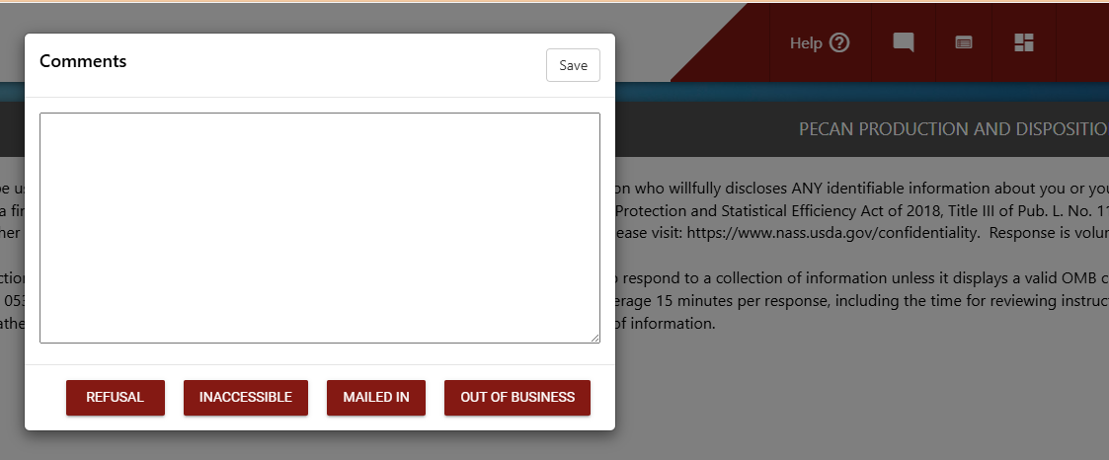
Call Result: Refusal
If the respondent refuses to do the survey:
Verify it is a refusal of the survey and not just the timing
Select the refusal call result
Complete the questionnaire
Click comment icon on top right
Select Refusals
Code Respondent
Submit Survey
Complete READI Sample

Slide 9
Call Result: Inaccessible
These should be very limited. This should only be used if the respondent will not be available during the whole survey period
Do not complete the questionnaire
Select the Inaccessible call result
The record will be removed from the calling pool and will be considered an inaccessible for the survey.

Slide 10
Call Result: Appointment
Appointment should only be selected after an appointment is made in the appointment block
Do not complete the questionnaire
Select Appointment tab
Set appointment time (make sure to hit check mark)
End Call
Select Appointment (should already be highlighted)
The record will be removed from the calling pool and delivered at the time of the appointment. It will try to return to the one that made the appointment if ready (even if in different survey). If not ready it will go to next available. (10min prior to 5 mins after)

Slide 11
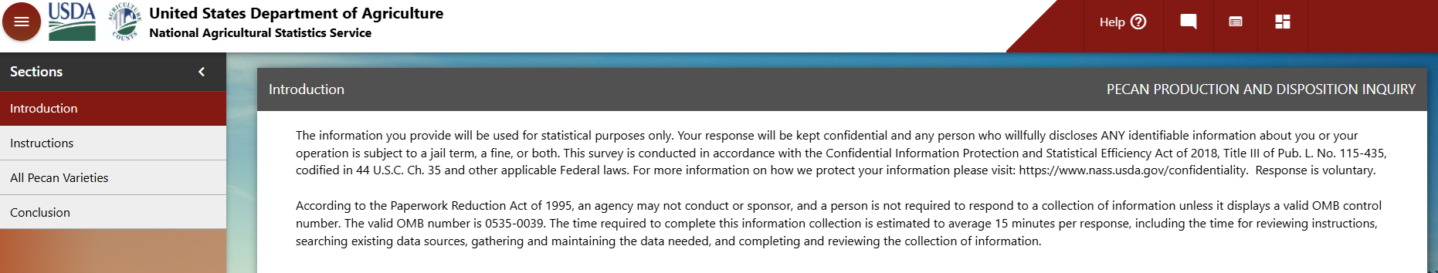
Saving the Questionnaire for Later Contact
Save and Return to READI button

Slide 12
Call Result: Collected
Collected should only be selected when information is collected. This includes when an operator is out of business and should be selected after the questionnaire is submitted
Complete the questionnaire
Select the Collected call result
The record will be removed from the calling pool and will be considered a complete for the survey.

Slide 13
Comments: Where to they belong?
All survey related comments belong in the survey questionnaire.
Any dial related comments (something that will help the next enumerator attempting to contact this operator for this survey)

Slide 14
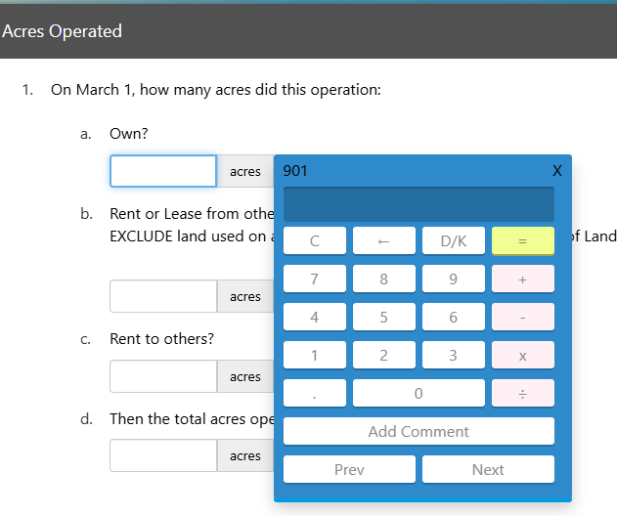
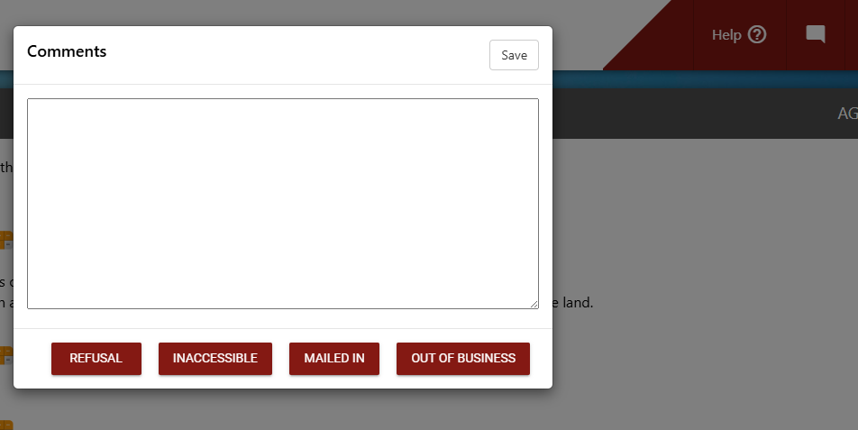
Comments: Survey Related Comments
Item Level Comments
Record Level Comments
Include any comments about the operator or operation. (Current state, future state, information to help understand what is going on).

Slide 15
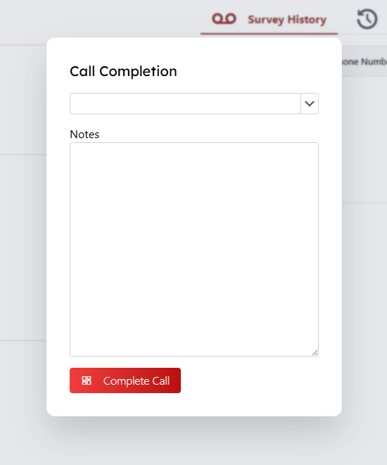
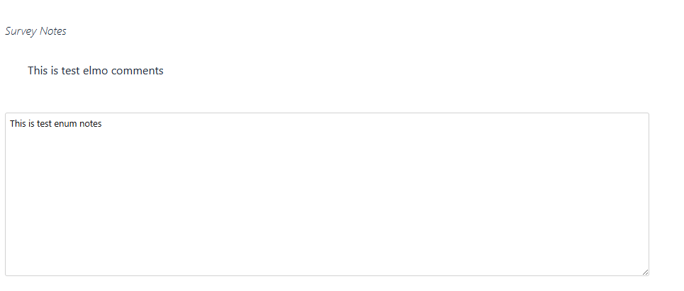
Comments: Dial Related Comments
Include: any notes to help the next attempt.
Exclude: any survey information or item information

Slide 16
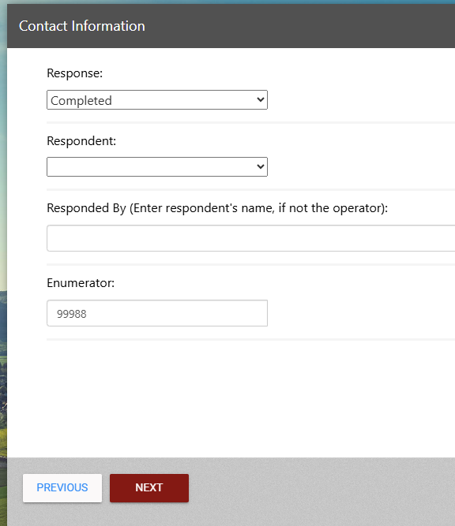
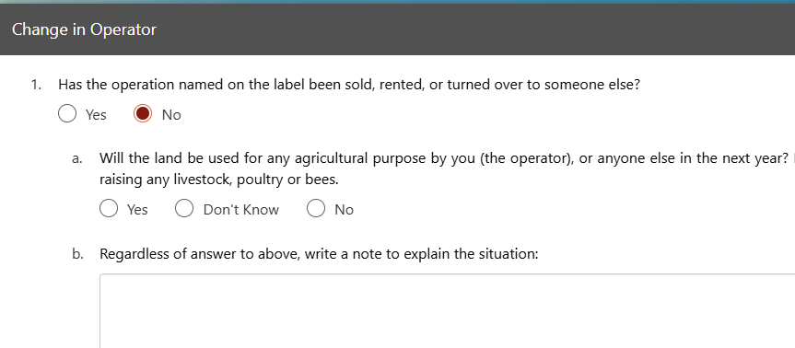
Out of Business: What do I do?
Open the survey and verify if they are out of the item we are calling about or out of all agriculture.
  If out of the item
    Answer screening questions
    Complete change of operator
    Code Response a completed, and Respondent

Slide 17
Out of Business: What do I do?
You can use the Out of Business button on the comments area. This short cuts all the screening questions. (will work to get others removed)

Slide 18
Other Oddities
With READI, you will only need one tab of the session running. Multiple tabs will confuse the system. Fix coming to prevent this.

Slide 19
What’s coming?
800 number in the process of being ported
  Both numbers have been whitelisted
Some calling enhancements

Slide 20
Questions

