Slide 1


Time Scheduling Tool

Slide 2
Why A Scheduler
Implementing a scheduling tool in the workplace offers significant benefits, from collaboration to supporting work-life balance and remote work.
By streamlining time management and reducing administrative burdens, these tools help create a more organized, efficient, and satisfied workforce.

Slide 3

Manager Scheduler Benefits
  Cost Savings
  Data-Driven Decision Making
  Enhanced Communication
  Greater Flexibility and Responsiveness
  Increased Operational Efficiency
  Improved Compliance & Record Keeping
  Improved Employee Satisfaction

Slide 4
Enumerator Scheduler Benefits
  Increased Productivity; Greater Flexibility and Adaptability
  Reduced Scheduling Conflicts
  With real-time updates, reducing confusion and miscommunication.
  Better work-life balance
  Scheduling tools can help employees plan their work hours more effectively, making it easier to set a schedule
  Support remote work, allowing the scheduling tool to facilitate coordination across different locations and time zones

Slide 5
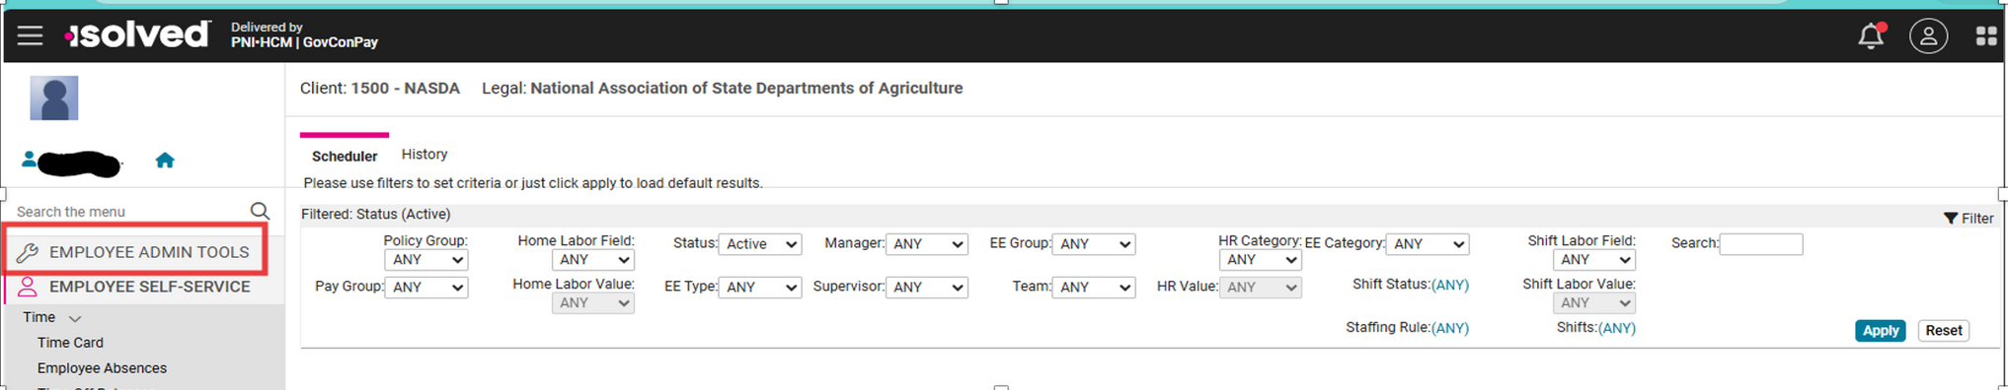
First Things First
Log in to iSolved.
Select “Employee Admin Tools”

Slide 6

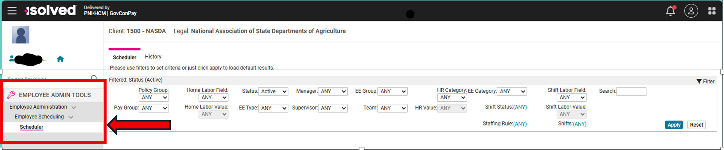
Next Steps
Select “Employee Administration”
Then select “Employee Scheduling
Next select “Scheduler” and then select Apply to load the results

Slide 7
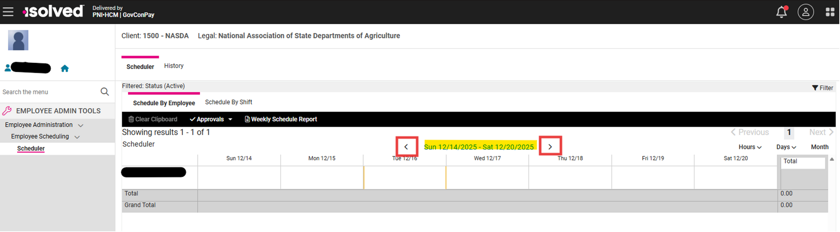
Example
This is an example of what you will see after you select. .
Note: The current pay period will appear, and you can move between weeks using the arrows.
(the dates highlighted below will show you in which pay period you are working).

Slide 8
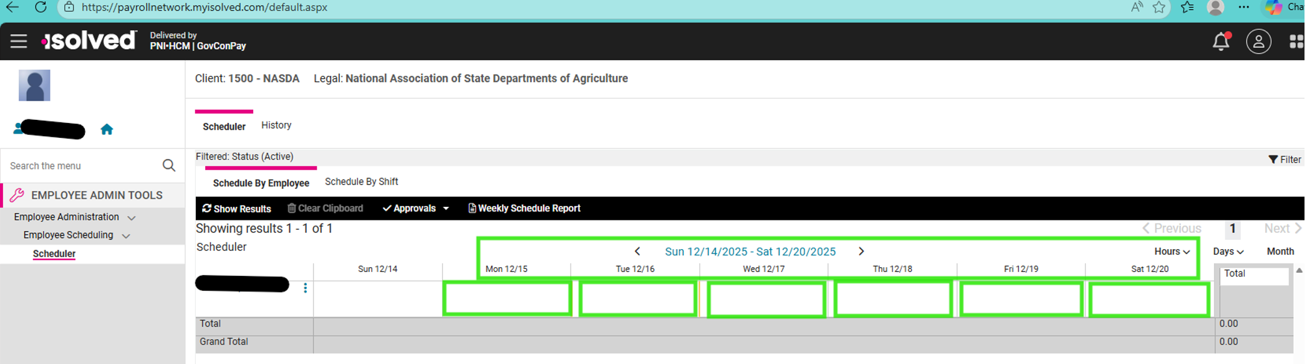
Entering Your Daily Schedule
Next select the respective date to add your work schedule for that day.
You will enter one day at a time, clicking in the day of the week that you want to add your schedule, prompting the “schedule dialog box” to appear.

Slide 9
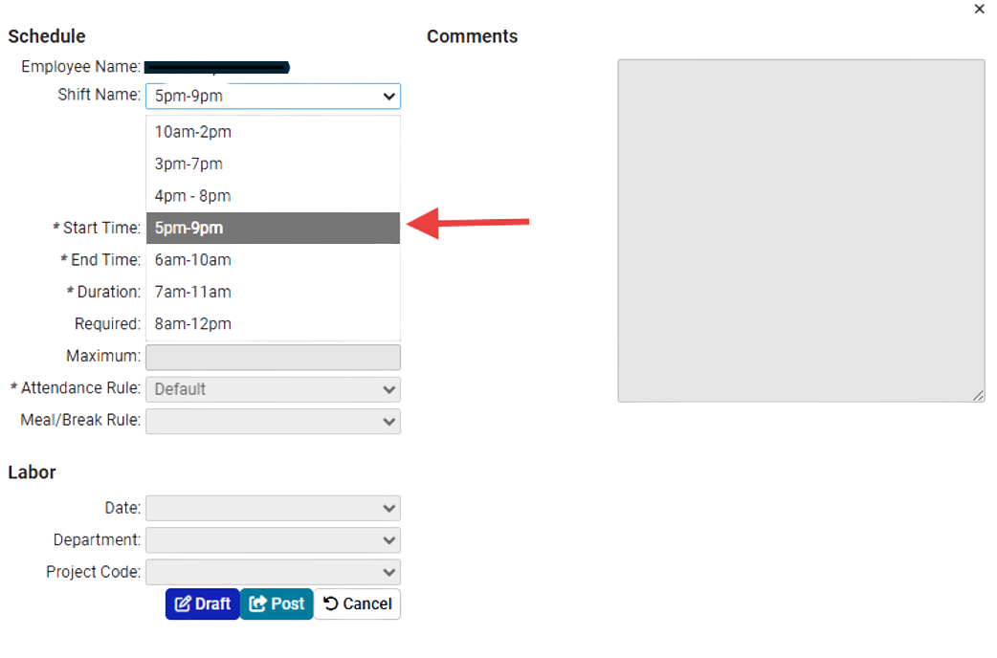
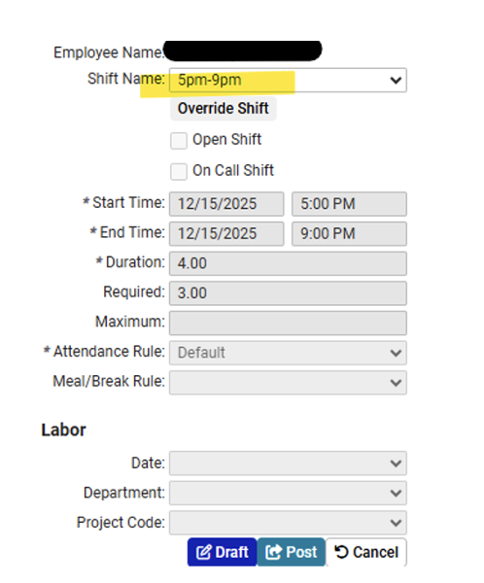
Schedule Dialog Box
Please choose the shift from one of the seven (7) shifts listed in the drop-down menu that you intend to work. If your shift is not listed, choose the shift that is closest to the times that you intend to work. Select “Override Shift” and put your specific Start time and End time in the fields.
Once you have selected a shift, please select Draft.
(Do not select Post: Your manager will Post final schedules)

Slide 10
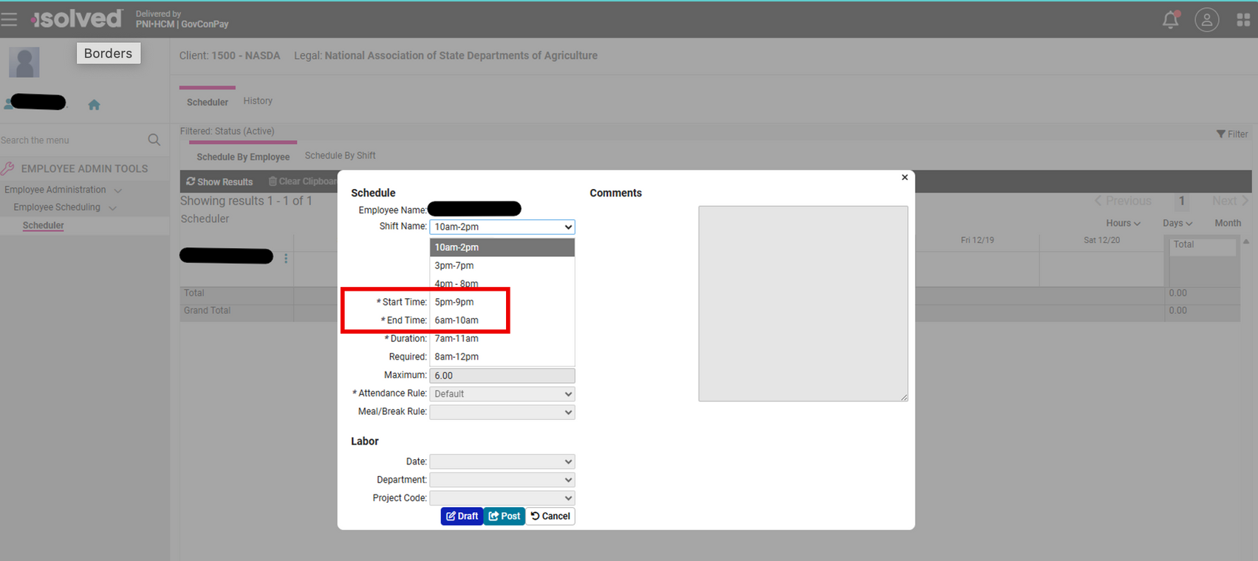
Schedule Dialog Box
Note: Please note the start time and end time to ensure you are on the correct time.

Slide 11
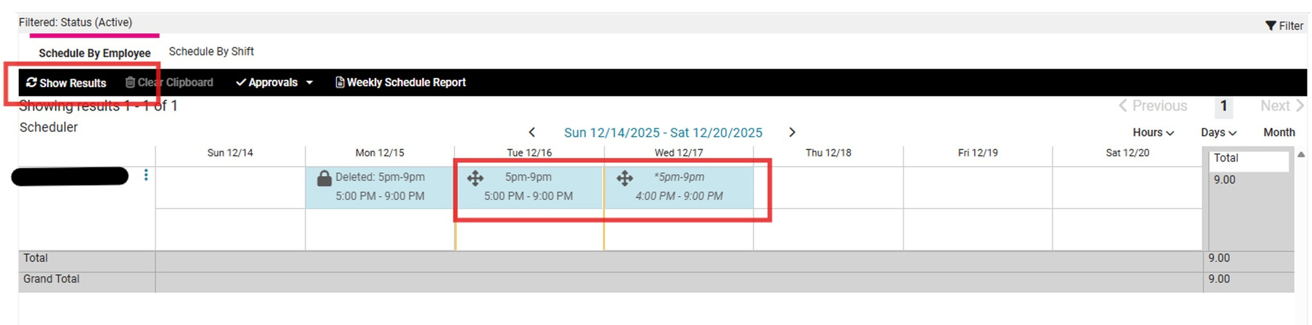
Drafting Your Schedule
Once you have entered your schedule for the selected pay period, click on SHOW RESULTS.
Your Manager will then be able to see your planned work schedule, and it can be approved or amended.

Slide 12
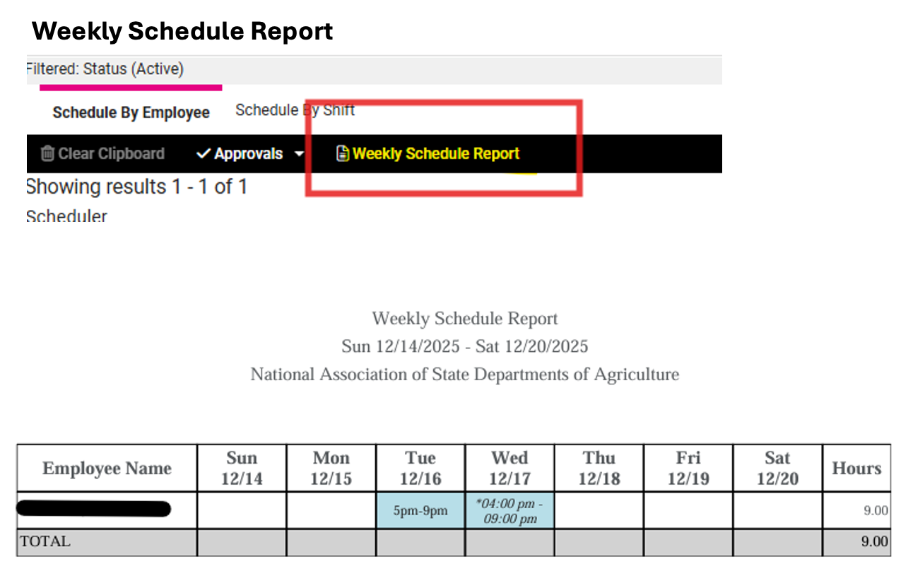

Your Weekly Schedule
Once you have entered your schedule for the selected pay period, click on SHOW RESULTS.
Your Manager will then be able to see your planned work schedule, and it can be approved or amended.

Slide 13

When To Enter Time
The scheduler will remain open for you to enter time from Wednesday through Friday, the second week of the pay period.
All schedules must be entered into iSolved no later than Friday, by close of business.

Slide 14
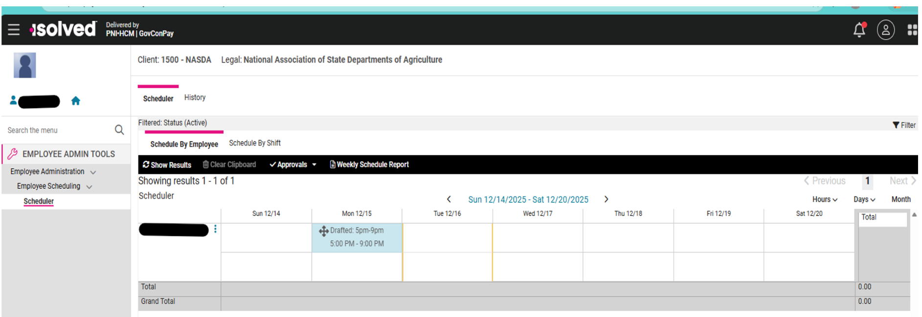
Demo

Slide 15

Questions?
Zakiyyah Rasul
Day/Evening Manager
National Data Center
National Association of State Departments of Agriculture
4350 North Fairfax Drive,
Suite 810, Arlington, VA 22203
501-744-8861

