Slide 1
Your IPad: the basics.
Getting familiar and comfortable with using your iPad.
Thurs, Sept 24th - Made & Presented by Dillon & David

Slide 2
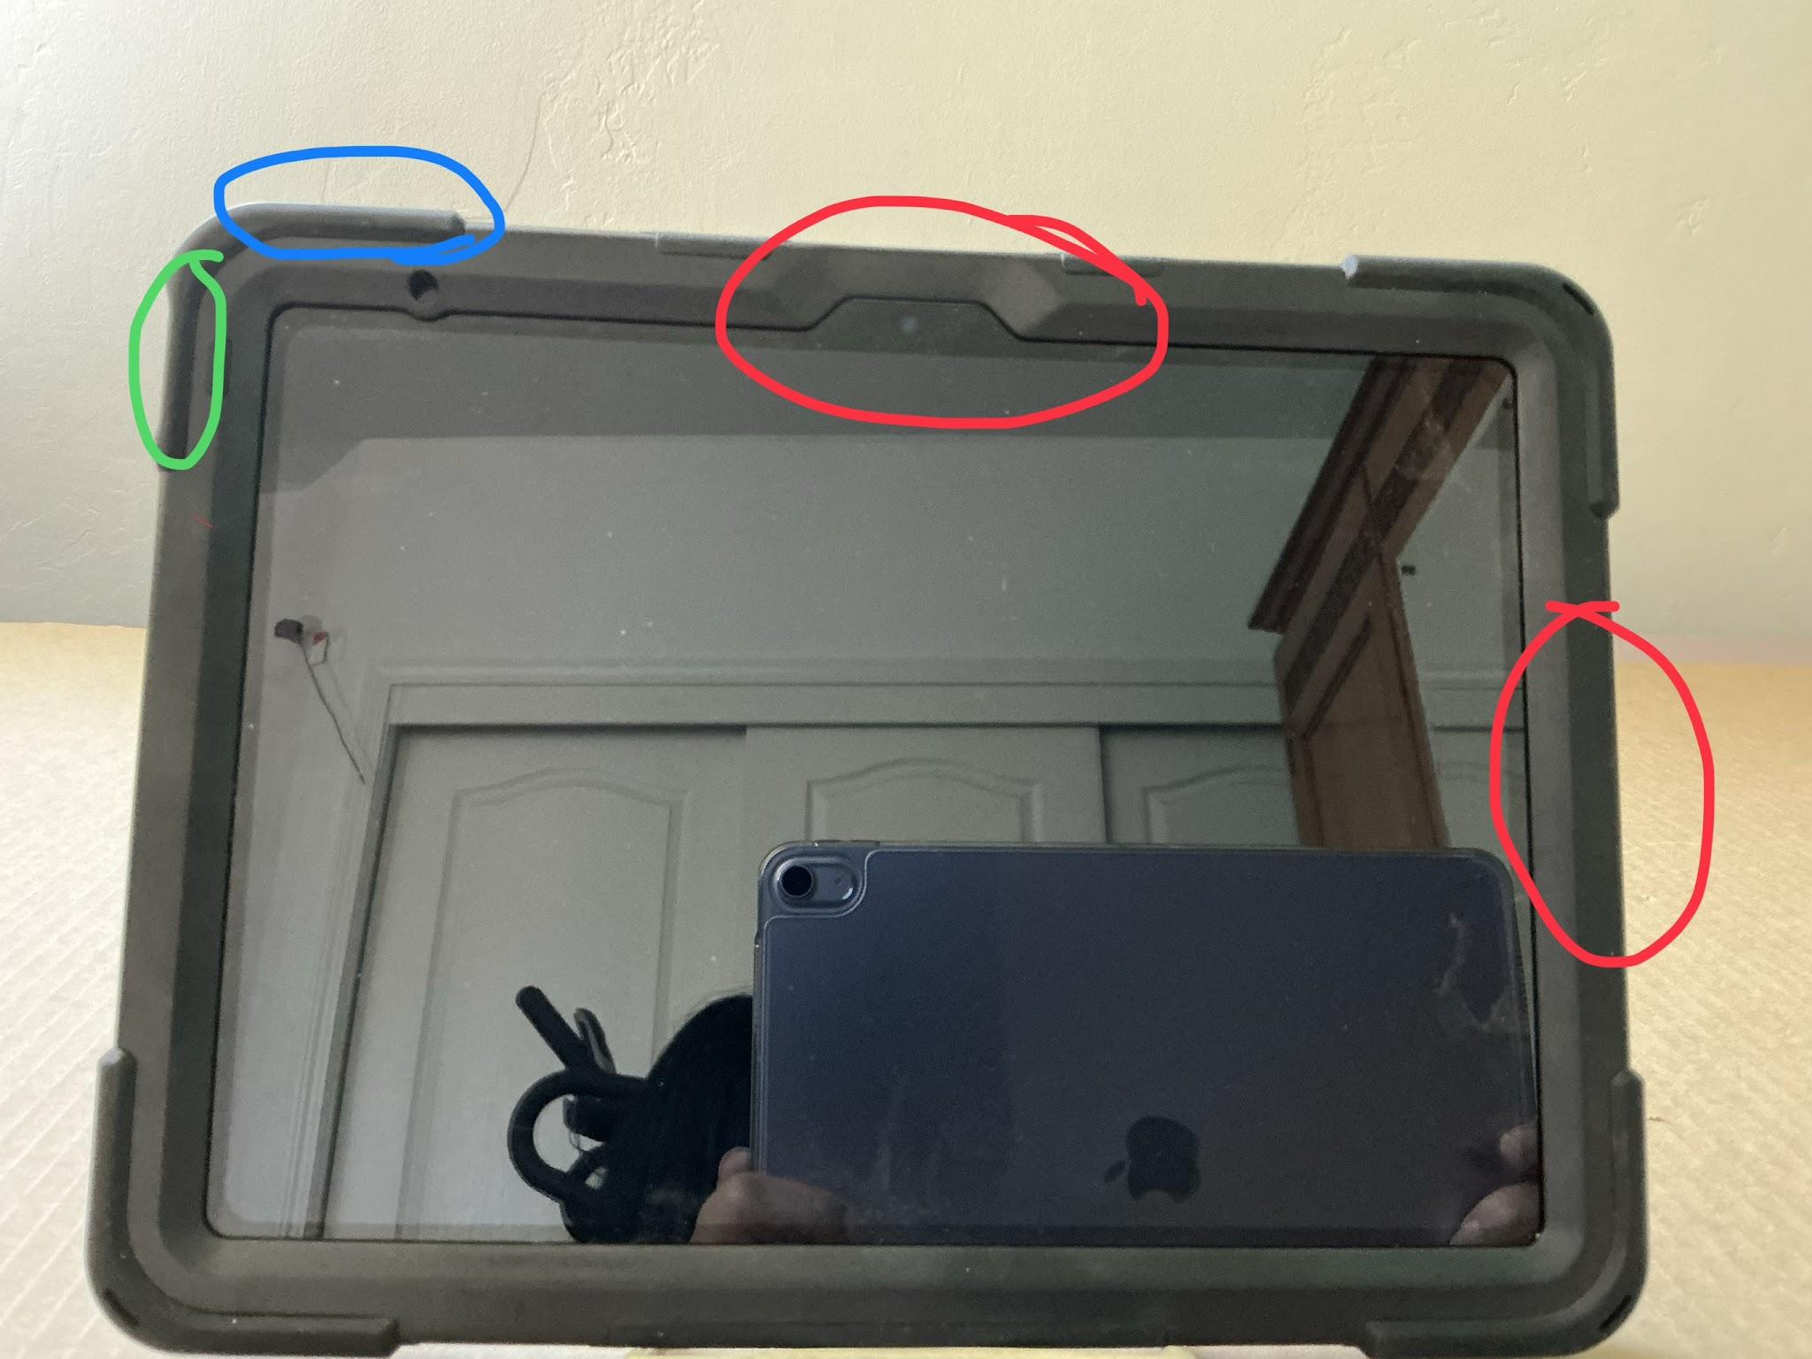
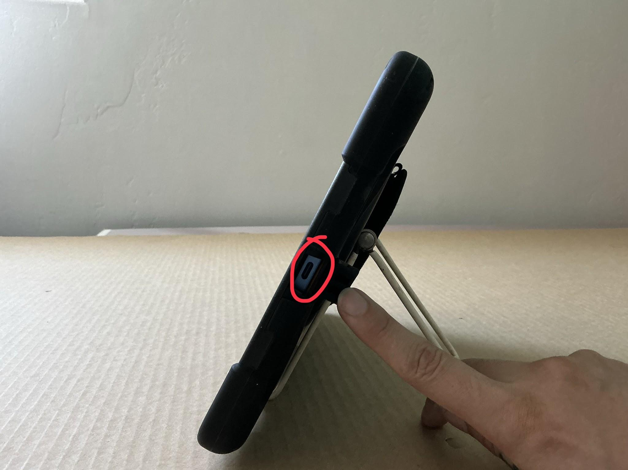
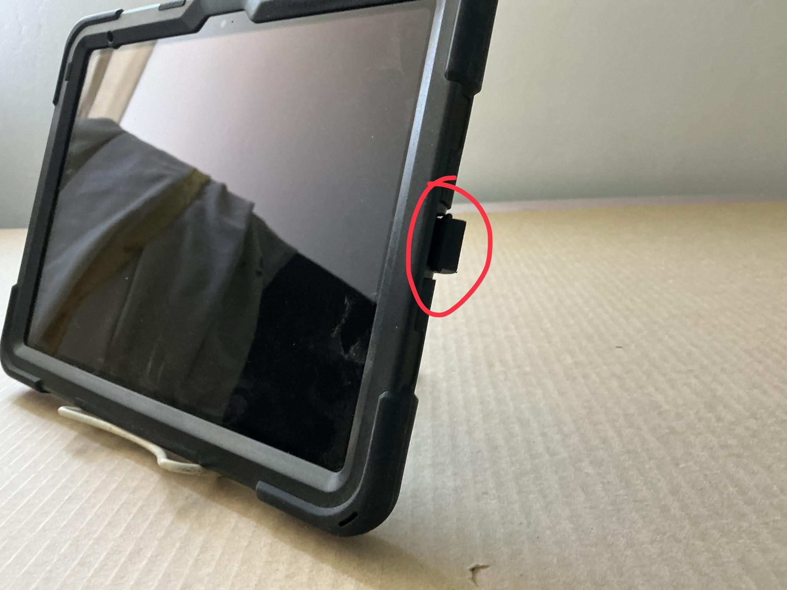
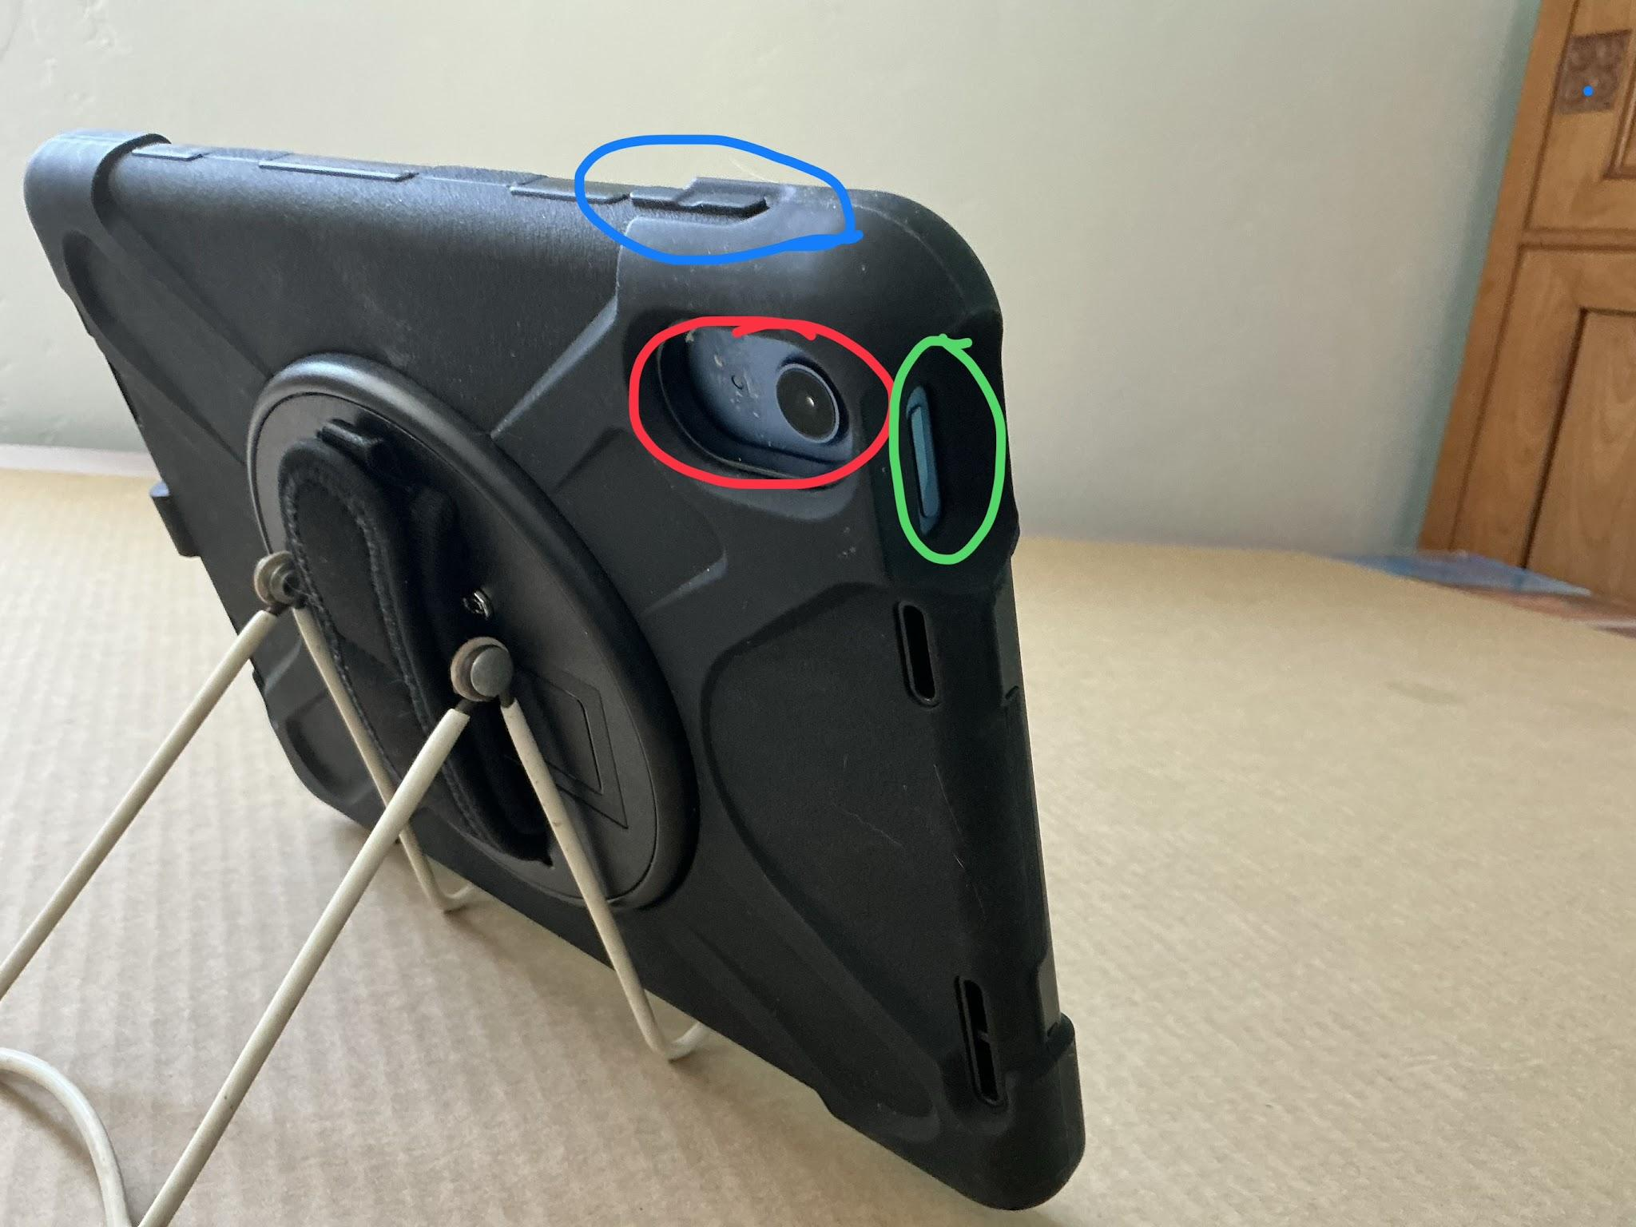
The physical parts of your iPad
The Foundations
-Red circle at the top middle: front facing camera (in a trapezoid plastic cut out)
-Red circle on right: charging port cover
-Blue circle: volume buttons on edge
-Green circle: lock/ unlock/ power button
View of the charging port from head on. The IPad A16 model you have uses a USB C cord and 20W wall plug.
**If you need to buy another set of charging materials, consult your trainer they can send you in the direction of official Apple products**
Here we see the charging port cover opened up
-Blue circle: volume buttons from back view
-Green circle: lock/ unlock/ power button from back view
-Red circle: Back facing camera and back facing microphone (small grey dot next to camera)
2

Slide 3
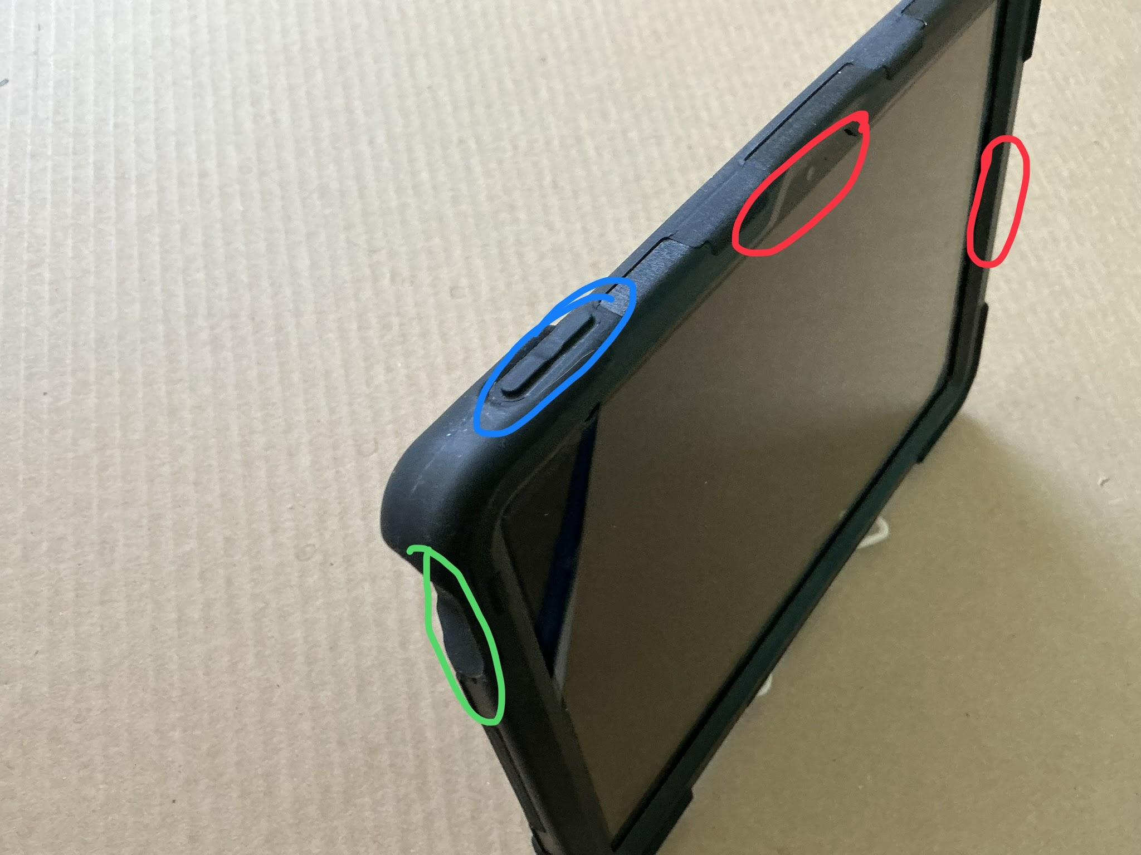
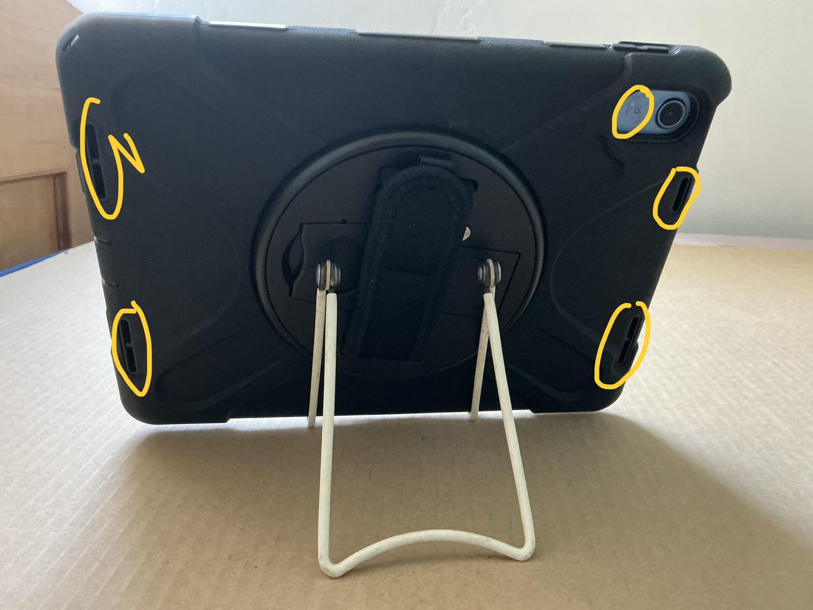
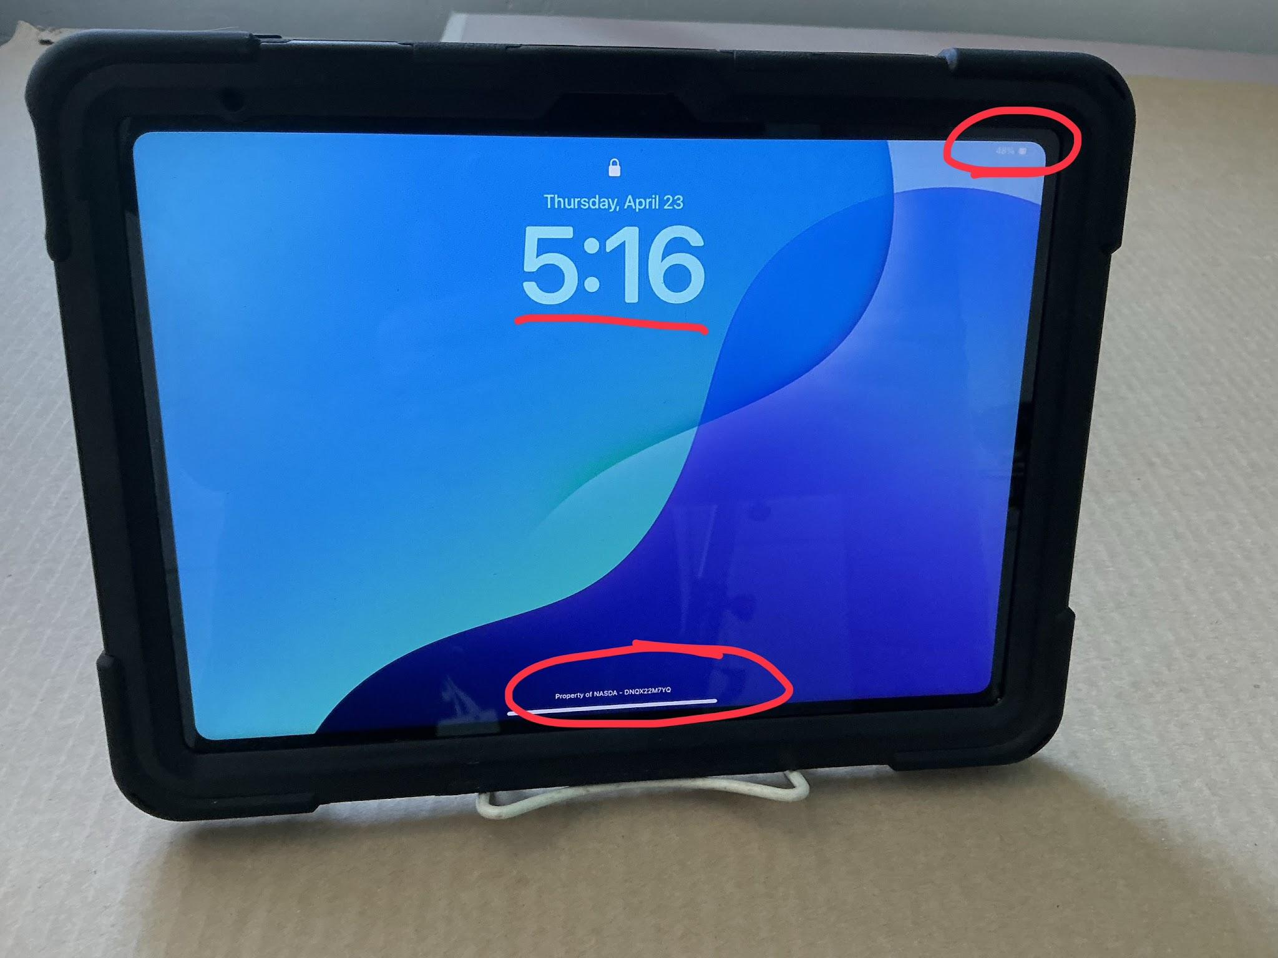
Physical Parts, continued & different views
-Green circle: lock/ unlock/ power button
-Blue circle: volume buttons
-Red circle (top); front facing camera
-Red circle (right): charging port / cover
Yellow circles: microphones and speaker slits, do not block or cover with stickers (like this iPad I received back from someone)
Red circle (top right): WiFi indicator, Cell service indicator, battery indicator
Red underline: (top center): date and time
Red circle (bottom): Unique iPad serial code
3

Slide 4
Surprisingly a lot
Different Uses for Buttons
1
Single click and release, Power Button
2
Press & Hold (5 seconds): Power Button & either Volume Button
Will make your iPad sleep when on, or wake it up from sleeping.
Pressing and Holding the power button & one of the volume buttons for 5 seconds will allow you to turn the iPad off, via slider on screen.
3
Hard Reboot
4
Click & Release (same time) Power & either Volume Button
When your screen is frozen, and the slider will not appear. Hold your iPad with your charging port in your right hand. Lay down your iPad on a table.
Click & release left volume button, click & release right volume button.
Press and hold lock button, for approximately 20 seconds uninterrupted, w/o moving your finger. It will go dark, then release the power button when the Apple logo appears.
If it does not go dark after 5 sec, try full steps again.
This will perform a Screenshot, taking a picture of your screen and saving it in your photos. You will see the screen flash, and a preview in the bottom left corner for a bit. You may also hear a camera sound “click”
4

Slide 5
Your fingers are your mouse
The 4 types of “clicks” aka taps
There are 4 types of common ways you will use your finger to interact with your iPad:
1: Tap - one single, quick tap. No hold.
2: Double Tap - two consecutive quick taps, no hold on either. Usually used for selecting text.
3: Press & Hold - one tap where you keep your finger held down. Usually this will be used to open a small menu of options connected to the original thing. In a PowerPoint like this, it will be used for moving objects around.
4: Swipe - a directional swipe, or flick. Used to exit apps, change Home Screen pages (between one and two), unlock the iPad, close apps running in the background.
Note: sometimes these actions can be combined for certain procedures.
5

Slide 6
Making your typing more efficient
Typing On Your iPad
On the keyboard to get secondary characters: Press & Hold, Short Downward Swipe (the top characters on the keys are secondary, the bottom characters on keys are the primary characters for that key)
Typing Suggestion: Press & Hold, Slow Small Swipe - on the text where you’re typing to get a magnifying glass to place the typing Caret (the flashing line showing where you’re typing) in between certain letters.
This can also be done with the spacebar. Press & Hold the spacebar when typing, and it turns into a trackpad, moving the Caret anywhere you move your finger.
A Tap or Double Tap on a text box usually “wakes up” the text box and allows typing. If the keyboard doesn’t appear right away, Tap on an empty portion of screen and then try again.
Tapping on text you just typed will move the Caret in a general area. Double Tapping on text that you typed or you’re viewing will select it in blue. This blue highlight will also have two blue dots on the front and end of the selected area. Drag those dots left or right to select more or less.
After Selecting text you typed or are viewing, it will pop up a small menu above the selected text, where you can cut, copy, or paste, or sometimes bold, underline, or italicize.
6

Slide 7
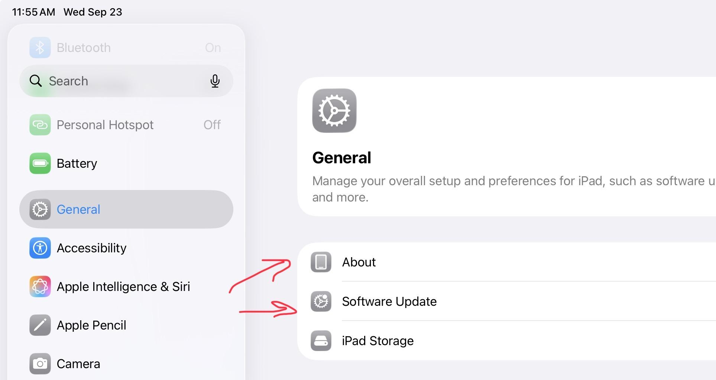
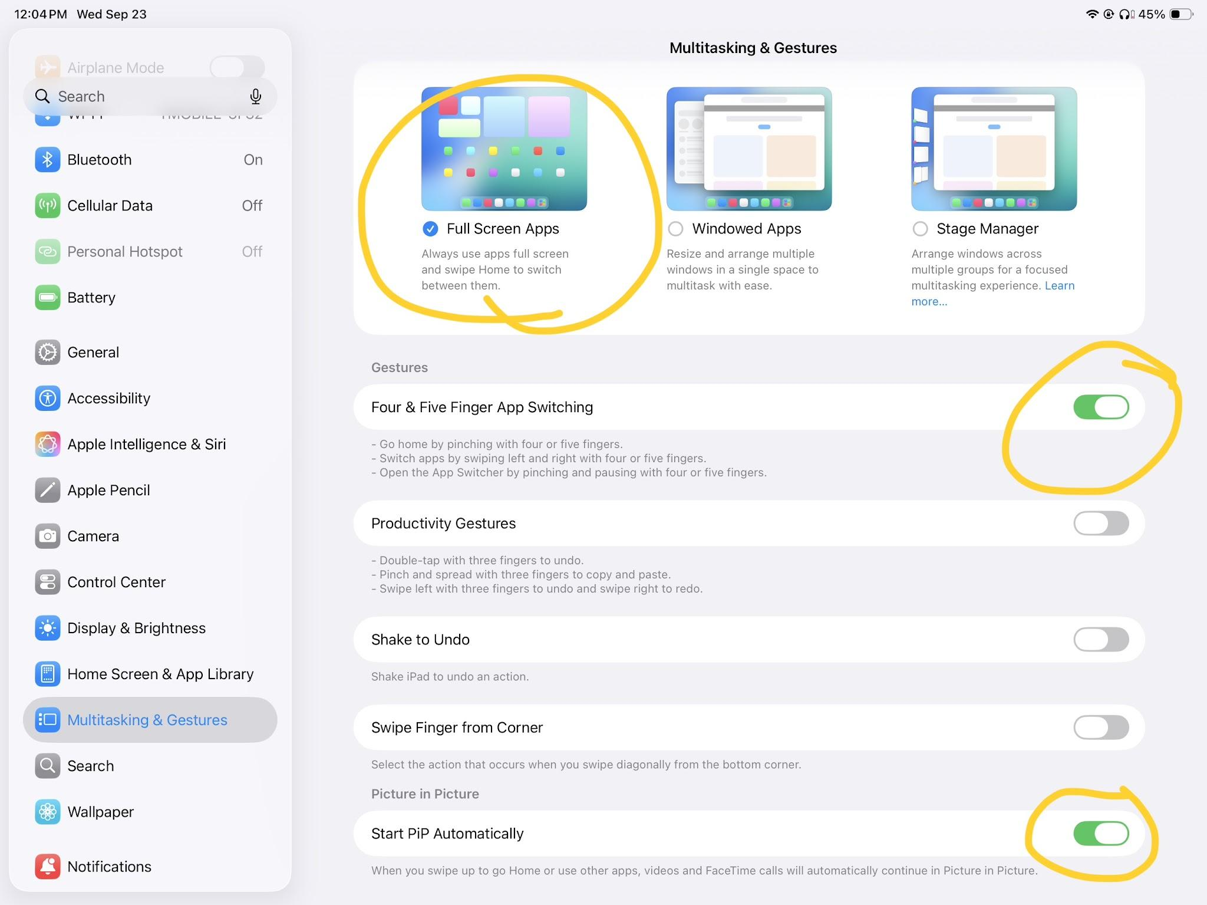
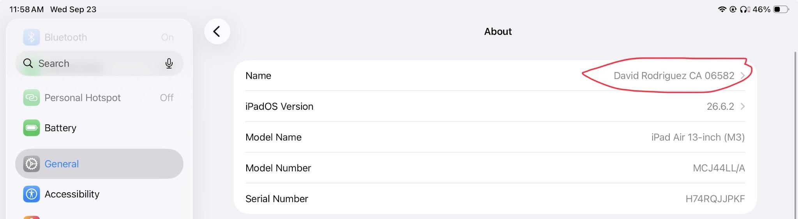
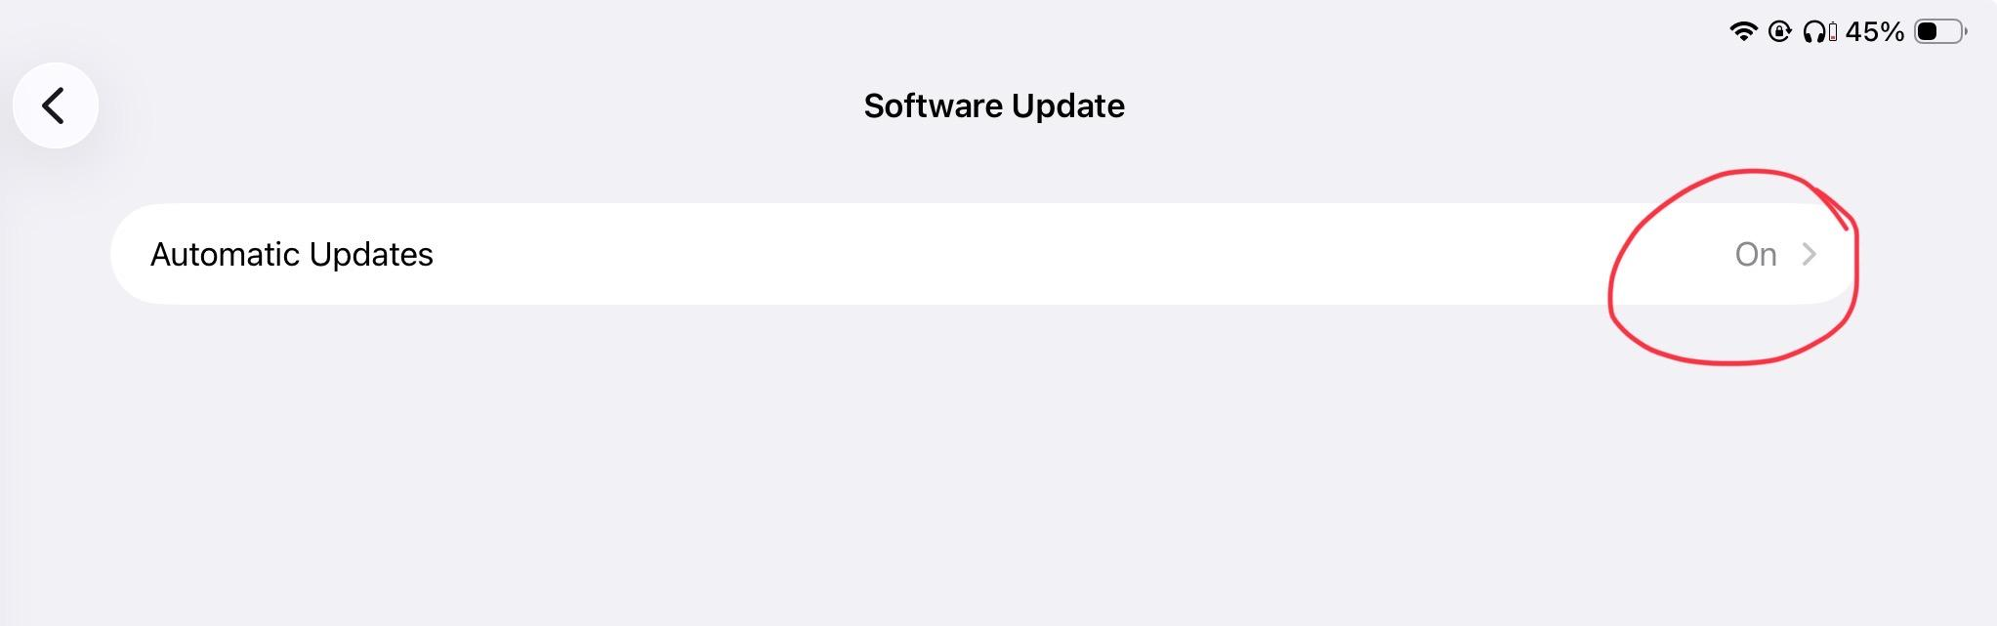
Mandated settings by NASDA
Necessary Settings Changes
In the Settings app, find General. Within General the two necessary changes you will need to make is turning ON auto software updates, and changing the NAME of your device. It MUST be your full name and state abbreviation. Adding your enumerator # is fine also.
In the Multitasking section, you will want to make sure you have Full Screen Apps turned ON. This makes things easiest to see, and prevents a mess of apps being open at the same time. Make sure Four & Five Finger Gestures are ON. And make sure PiP is ON.
**You don’t need to use Four & Five Finger Gestures, except for closings apps that are running in the background**

Slide 8
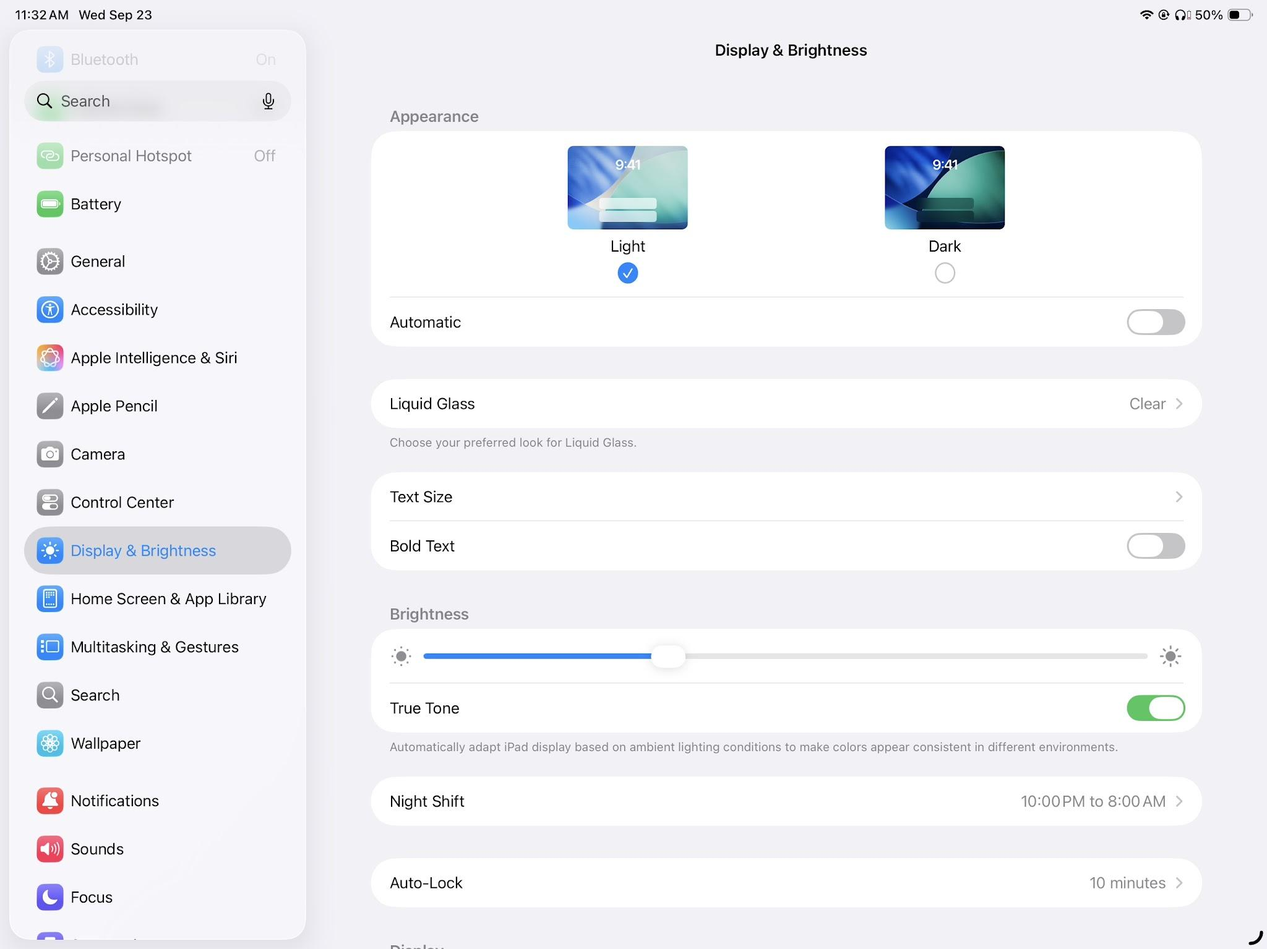
In your Settings app, you’ll see it’s split into two sides. On the left side is the broader spectrum of settings folders. On the right is the more specific settings within those folders.
Here we’re in Display & Brightness, where I would recommend changing the auto lock timer to 10 / 15 mins from the standard 2 mins.
If needed, change the text size for better visibility across all native iPad text, and apps that support dynamic sizing. This won’t affect websites.
If you’d like, change your appearance to Dark Mode. It’s a good way to save battery and ease eye stress.
True Tone will allow your iPad to adjust the warmth and brightness depending on your environment conditions (I recommend it)
Night Shift will completely shift the screen light to eradicate blue light. It’s especially helpful in the evenings or nights, or days your eyes are stressed.
Making you more comfortable with your IPad
Recommended Settings Changes
7

Slide 9
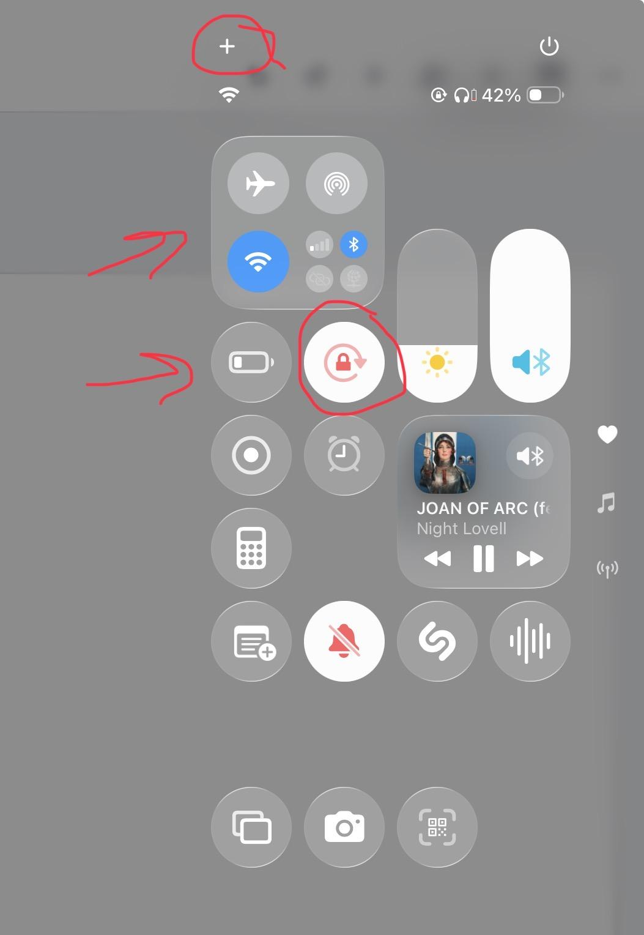
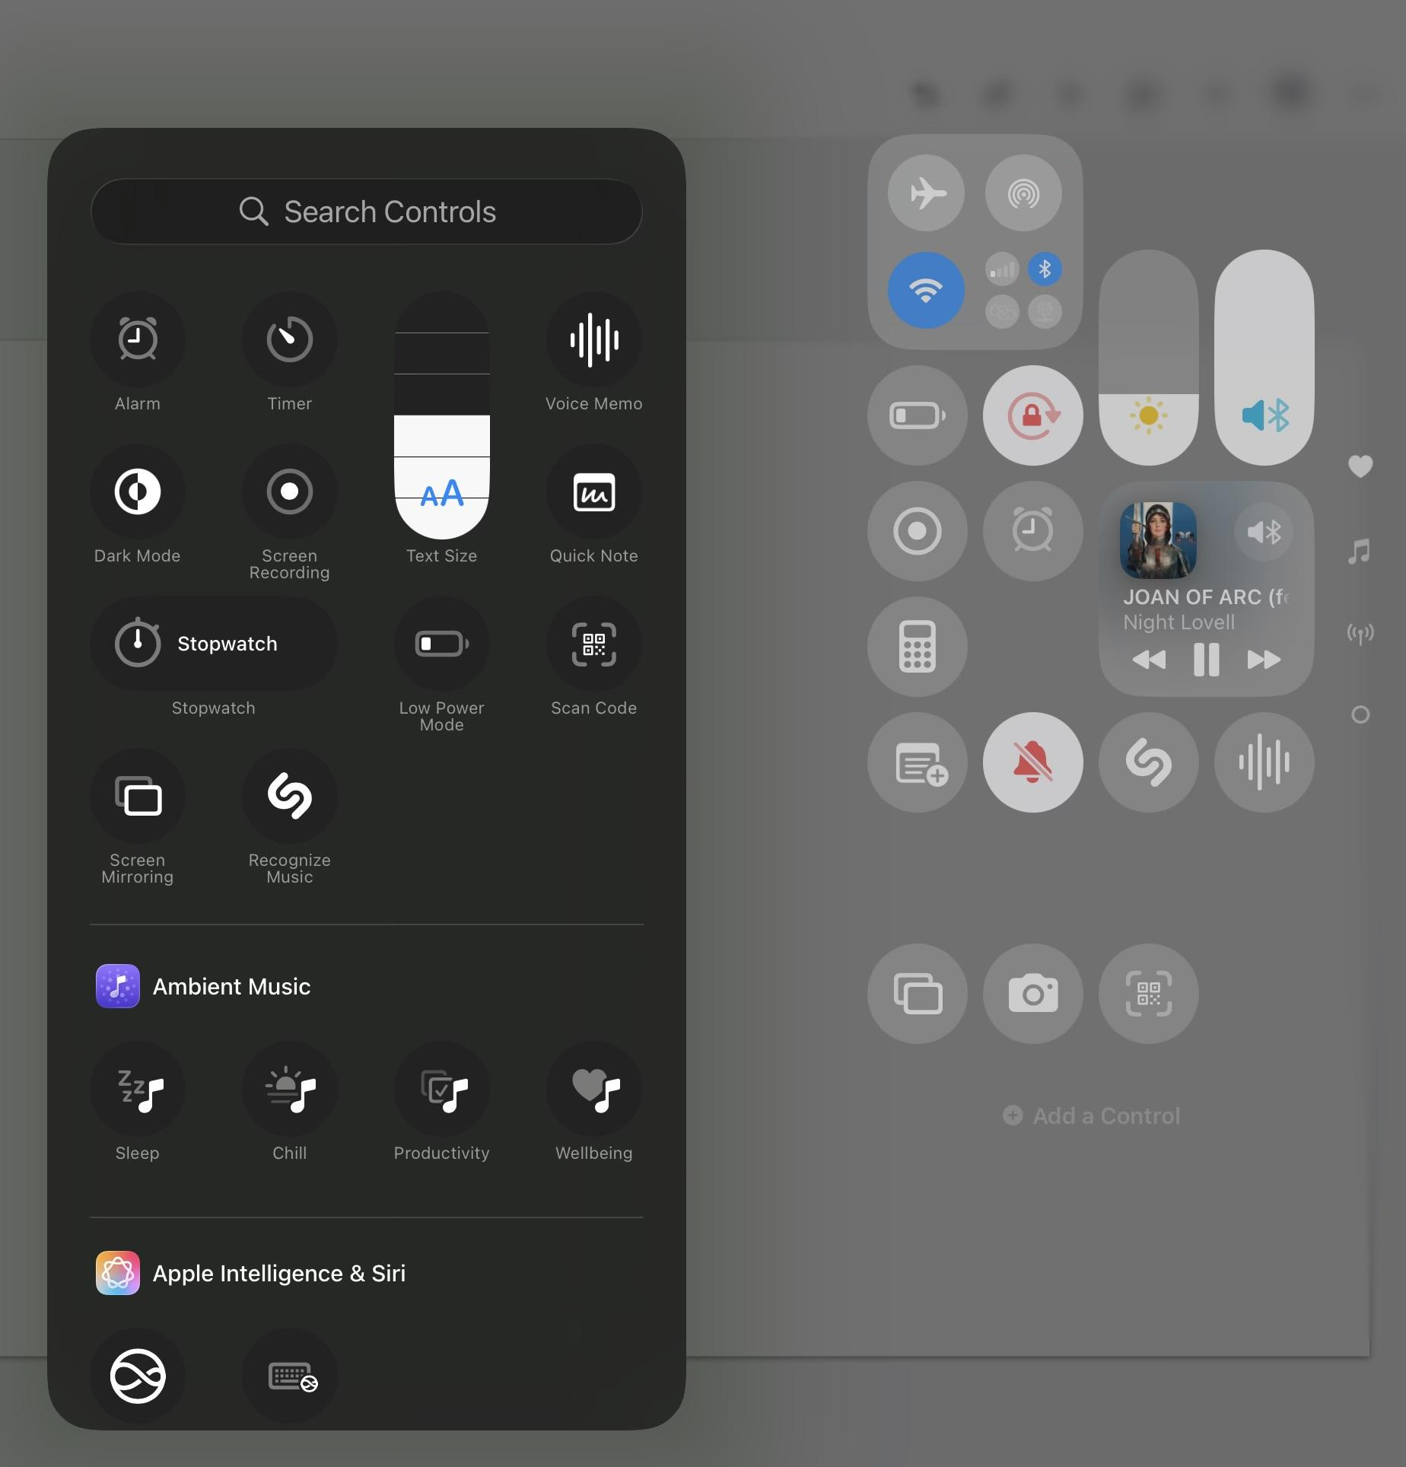
Quick changes to settings on the fly
Using Control Center
If you make a single downward Swipe in the top right corner of your screen, you will access the “Control Center”
Here you can make settings changes quickly without digging thru the settings app.
Some I recommend adding:
-Low battery mode
-Rotation lock (circled)
-Screen recording (below low battery)
-Calculator (Below screen recording)
-New Note / Quick Note (below calculator)
-Silent Mode (next to new note)
-Camera Access
-Set Timer
You will use the + sign at the top to add —> functions to the control center.
You’ll get a scrolling menu that allows you to add or subtract functions, as well as move them around to your liking.
In the top right of the control center we also see attached devices (Bluetooth or hearing aids), if your rotation lock is on, battery level, if you have an alarm set and a power button

Slide 10
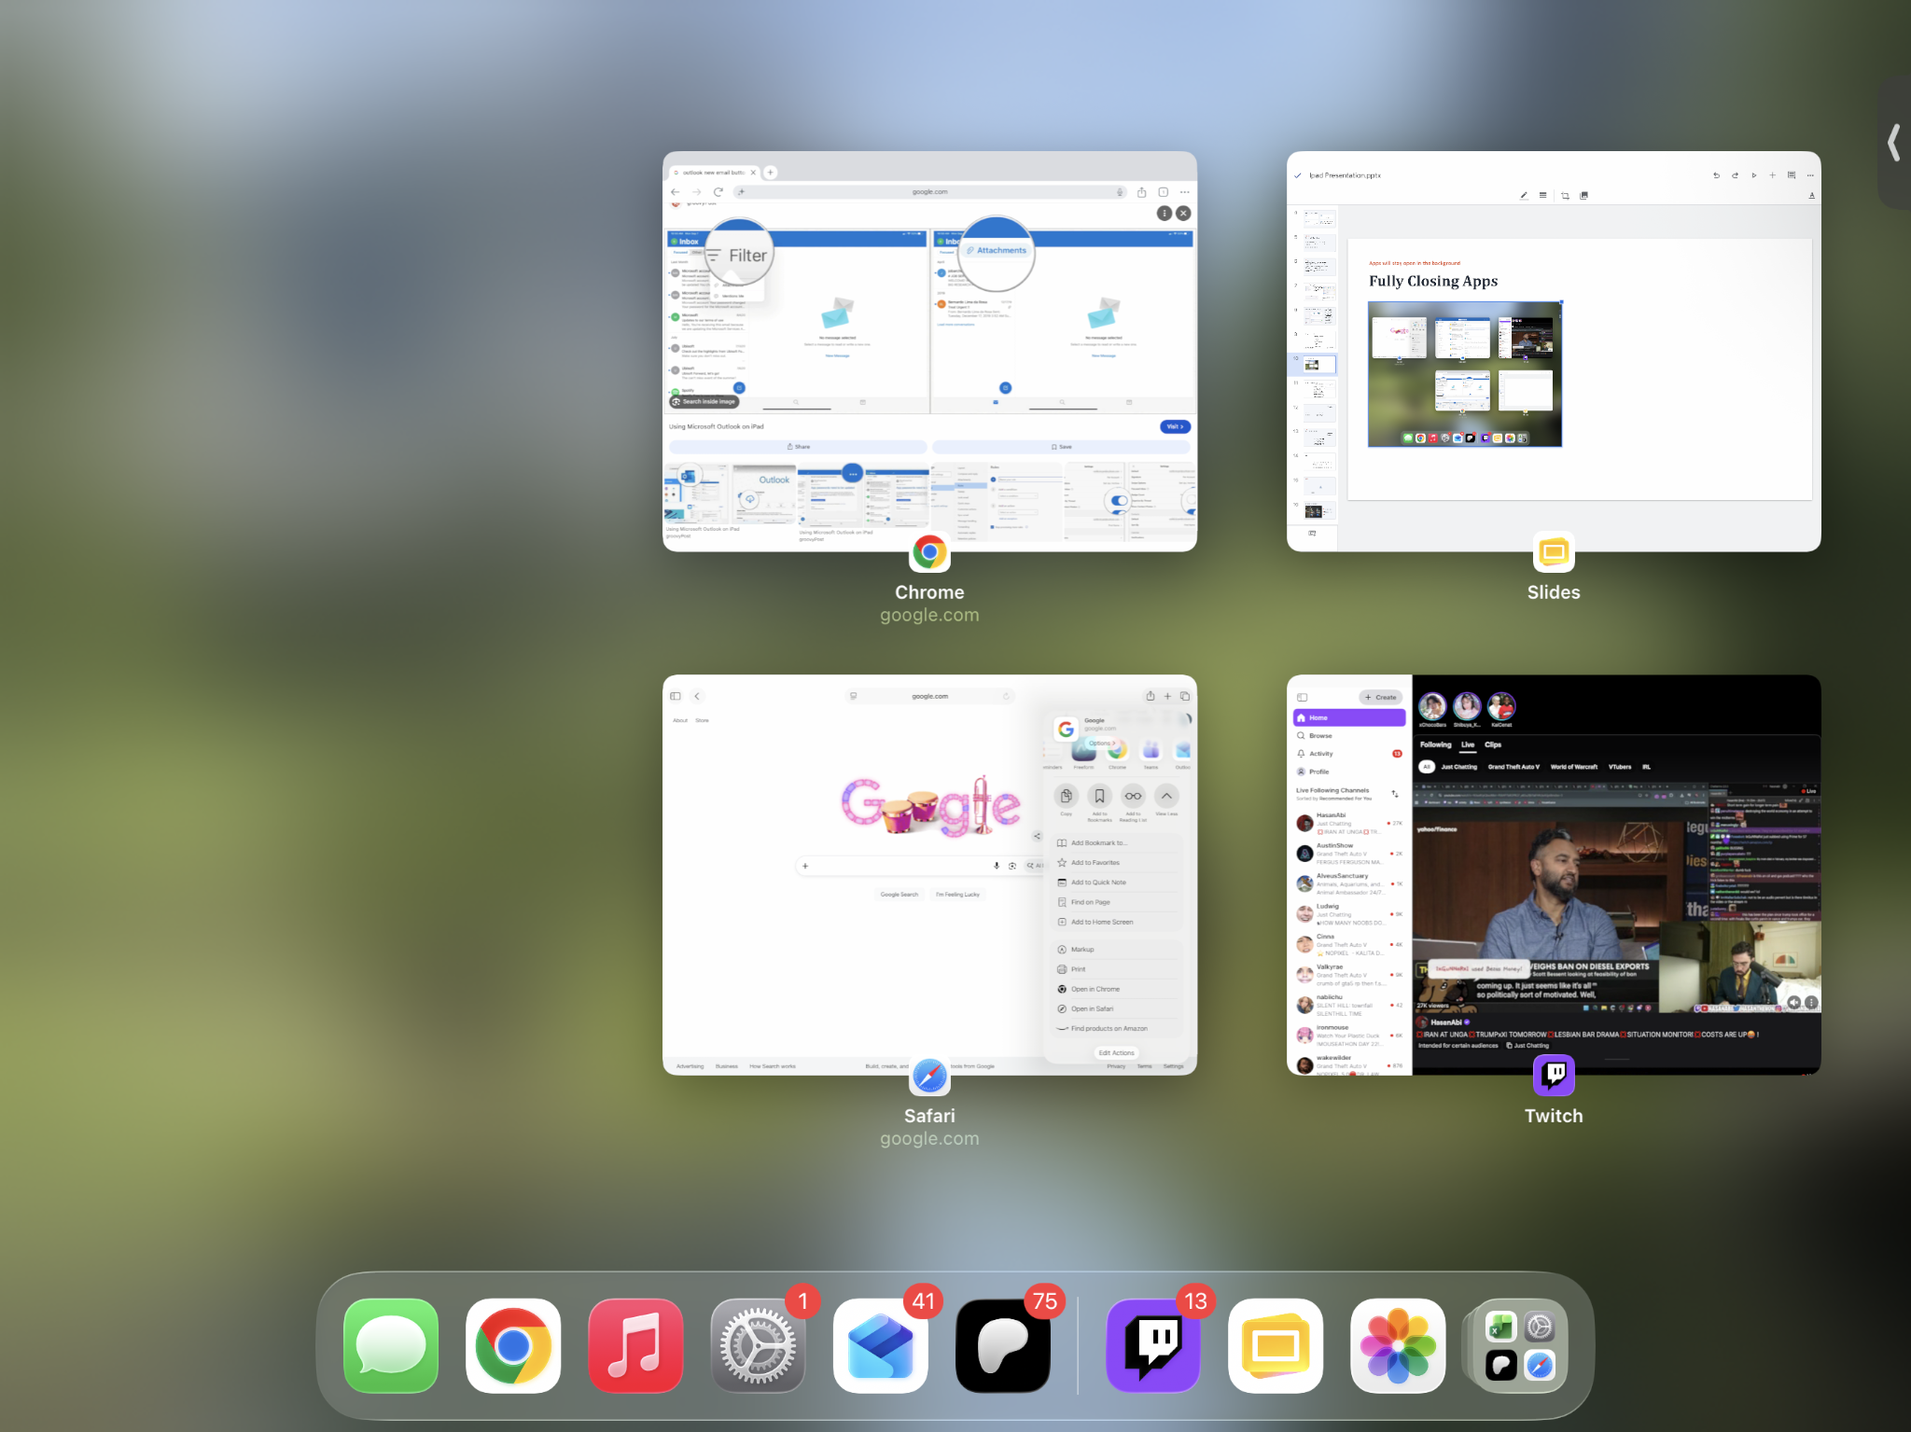
Apps will stay open in the background
Fully Closing Apps
After we turned ON Four Finger Gestures it allows for the easiest way to fully shut down apps that are running in the background.
Using four fingers (thumb, index, middle, ring) pinch with those fingers and it will show you a page like the example on the left.
Here you can fully shut down apps that are still running in the background.
This can help make an app run better if it’s buggy, or help the iPad maintain better battery life, and generally let you start fresh when opening them the next time.
When you see all the apps in small windows, simply Swipe on the small window and it will slide upwards and disappear. It’s easier to Swipe in a Flick motion to close them.

Slide 11
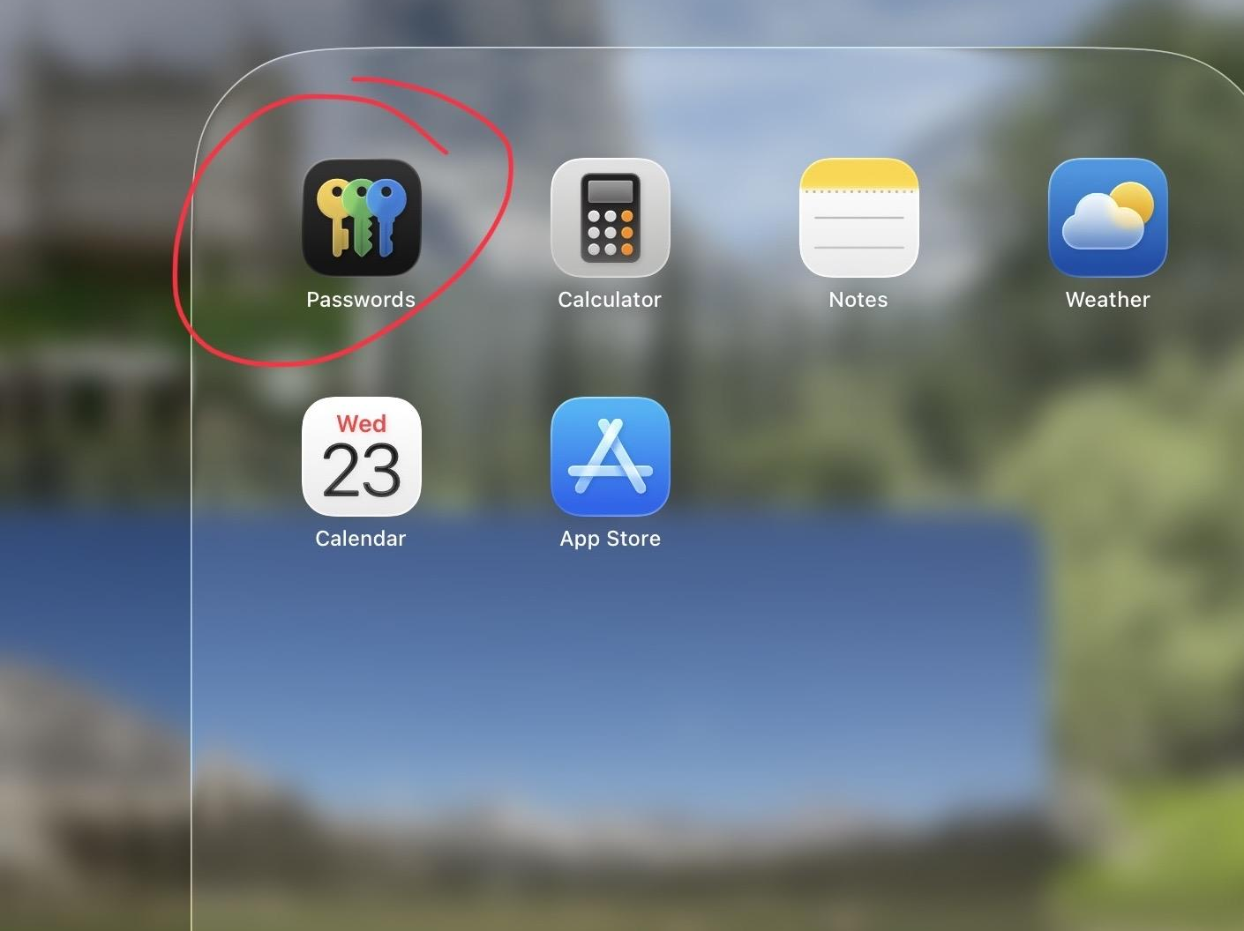
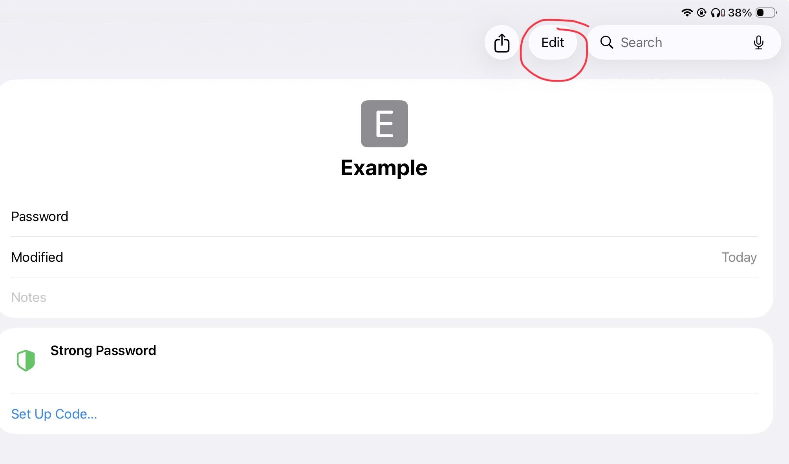
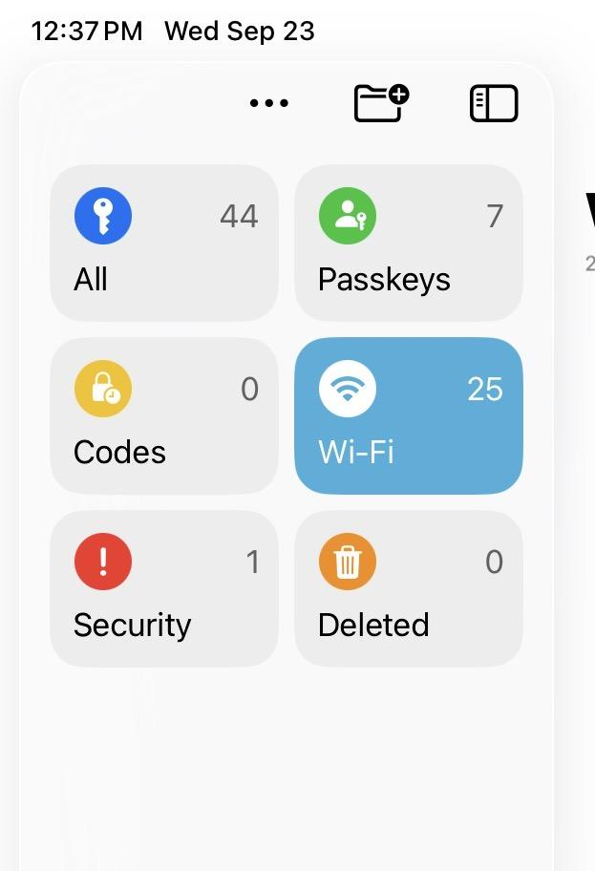
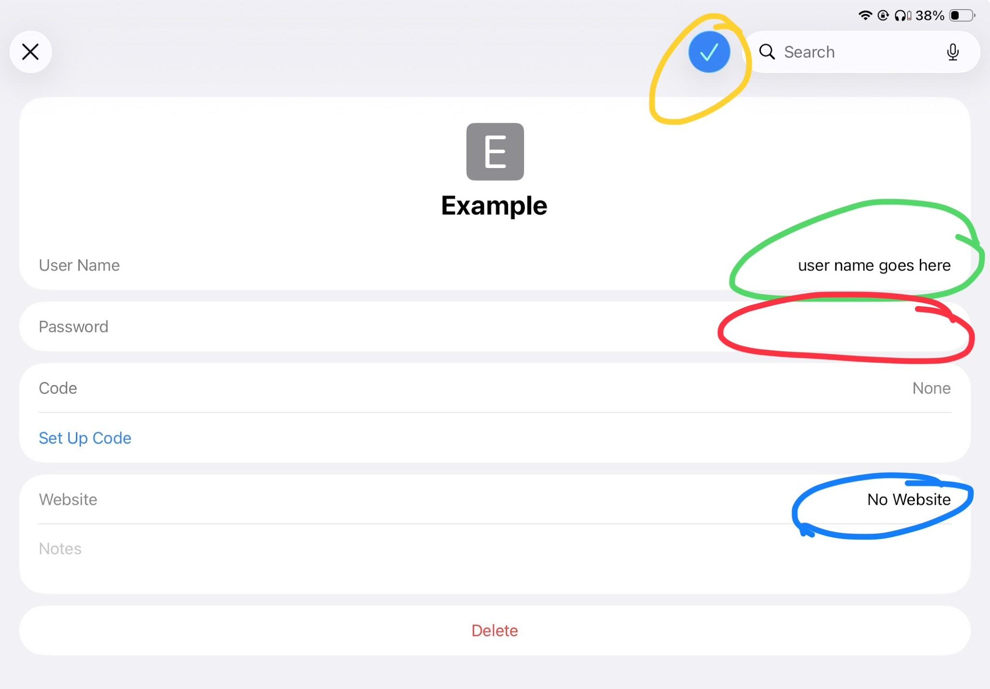
Only one area to keep your passwords, WRITE THEM DOWN AS WELL!!
Using the Passwords App
When first clicking on the Passwords app, it will ask for permissions to turn on autofill, and send you notifications. Allow both.
This will store your passwords for your accounts you access on your iPad.
This is NOT a fool proof system. Be sure to write down, label and date login info on a physical notepad and keep it somewhere safe, where you won’t lose it. Sticky notes all over a desk or computer is NOT safe, and prone to being lost.
If you need to Edit saved info, click on the account in the list of All. This will bring up the saved entry, click Edit in the top right section of the screen.
There you can update or enter information. Username, password, and a link to the page.
This info will be saved & updated automatically if you allow autofill and notifications when you first enter the app. You shouldn’t have to touch the saved info or edit it yourself within the passwords app.

Slide 12
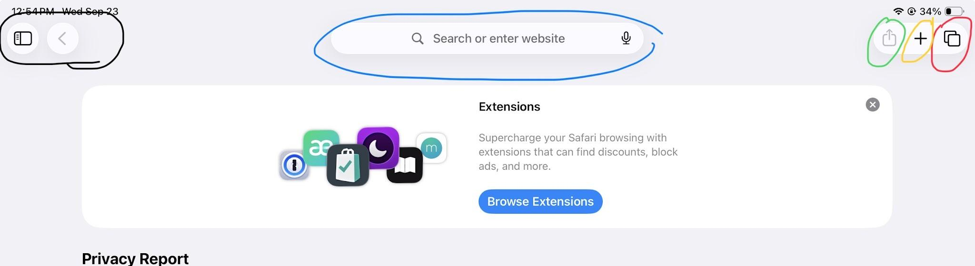
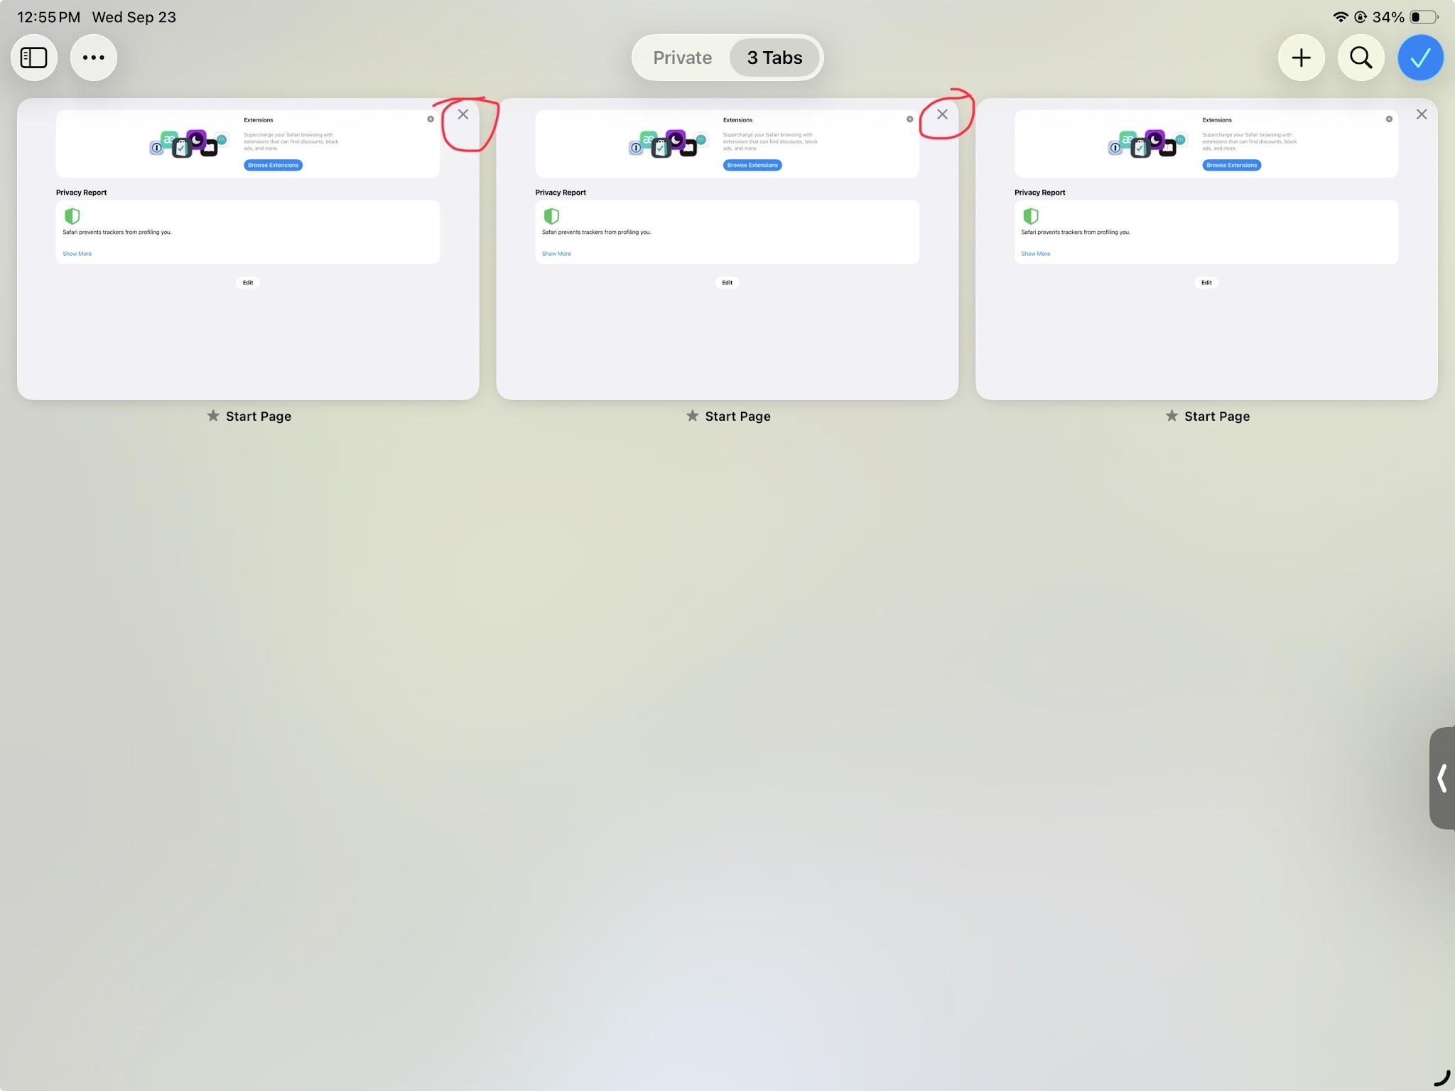
Apples native browser
Using Safari
Blue circle: the search bar / address bar
Red circle: the tab switcher
Yellow circle: add new tab
*Addressed on next page*
Green circle: functions menu
Black circle: sidebar menu
When pressing the Tab Switcher you will see all open tabs. Pressing the small X in the corner of them will close them.
Here you can jump between pages when multitasking. Or close them for good.
6

Slide 13
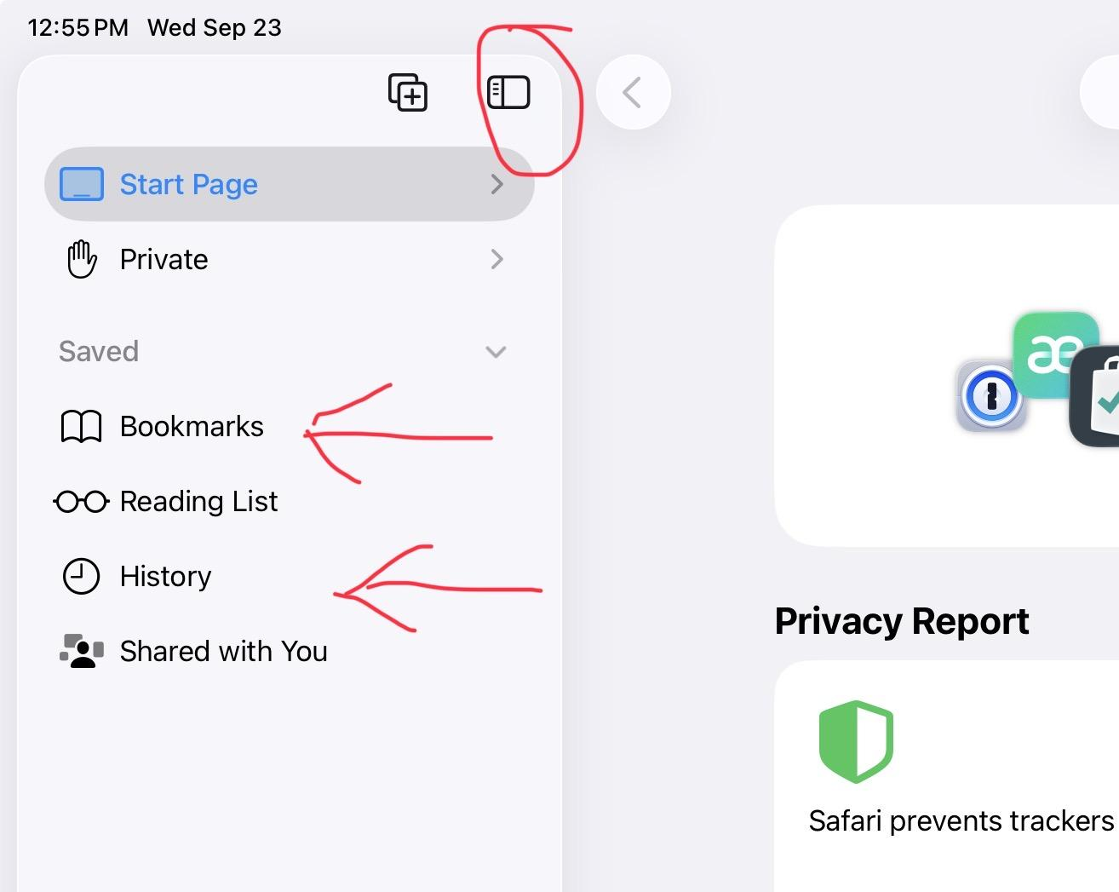
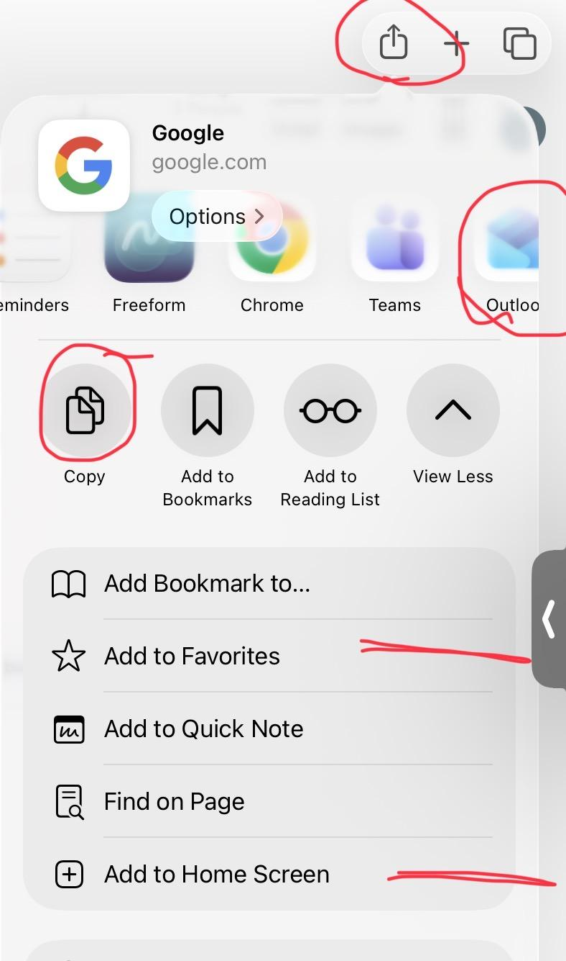
More functions, when you need them
Additional Functions, Safari
The Sidebar Menu will allow you to find your
History
Bookmarks / Favorites
The square with an arrow coming out the top will open Functions Menu. This will allow for things like:
-Sharing a page via Outlook
-Copying the url link to paste later in an email or document
-add to favorites menu or bookmarks for quick access to commonly used pages
-add shortcut to Home Screen. Even faster way to get to a page from your Home Screen, with one tap.
6

Slide 14
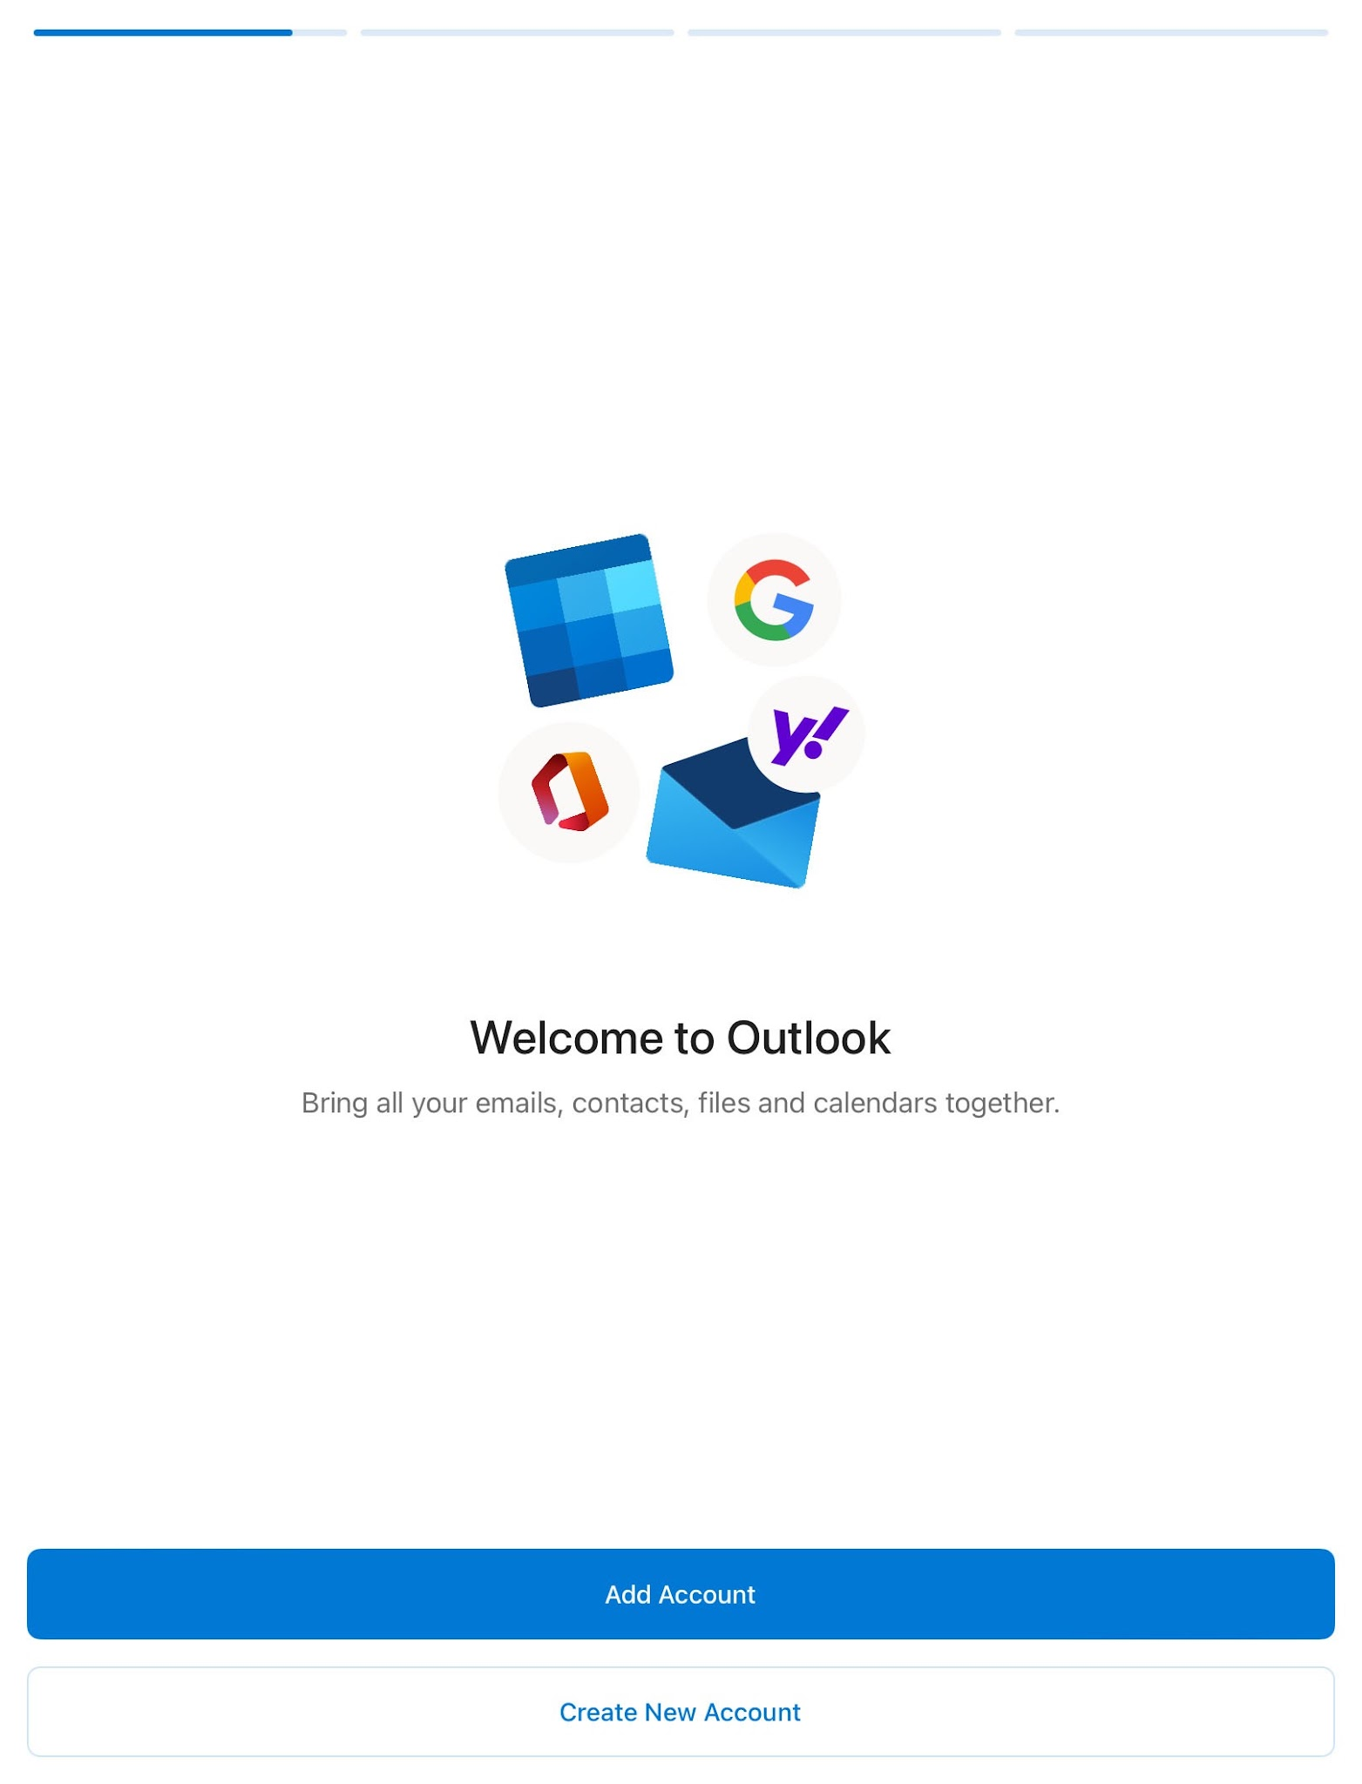

We will have our next class on Outlook, a full deep dive
Outlook
When first accessing click ADD ACCOUNT
Check for this icon to create a new email
If a mass email is sent to lots of people, be sure to select “reply to sender” to avoid bugging more people than necessary, or possibly discussing things that doesn’t concern others.
All NASDA enumerators emails are in your contact book already. Start typing an enumerators name, and you’ll get options to choose which person.
For example: typing David will give you multiple options. If you’re looking for the Trainer David then select David N Rodriguez. If you’re looking for David Exline, select David Exline.
Pressing & Holding on a specific email will give you multiple options. Reply to, archive, forward, flag, mark as unread or read.

Slide 15

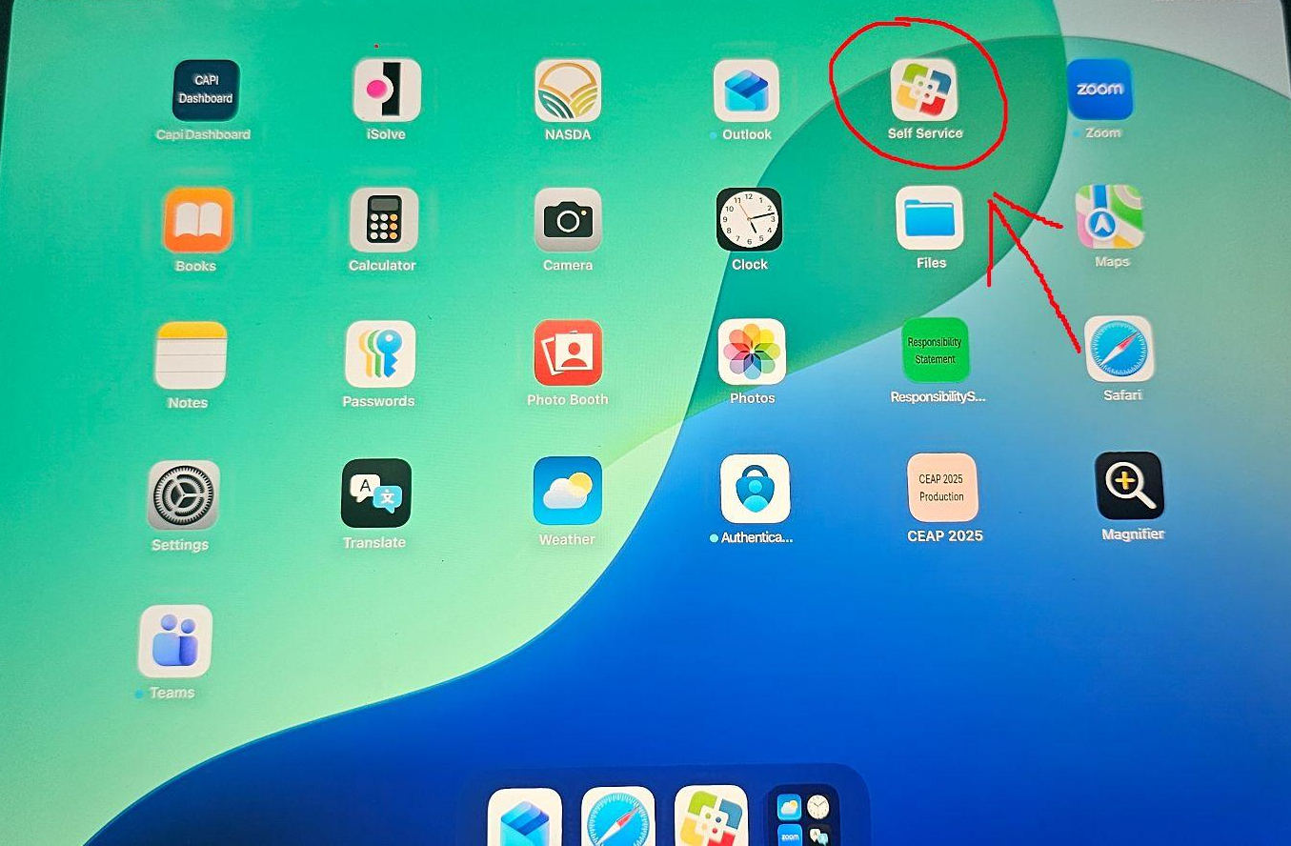
Where to find it
Self Service
Always allow notifications from Self Service. When first entering, click the Blue Arrow.
5

Slide 16
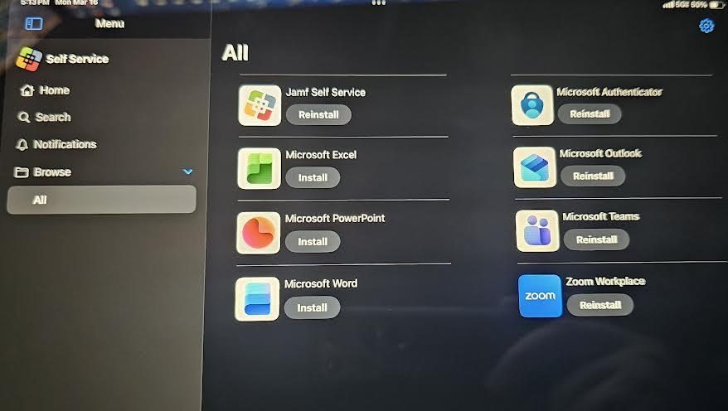
Managing the apps on your iPad
How to navigate Self Serivce
1
Click ALL
This will show all of the apps that are available
3
2
Install
If you want to install an app this is the button that you click
1
3
Emblems
Once installed this emblem will appear on the home screen
2
Add one photo — point out several things in it using the numbers
6

Slide 17
Requesting iPad Assistance
Before sending an email, make sure you have fully rebooted the ipad from full shutdown.
Take pictures or videos of the issue once it has happened
Find the Serial Number for your iPad at the bottom of the lock screen
When sending an email make sure to include as much detail about the issue as possible (what happened, serial number, pictures, your name, your state, your contact information)
For most inquiries contact us at our emails: david.rodriguez@nasda.org and dillon.taylor@nasda.org
For emergencies, call us or text us. David: (661) 747-8168 | Dillon: (760) 996-8845
2

Slide 18
Don’t forget
Reminders
1
Safari
2
Passcode
Close all tabs that you are not using in safari
Keep iPad passcode in a location you will remember
3
Shutdown
4
Emails
If the ipad is having issues fully shut it down
Only reply to the sender if it is a mass email
4

