Slide 1
NASDA Survey Training
October 2026

Slide 2
October Quick Reference Guide
Survey Name | October Ag Yield | October Citrus | Pecan AP | Milk Production | Quarterly Colony Loss | Row Crop CAPS
Project Code | 128 | 133 | 142 | 178 | 115 | 190
NDC Sample | 4500 | 150 | 1442 | 3555 | 1622 | 50090
States | Leading Row Crop States | AZ,CA,FL,TX | AZ,GA,NM,OK,TX | Top 24 States | All | All
Survey Dates | 9/29-10/5 | 9/25-10/5 | 9/29-10/5 | 9/30-10/14 | 9/30-10/19 | 10/30-1/18
Mail Date | ???? | 9/14 | 9/24 | 9/22 | 9/24 | ????
Release Date | Crop Production 10/11 | Crop Production 10/11 | Crop Production 10/11 | Milk Production 10/22 | Honey Bee Colonies Date TBD | State-Jan 2027 County –Mid Feb
Click Here for National Data Center - Survey Calendar

Slide 3
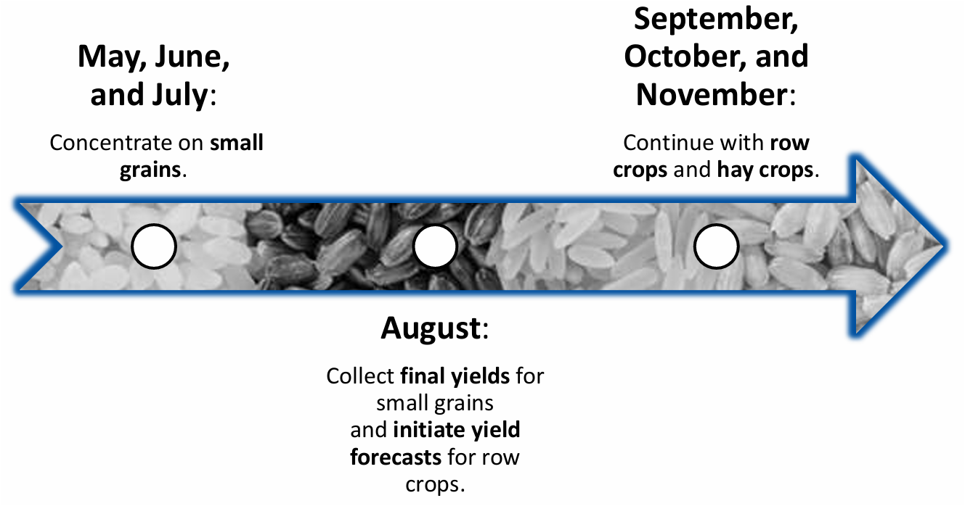
October Ag Yield
October is the third month we’ll ask about row crops. Crops vary by state and can include corn, sorghum, soybeans, cotton, peanuts, and rice as well as information on hay & forage crops.
October Ag Yield training materials can be found HERE

Slide 4
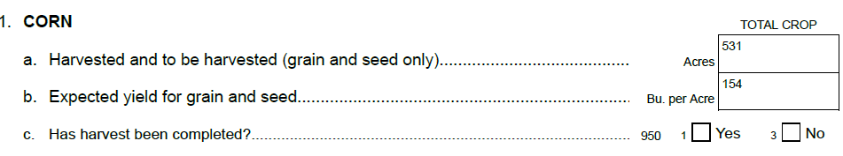
October Ag Yield
Each crop asks for acreage, expected yield, and harvest status.
TIPS
If bales are reported, MUST obtain weight. Record hay YIELD/ACRE, not total production.
If a yield is reported as a range, calculate the average and record that
If yield
or harvest
is a valid zero, leave a note. (Harvested for silage, hay, grazed, weather event, insects. etc.)

Slide 5
October Citrus
The October Citrus Production Survey is conducted quarterly in AZ, CA, FL and TX.
Citrus Fruits of Interest (vary by state)
Valencia Oranges popular and sweet; the premier choice for orange juice.
Mandarins smaller and slightly flattened like a pumpkin.
Mandarin Hybrids (tangerines/tangelos) a small, sweet reddish-orange variety with easy-to-peel skin.
Grapefruit large tart hybrid of the orange and the pummelo.
Pummelos a sweeter grapefruit, lacking the bitter tart notes of traditional ones.
October Citrus Training Materials can be found HERE

Slide 6
October Citrus – Tips and Tricks
For each citrus crop we ask the same questions:
Total Acres
Total acres must be equal to or greater than bearing age acres.
Bearing Age Acres
All acres of bearing age should be recorded even if they did not produce a crop during the current growing season due to freeze damage, disease, drought, etc.
Expected Production
obtain expected production for the current year, not actual production from the previous crop year.
Pay close attention to the unit reported and obtain weight per unit if reporting boxes, bushels etc.

Slide 7
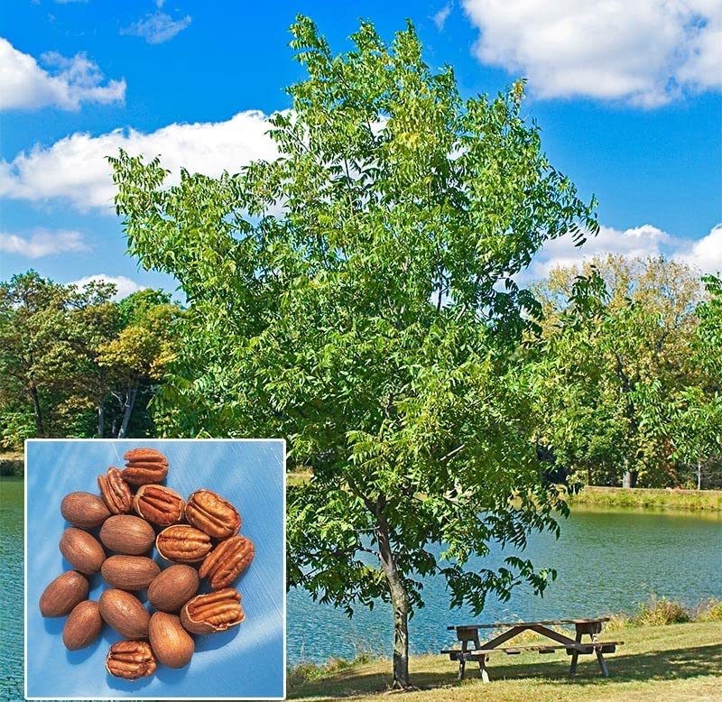
Pecan Acreage and Production
NDC Website –HERE
Acreage: If trees are scattered in a pasture, get the best
estimate of tree acres and not pasture acres.
Production: Asking Total Production – typically reported in pounds.
Calling 5 states (two questionnaire versions)
  Improved Varieties- these trees are the result of careful grafting and budding. Planted in managed, cultivated groves. Meatier w/ a nicer appearance.
  Native Varieties-growing wild, usually unattended and not cultivated.

Slide 8
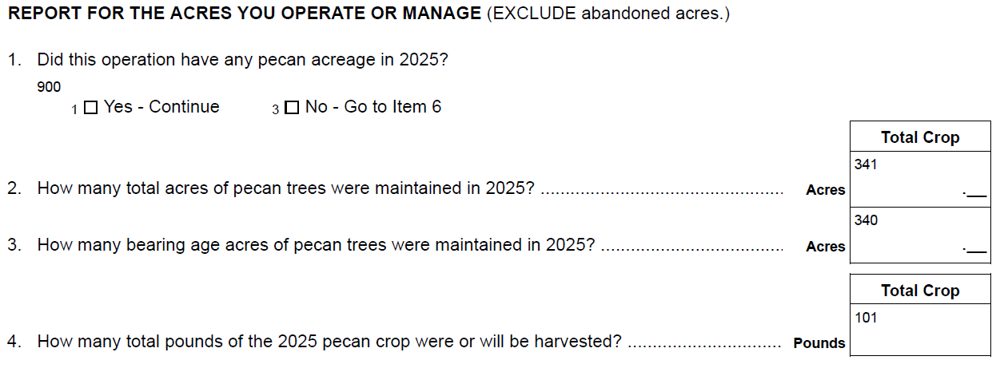
Pecan A&P Questionnaire Version 1: AZ, GA, NM

Slide 9
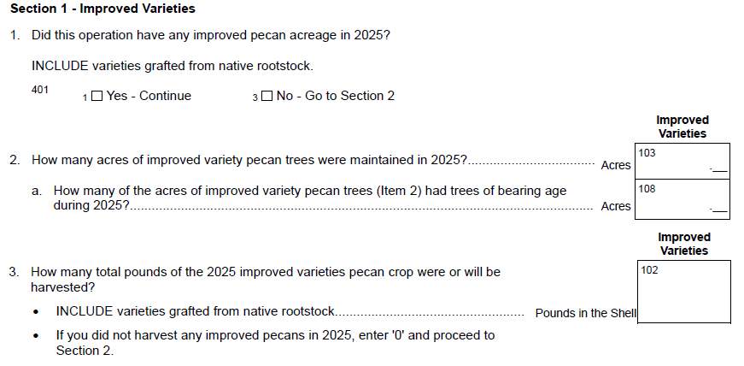
Pecan A&P Questionnaire Version 2: OK, TX
Section 2 – Wild Native Varieties
***SAME Questions***

Slide 10
Milk Production Survey-Tips and Tricks
Questions on the Milk Production Survey will vary based on month and state. There are three different state versions of the questionnaire.
Questions | January | April | July | October
Milk Cow Inventory and Production on the 1st of the month | √ | √ | √ | √
Milk Disposition |  | √ |  | √
Heifer Replacement Prices | √
Corn Silage Values |  |  |  | √
Hay Prices | √ | √ | √ | √
Milk NDC Website - HERE

Slide 11
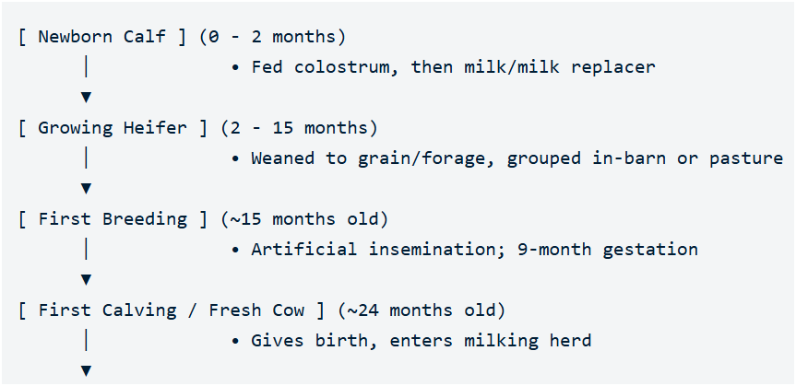
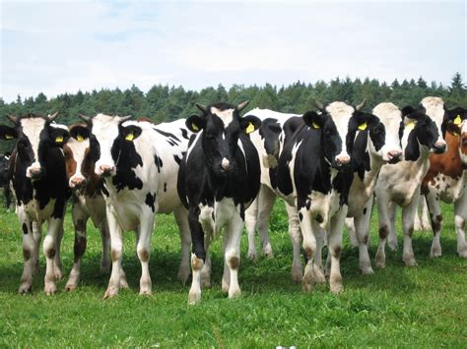
Milk Production – Dairy Life cycle

Slide 12

Milk Production –Lactation Cycle
Early Lactation (Days 1 - 100) Milk yield peaks at 40-70 days Re-bred via AI (~85 days)
Late Lactation (Days 201 - 305) Milk production gradually tapers down
Dry Period (Days 306 - 365 (Final 60 Days) Milking stops; cow rests to build body condition
Mid Lactation (Days 101 - 200) Steady milk production; pregnancy progresses

Slide 13

Quarterly Colony Loss
Information Sheet on NDC Website: HERE
Familiarize yourself with the terminology in the link.
Different than typical surveys.
The purpose of the survey is to monitor the impact diseases are having on the bee population. (Disease questions are not asked on the Annual Bee & Honey Survey.)
Commercial beekeepers operate migratory businesses moving their bees across the country to follow different growing seasons. Collecting accurate data can be challenging with this constant movement of bees.
Follow the instructions closely!!!
Make good notes!!!

Slide 14
Quarterly Colony Loss Outline
3. Colonies by State
Be familiar with “requeening”, “nucs” and “packages”
4. Colonies Lost
Must exhibit all 4 symptoms listed
2. Colonies Owned
1. Screening
5. Colony Health by State
Measures impact of Varroa mites, other pests, diseases, pesticides.
9. Contact Info
7. Change In Operator
6. Comments
8. Conclusion

Slide 15
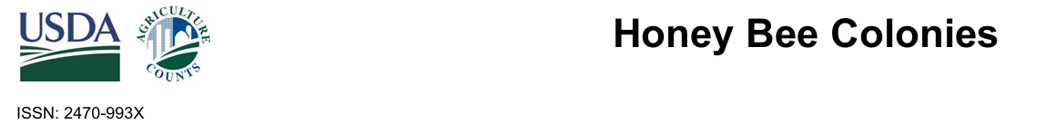
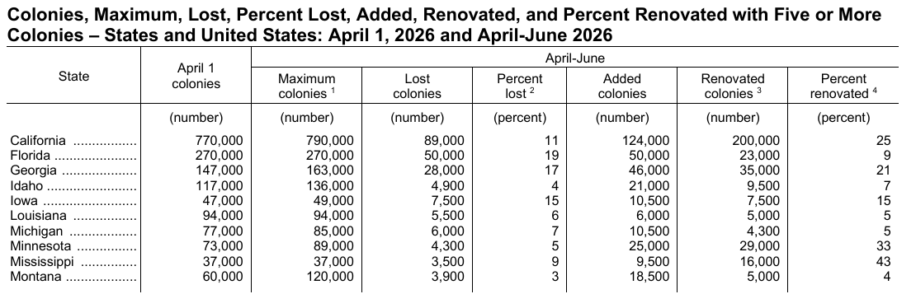
Last Quarter’s Release

Slide 16
Callers Corner – NASS vs FSA Data Requests
Tools
Farmers are often frustrated that they’re asked to report to both NASS and FSA.
Let’s compare the purpose and benefits of both NASS and FSA data requests, how they differ, and why they aren’t (currently) combined.

Slide 17
Callers Corner – What Does NASS Do?
Tools
NASS produces and disseminates unbiased statistical information on an equitable, impartial, and transparent basis.
NASS does not set policy, regulate activities, permit influence, disclose individual reports, favor any group above others.

Slide 18
Callers Corner – What Does FSA Do?
Tools
FSA supports American agriculture by providing:
Farm Loans: Makes direct and guaranteed loans to beginning, family-size, or limited-resource farmers who cannot get standard commercial credit.
Disaster Assistance: Provides financial relief and emergency support to ranchers and growers after natural events like droughts, floods, and wildfires.
Commodity Programs: Administers price support and market stability programs to protect farm income from sudden market drops.
Conservation Efforts: Manages land protection initiatives, including the Conservation Reserve Program (CRP) to safeguard vulnerable soil and water.

Slide 19
Callers Corner – How Do NASS & FSA Use Each Other’s Data?
Tools
NASS utilizes aggregated FSA administrative data to complement and refine its final crop reports.
FSA depends on NASS State and County Data to determine crop loan rates and to determine disaster payments. (The Row Crop CAPS you’ll collect data on supplies this data)

Slide 20
Callers Corner – What Does FSA Do?
Tools
How do Farmers participate in FSA programs?
1. Farmers visit a local USDA Service Center and complete baseline paperwork on their farm.
2. They then report their crop acreage, failed acreage, and prevented planted acreage seasonally to ensure and maintain program eligibility. Referred to as the Crop Acreage Report*, the deadline for reporting varies by state and county but in general is around July 15th.
*When producers tell NASS they “already gave the data to FSA and to get it from them”, their Crop Acreage Report is what they are typically referring to.

Slide 21
Callers Corner – Why Do We Need Both?
Tools
NASS and FSA cannot fully merge their data collection efforts because of strict federal confidentiality laws and completely different operational mandates.
A complete merger of their primary data collection is blocked by several critical legal, structural, and methodological barriers. We’ll quickly touch on those differences in the next few slides.

Slide 22
Callers Corner – NASS vs FSA Data
Tools
Legal Barriers and Strict Confidentiality
NASS data is strictly protected under the Confidential Information Protection and Statistical Efficiency Act (CIPSEA)which forbids sharing any identifiable, raw producer data with any other entity, including other USDA agencies, for regulatory or administrative purposes.
NASS data is legally shielded from subpoenas and Freedom of Information Act (FOIA) requests.
Conversely, FSA data is administrative and subject to different disclosure rules for verifying program compliance.

Slide 23
Callers Corner – NASS vs FSA Data
Tools
Differing Scopes and Populations
NASS is mandated to measure the entire agricultural economy.
FSA only collects data from producers who actively enroll in USDA farm programs, such as Price Loss Coverage (PLC) or disaster assistance. FSA records do not cover 100% of U.S. agricultural land or collect any livestock data.

Slide 24
Callers Corner – NASS vs FSA Data
Tools
Different Timelines
Commodities markets rely on NASS to provide early, objective supply-and-demand estimates (like the June Acreage Report) to establish transparent pricing.
FSA certified acreage reporting deadlines occur later in the summer, and data is continuously updated as compliance paperwork is processed.
Relying strictly on FSA data collection timelines would leave the market blind during critical early-season price discovery windows.

Slide 25
Callers Corner – NASS vs FSA Data
Tools
Methodological and Definitional Variations
Tracking differences: The two agencies define and categorize land use differently.
Prevented vs. planted crops: FSA tracks "prevented planting" and "failed acres" specifically to calculate insurance and program payouts.
Subjective bias: Farmers may face financial incentives to report higher acreages to the FSA to maximize program benefits.
Statistical smoothing: NASS uses mathematical models to smooth out reporting biases and provide an objective look at overall crop realities.

Slide 26
Current Events Impacting our Farmers
NASS Data Modernization Plan
This September USDA Secretary Rollins has unveiled the plan to put Farmers First, reduce unnecessary burdens on producers, and improve the timeliness, accuracy, and usefulness of the agricultural data that informs decisions across American agriculture. (Part of this is to attempt to reduce reporting by farmers across different agencies.)
Notes:
These are not meant to encourage political discussion, rather to make enumerators aware of sensitive issues and challenges the farmers and ranchers may be currently facing.

Slide 27
Current Events Impacting our Farmers
Farm Bill Status
The House passed its version on April 30th
The Senate Ag Committee advanced their version Sept 16th
The Bill is debated and voted on by the full Senate.
Leaders from both chambers merge and reconcile the two version.
The full House and Senate pass the final combined version.
The Bill goes before the President for signing.
NASDA remains committed to continued collaboration with the U.S. Senate to bring the legislation across the finish line.
Notes:
These are not meant to encourage political discussion, rather to make enumerators aware of sensitive issues and challenges the farmers and ranchers may be currently facing.

Slide 28
Current Events Impacting our Farmers
US-Canada Trade Conflict
Following a breakdown in trade talks, the Trump administration imposed a 50% tariff on roughly $20 billion worth of Canadian goods, prompting Canada to retaliate with equivalent import taxes on American products. Farmers are caught in the crossfire, expecting a squeeze on both their supply costs and overall sales.
Notes:
These are not meant to encourage political discussion, rather to make enumerators aware of sensitive issues and challenges the farmers and ranchers may be currently facing.

Slide 29
Questions

