Slide 1
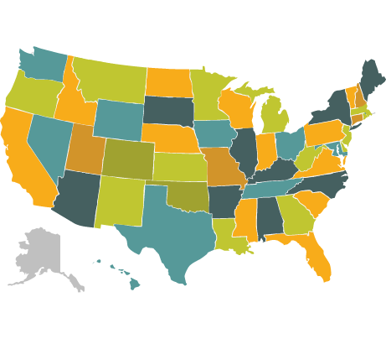
Incoming Telephone Call Training

Slide 2
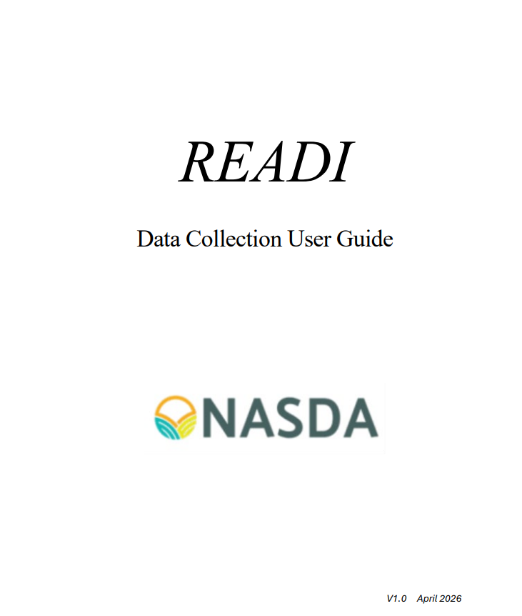
READI Manual
The READI Manual can be accessed on the NDC website below:
  https://www.nasda.org/wp-content/uploads/2026/08/READI-Manual-V2.0-Final.pdf
This manual provides enumerators with essential technical and operational guidance required to securely access and efficiently navigate the READI Platform.
The READI Manual can be HERE

Slide 3
Why the READI Manual is Necessary
Subject Areas | Functions
System Integration | Teaches enumerators how to use NASS software combined with Zoom calling.
Security Compliance | Helps guide enumerators through the mandatory Login.gov authentication process.
Data Accuracy | Helps ensure consistent collection of calling metrics and survey data.
Role-Specific Focus | Helps filter out complex management features to prevent user confusion.
Quality Assurance | Details various protocols required for call monitoring and recording.

Slide 4

What is ITC?
The Incoming Telephone Call (ITC) module within the READI platform that handles inbound communication and data collection.
ITC is fundamentally about Customer Service, the quality of each call can leave a lasting impression.
ITC handles questions or concerns from those calling in.
ITC ensures professional and reliable support for our "customers", the farmers of America.
ITC represents the voice of USDA Ag Statistics.

Slide 5
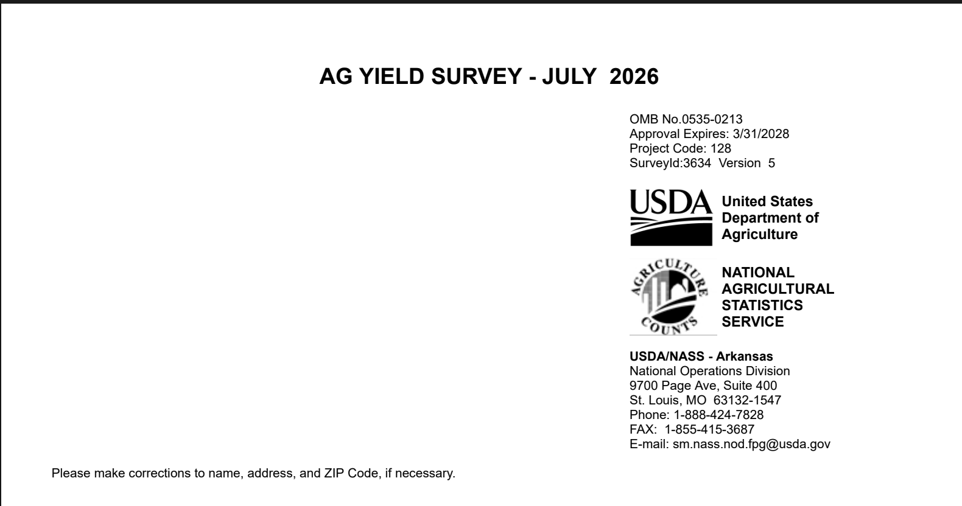
Where Can Operators Find the ITC Number?
ITC Phone number
1-888-424-7828
The ITC phone number can be found on the front of the paper survey.

Slide 6

Why Call ITC?
They need help understanding the survey.
They want to report their information.
They have questions or concerns.
They believe the information is personally beneficial.

Slide 7
What Does an Enumerator Do?
Contact agricultural producers
Conduct interviews using approved questionnaires
Record accurate responses
Maintain professionalism
Protect confidential information
Meet quality standards
Represent USDA and NASDA

Slide 8
The Enumerator’s Role
You Are NOT
❌ Offering opinions
❌ Giving farming advice
❌ Changing survey wording
❌ Guessing responses
❌ Sharing respondent Information
You Are
✔ Professional
✔ Accurate
✔ Respectful
✔ Patient
✔ Objective
✔ Trustworthy

Slide 9

Your Voice is Your Passport
Tone of voice:
  Inflection/Pitch
    Varied
    Animated
  Rate
    Too fast – Feel rushed
    Too slow – Cause impatience
    Match rate to respondent
Clarity of speech:
  Enunciation
    Articulate
  Pronunciation
    Familiarize
    Practice
  Show them your personality and let them hear your smile!

Slide 10
What do Operators Hear?
Thank you for calling the Department of Agriculture.
USDA National Agriculture Statistic Service NASS survey help line.
Press
1- For instructions, completing your USDA NASS survey online.
2- For information on confidentiality of the information your report to NASS
3- For information about the report that NASS released
4- For information about the Census of AG
5- For all other questions press 0 (zero)
To speak with an agent press 0, Thank you.
This call will be monitored.

Slide 11
Who Staffs ITC?
Function | Purpose
Scheduling | The ITC manager creates employee schedules during the second week of each pay period after the enumerators complete the iSolved scheduler.
Staffing | Staffing levels vary based on the number of active surveys, workload, and operational needs.
Supervision | The ITC manager oversees scheduling, daily operations, coaching, productivity, and staff performance.
Ramp-Up Periods | Additional staff are scheduled during large surveys and the Census of Agriculture (CoA) to meet increased workload demands.

Slide 12
ITC Low Call Volumes

Slide 13
ITC High Call Volumes

Slide 14
Calls by Reason Example
The Calls by Reason report categorizes inbound calls based on the primary reason respondents contact the NDC.
This report helps managers identify common inquiry types, monitor trends, and ensure staff are prepared to address respondents' needs effectively.
As an ITC enumerator, it is important to understand what reports are produced from the surveys that are conducted and why that data is useful.

Slide 15
ITC + Outbound Calling = A Flexible Workforce
By cross-training enumerators to handle both ITC and outbound calling, the workforce remains adaptable.
As inbound demand decreases, enumerators can seamlessly transition to outbound interviewing, ensuring that available work hours continue to support USDA-NASS's mission of collecting high-quality agricultural data.

Slide 16
Benefits of Working Outbound Calling and ITC
Maintains consistent productivity throughout the workday.
Maximizes the use of paid enumerator time.
Helps surveys stay on schedule and meet data collection deadlines.
Provides flexibility to adjust staffing based on changing workload demands.

Slide 17

What Type of Data do We Collect?
  USDA’s National Agricultural Statistic Service (NASS) collects objective, unbiased agricultural data to provide an accurate picture of U.S. agriculture.
  This information helps farmers, ranchers, businesses, researchers, policymakers, and the public make informed decisions.

Slide 18
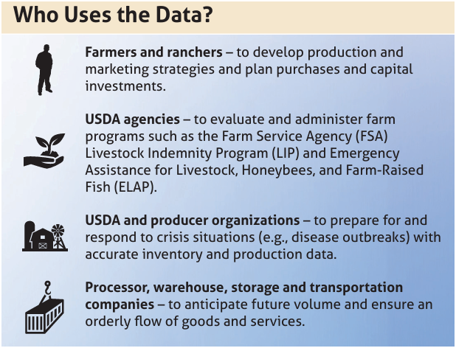
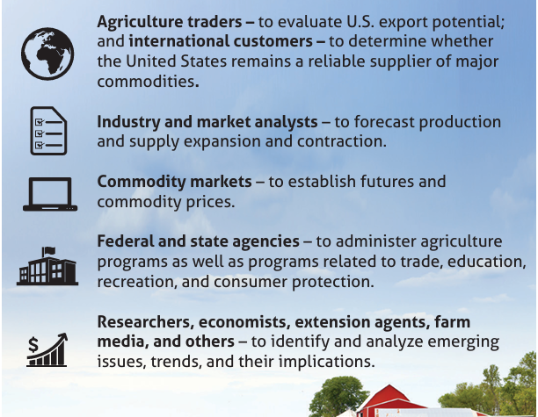
Who Uses the Data?

Slide 19
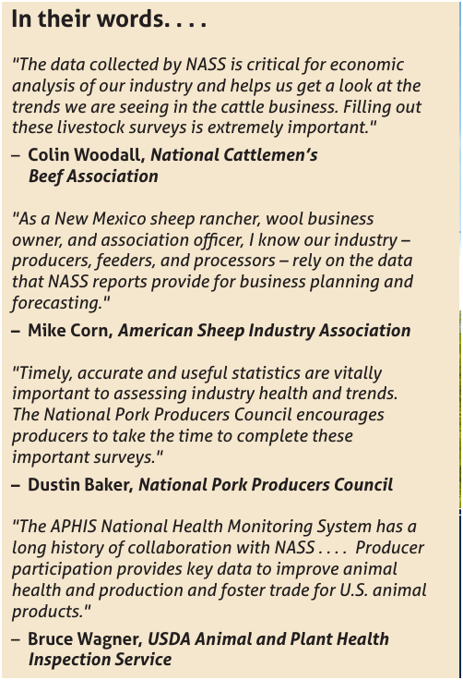
Testimonials
Did you know you'd be collecting data on a variety of commodities including catfish, bees and honey, vegetables, fruits, nuts, cattle and even maple syrup?
NASS reports cover a wide variety of agriculture commodities.
Here are a few quotes from some of our data users.

Slide 20
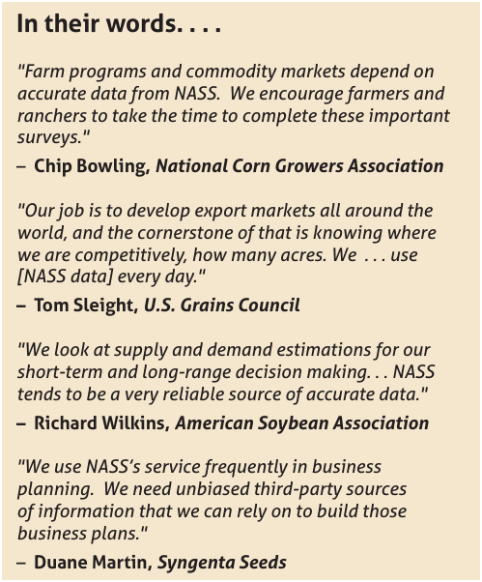
Uses of the Data
As an ITC enumerator, it is important to understand what reports are produced from the surveys that are conducted and why that data is useful.

Slide 21
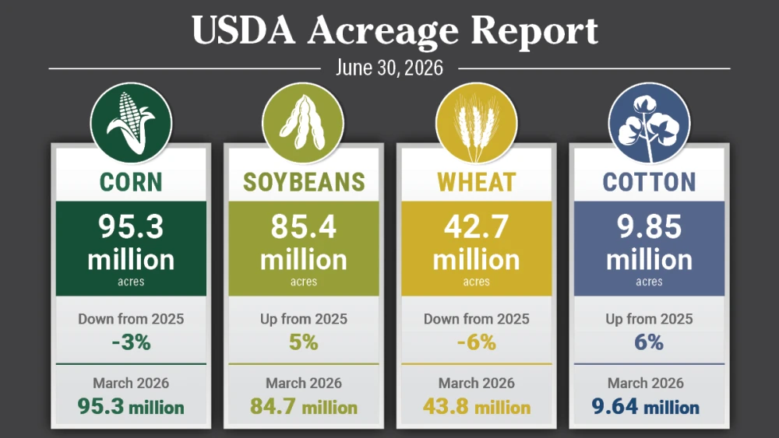
Why This Data Matters?
Helps farmers make planting and marketing decisions
Informs USDA farm programs
Supports crop insurance
Guides agricultural research
Monitors the nation’s food supply
Provides reliable statistics
Ensures agricultural markets have accurate, objective information

Slide 22
Major Data Categories
Categories | Examples | Information Collected
Crops- Collects information about field crops grown for food, feed, fiber, and fuel. | Corn, Soybeans, Wheat, Cotton, Rice, Peanuts, Hay | Acreage, Crop progress, Crop condition, Production, Yield
Livestock- Collects information about animals raised for food, fiber, and other agricultural products. | Beef cattle, Dairy cattle, Hogs and pigs, Sheep and goats, Chickens, Turkeys, Honeybees | Number of animals on hand, Animals born/sold/marketed, Death losses, & Production (milk, eggs, wool, honey, etc.)
Specialty Crops- This includes fruits, vegetables, nuts, nursery products, and horticultural crops. | Apples, Peaches, Strawberries, Tomatoes, Potatoes, Pecans, Almonds, Grapes, Greenhous flowers, Nursery plants | Acreage, Production, Yield, Utilization, Prices received, Inventories

Slide 23
Crop Information Breakdown
Category | Examples | How This Helps?
Progress- measures how far along a crop is during the growing season. | Percent planted, Percent emerged, Percent blooming, Percent setting fruit, Percent harvested | This information helps track whether crops are developing ahead of, behind, or on schedule.
Acreage- determines how much land is being used for agricultural production. | Acres intended to plant, Acres actually planted, Acres harvested, Prevented planning, Acres abandoned | This information helps estimate future production.
Yield- measures how productive the land was, not just how much was grown overall. | Bushels to the acre, Pounds per acre, Tons per acre, Hundredweight (cwt) per acre | This information helps estimate total crop production, monitor crop performance, measure the effects of weather, support farmers’ decisions, inform agricultural markets, guide government programs, and strengthen food supply planning.
Disposition-refers to what happens to an agricultural commodity after it is produced. | Sold for market, Fed to livestock, Stored on the farm, Used for seed, Processed, Exported, Used for personal or family consumption, Lost or discarded | This data helps show where agricultural products go after harvest or production.

Slide 24
Types of Surveys and Releases
National Agricultural Statistics Service (NASS) conducts hundreds of surveys every year and prepares reports covering virtually every aspect of U.S agriculture.
Nass conducts weekly, monthly, quarterly, annually and even 5-year surveys.
Let's look at a few examples of surveys NASDA enumerates for NASS and the reports created from that data.

Slide 25
Every 5 Years- The Census of Agriculture
By far the biggest undertaking at NASS is the Census of Agriculture. It is a complete count of the U.S. farms and ranches and the people who operate them. Even small plots of land (whether rural or urban) count if $1,000 or more of such products were raised and sold, or normally would have been sold, during the census year.
The Census of Agriculture looks at land use and ownership, operator characteristics, production practices, income and expenditures.

Slide 26
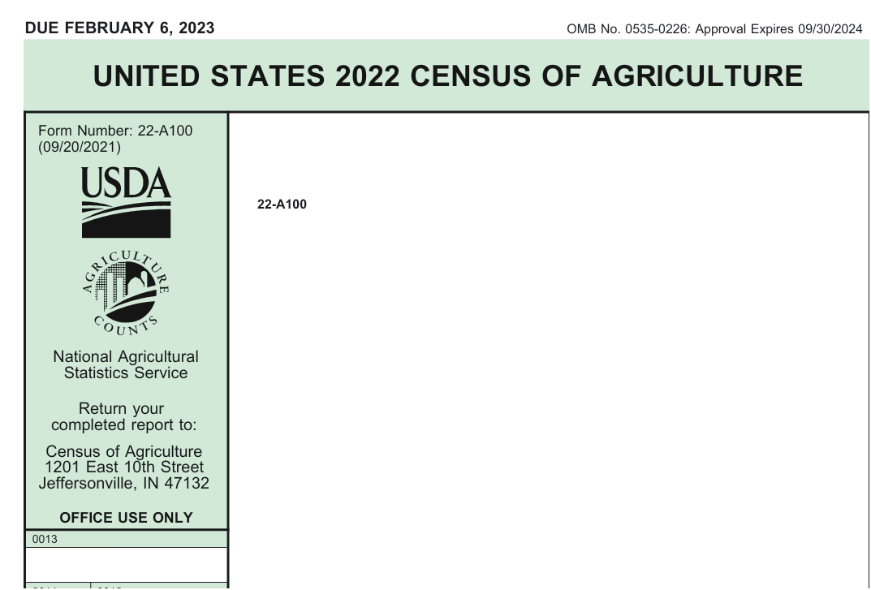
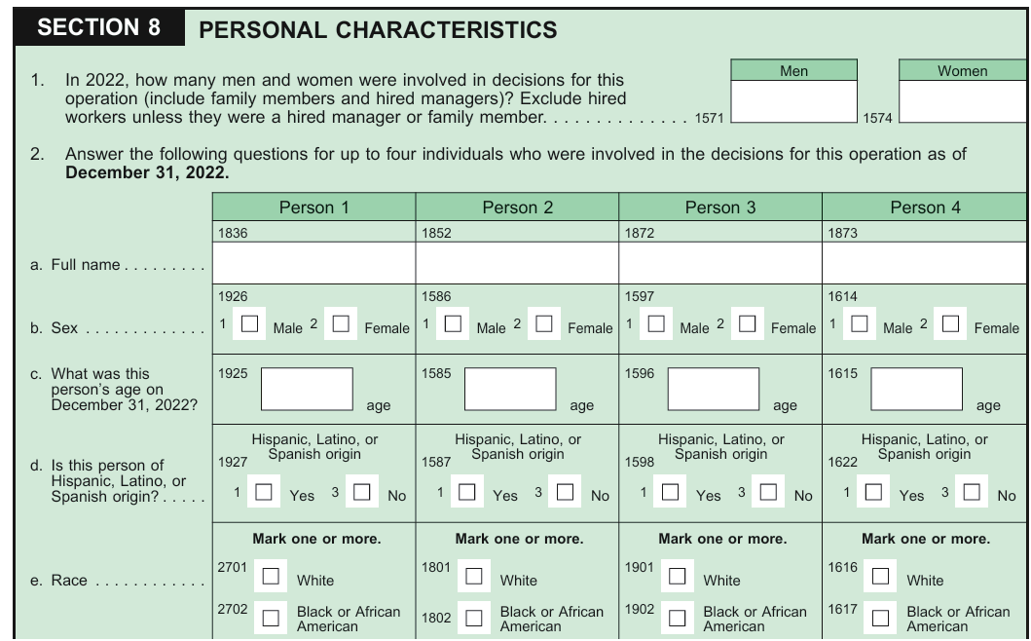
The Census of Agriculture Example

Slide 27
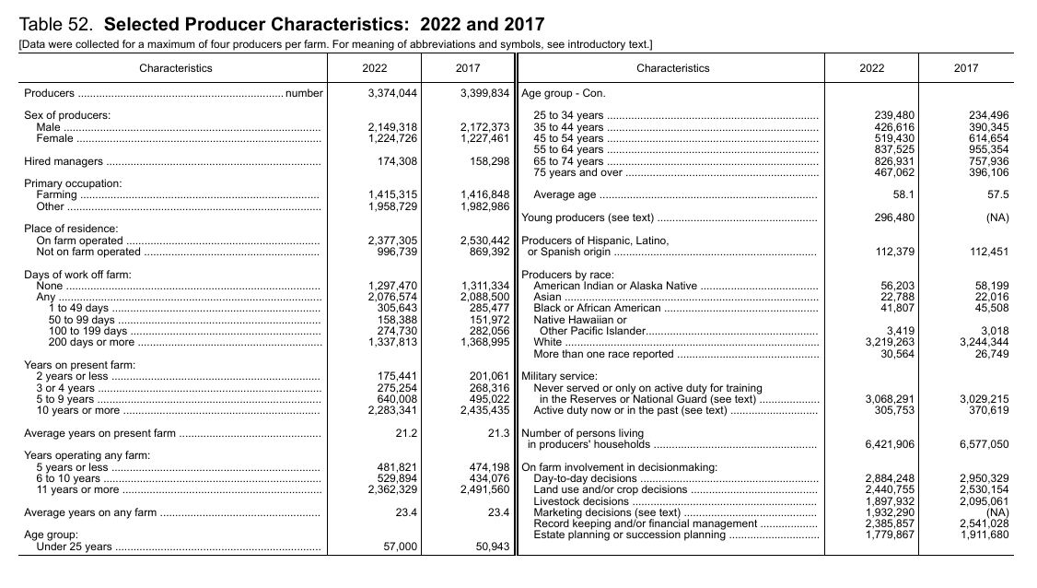
The Census of Agriculture Results Example

Slide 28
Quarterly-Agricultural Surveys
The Quarterly Ag Survey is used to provide accurate estimates of planted and harvested acres, yields and production for various crops, as well as the amount of grain in storage.
The Crop production report developed from this survey is one of the most read reports as NASS.
The survey is conducted in March, June, September and December and will be one of the heaviest calling and ITC times or year.

Slide 29
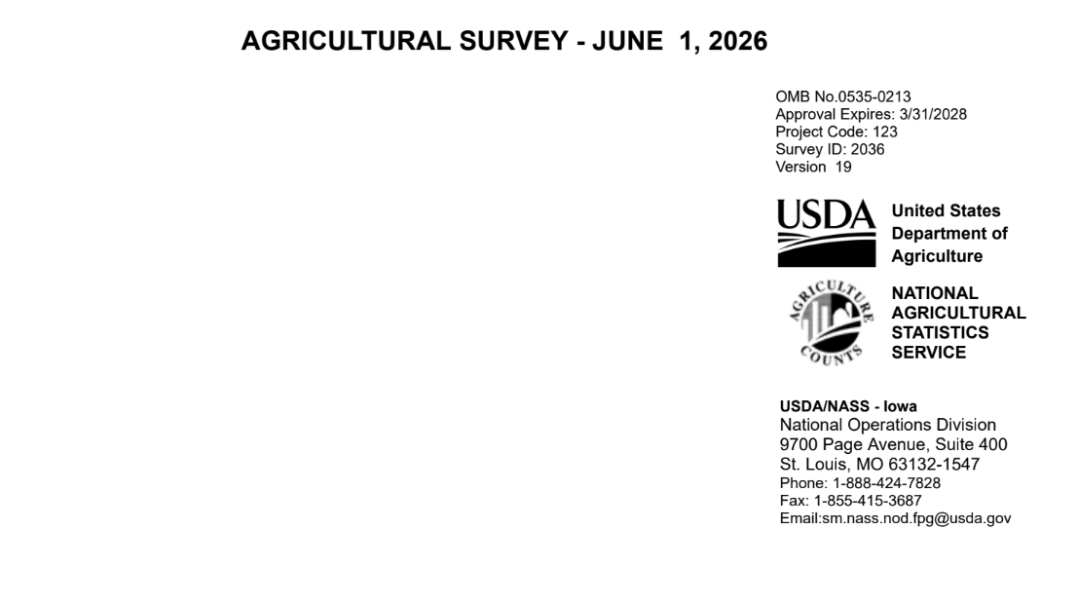
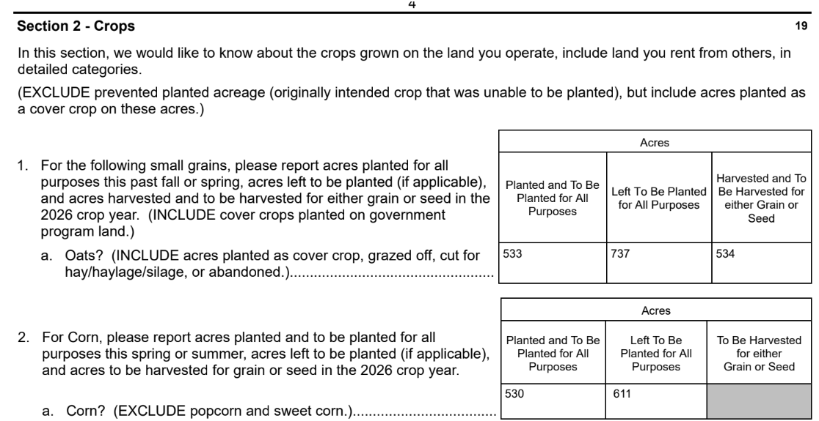
Quarterly- Agricultural Surveys Example

Slide 30
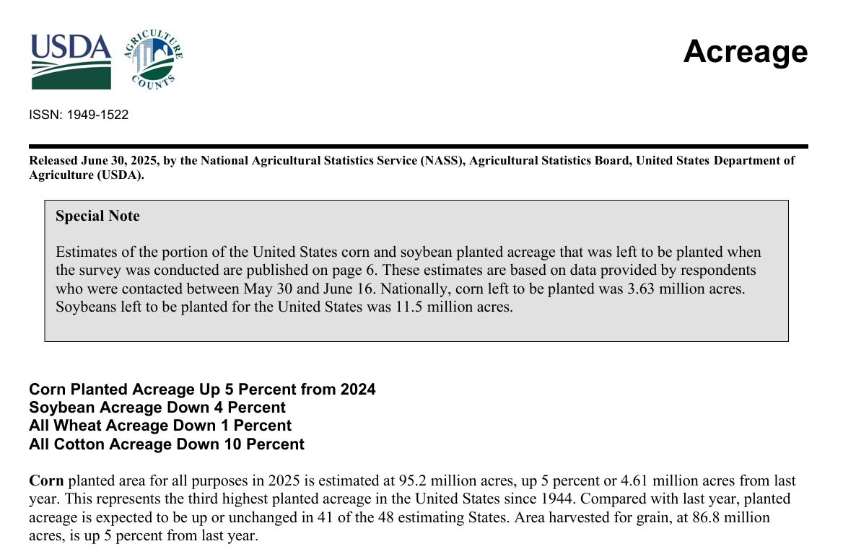
Quarterly- Agricultural Survey Results Example

Slide 31
Monthly- Cattle on Feed
The Cattle on Feed survey provides estimates of the number of cattle being fed a ration of grain, silage, hay and/or protein supplements for the slaughter market that are expected to product a carcass that will grade select or better.
The survey is conducted in the 16 largest cattle-feeding states. About 2,000 known cattle feeders with a capacity of 1,000 or more head are enumerated.

Slide 32
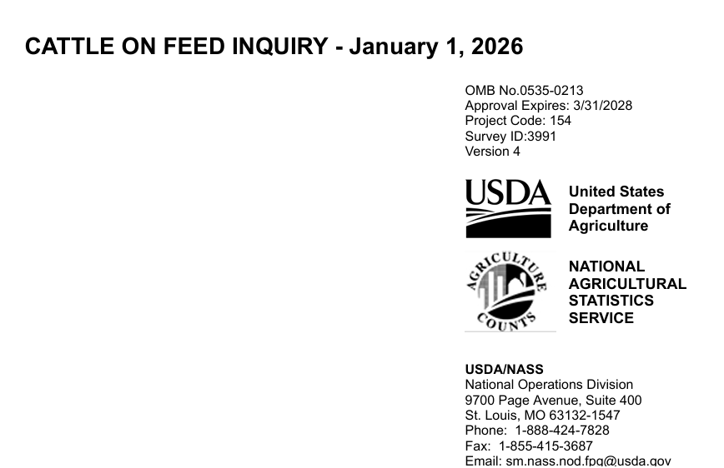
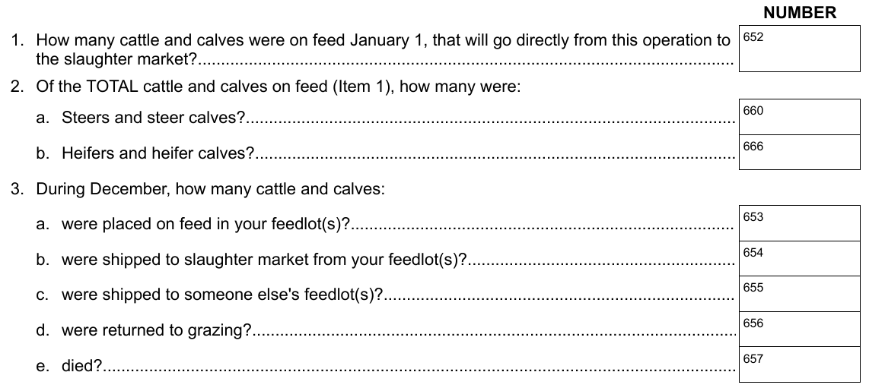
Monthly- Cattle on Feed Survey Example

Slide 33
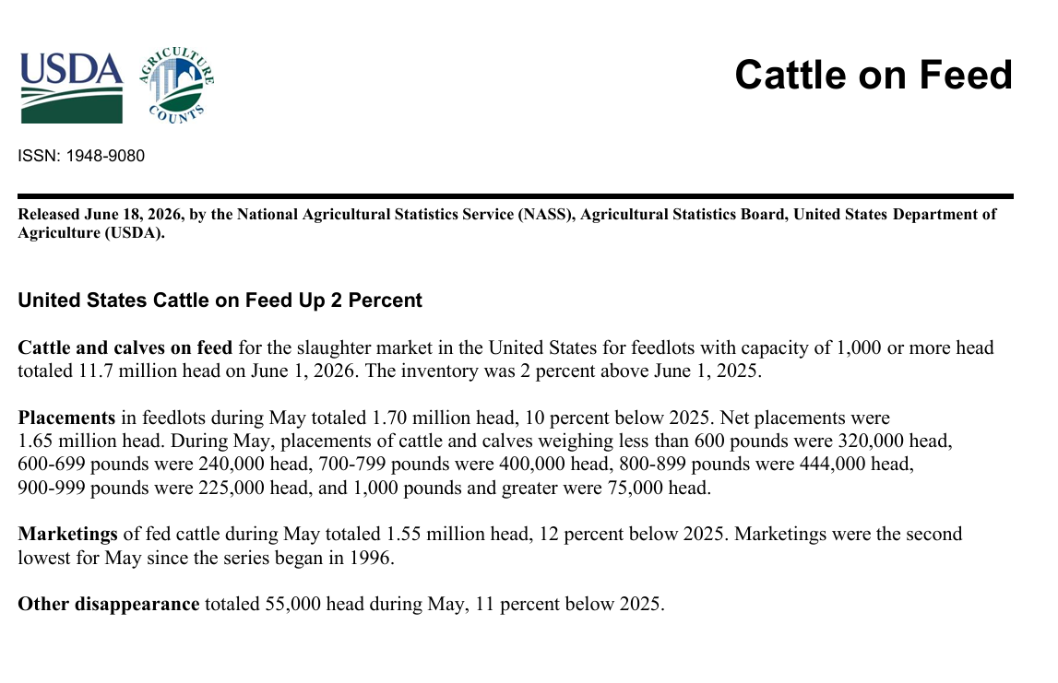
Monthly- Cattle on Feed Survey Results Example

Slide 34
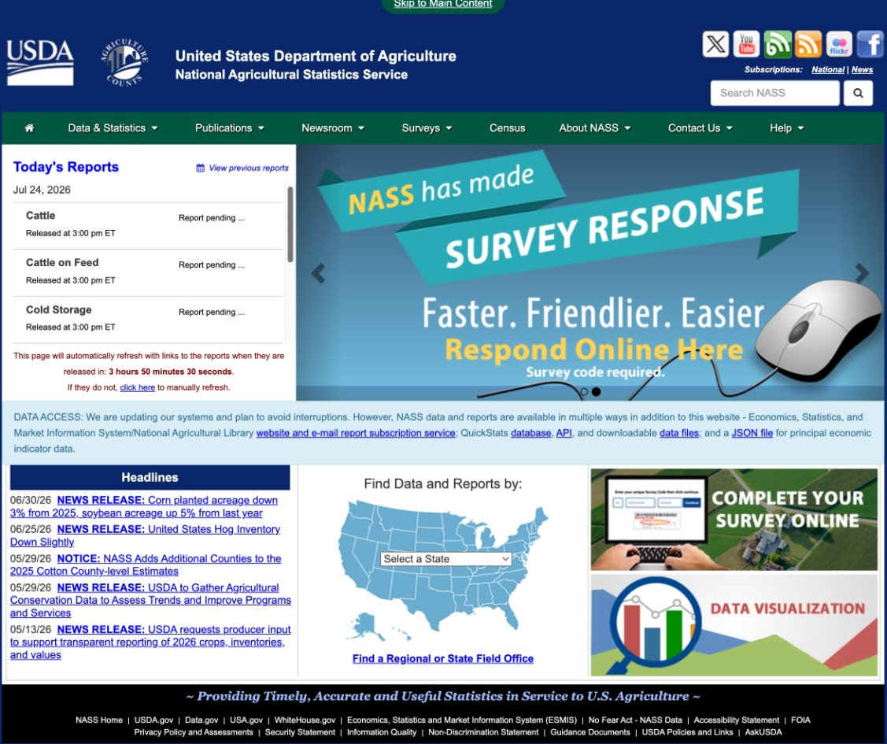
National Agriculture Statistic Service (NASS)
www.nass.usda.gov

Slide 35
NASS Website
National Agricultural Statistic Service, NASS conducts hundreds of surveys every year and prepares reports covering every aspect of U.S agriculture.
Examples include, but not limited to:
  Production and supplies of food and fiber
  Prices paid and received by farmers
  Farm labor and wages
  Farm finances
  Chemical use
  Changes in the demographics of U.S. producers
NASS is committed to providing timely, accurate, and useful statistics in service to U.S. agriculture.

Slide 36
NASS Website Navigation
Selections | Results
Data & Statistics | The quick stats database is the most comprehensive tool for accessing agricultural data published by NASS. It allows you to customize your query by commodity, location, or time period
Publications | NASS and Additional reports and Historical publications
Newsroom | New releases, videos, ASB (Ag Statistics Board) notices and briefing
Surveys | Respond to survey online
Census | Census of Agriculture data
About NASS | Structure and Organization, Guiding Principles, Civil Rights, work at NASS, Educational and Outreach, History and Procedures
Contact Us | NASS contact information
Help | Technical Issues, Search Tip and for developers and Data Users.

Slide 37
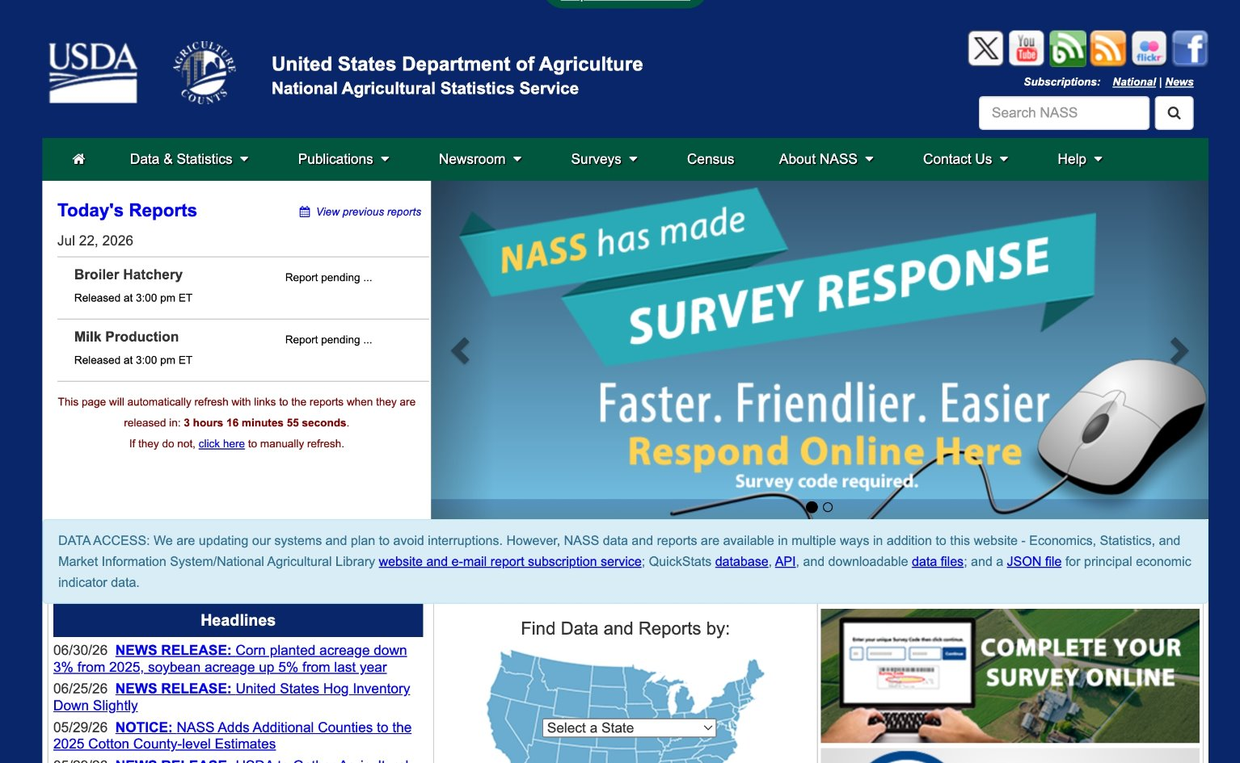
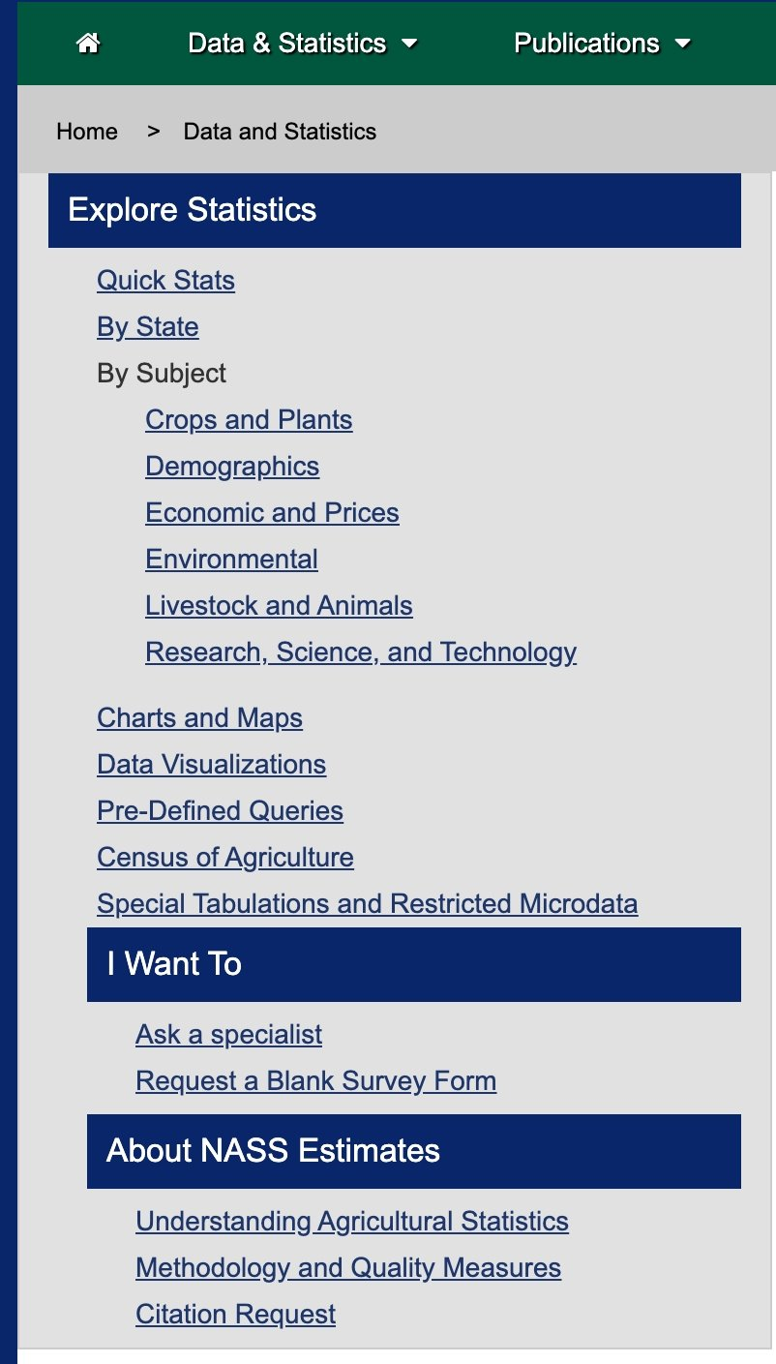
Data and Statistics Selection
Quick Stats is located under the Data & Statistics tab. The caller can search by state or subject.
The caller has the options to email a specialist if needed.

Slide 38
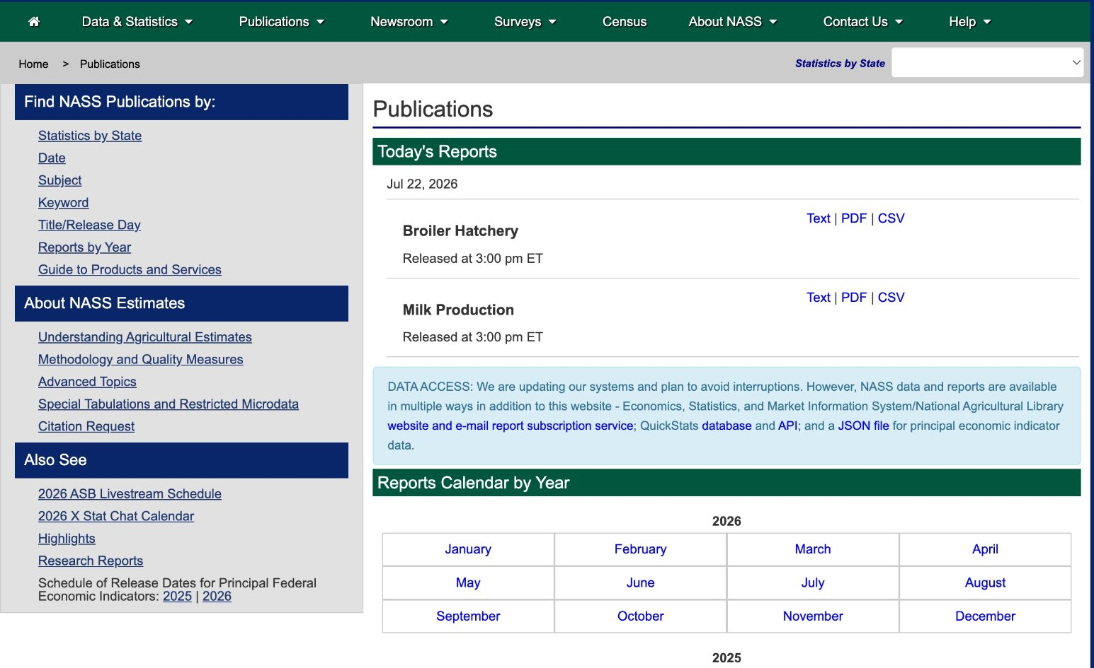
NASS Publications
Nass publications provide timely, accurate, and objective data about U.S agriculture. These reports support decision-making for farmers, agribusiness, policymakers, researchers, and the public.

Slide 39

Guide to Products and Services
The Fact Finders is located under the Publications tab.

Slide 40
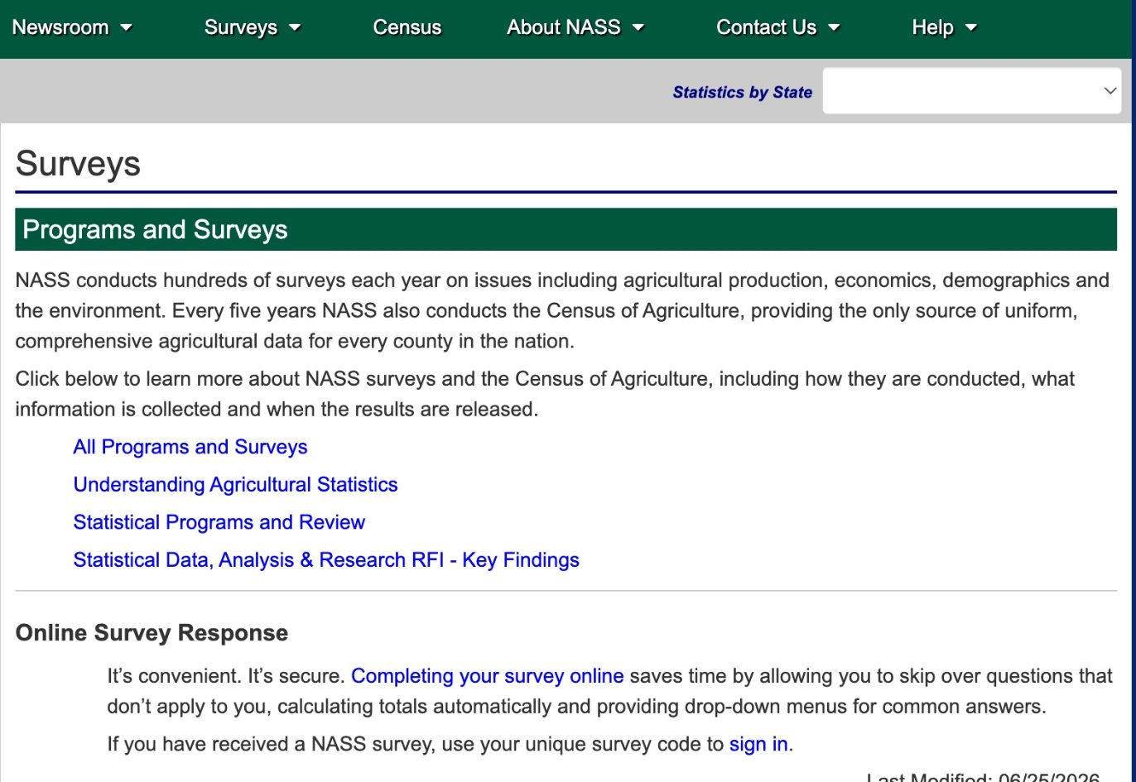
Completing a Survey Online
Under the survey option, the operator can select, Completing your survey or sign in to enter the survey code.
You can also provide the website www.agcounts.usda.gov

Slide 41
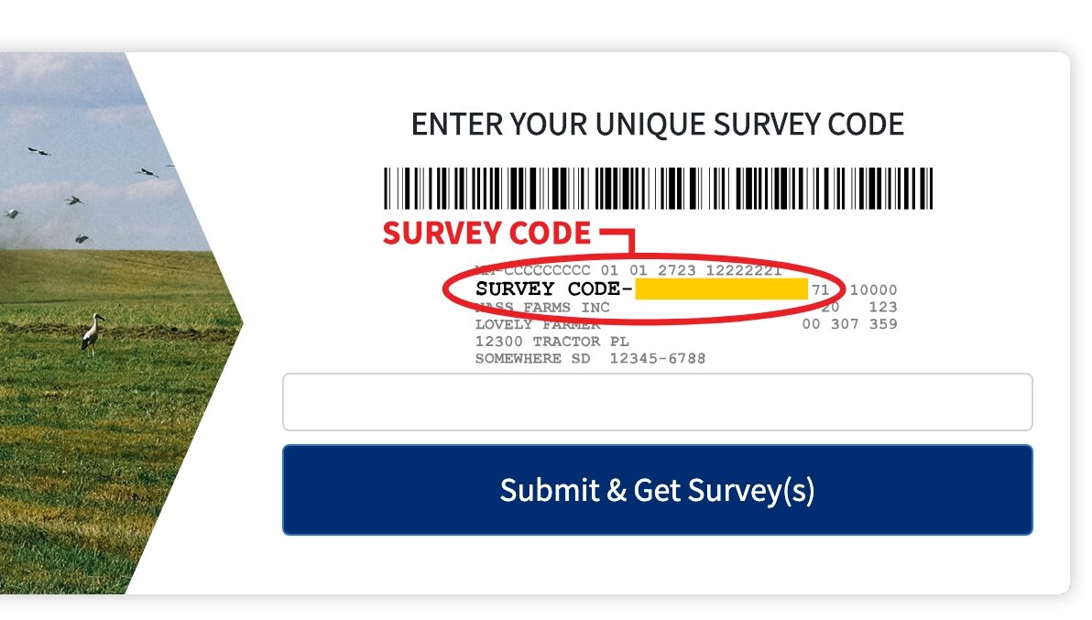
Survey EDR Code
The Survey/EDR code is located below the bar code on a questionnaire.
The EDR code has 6 numbers and 6 letters.

Slide 42
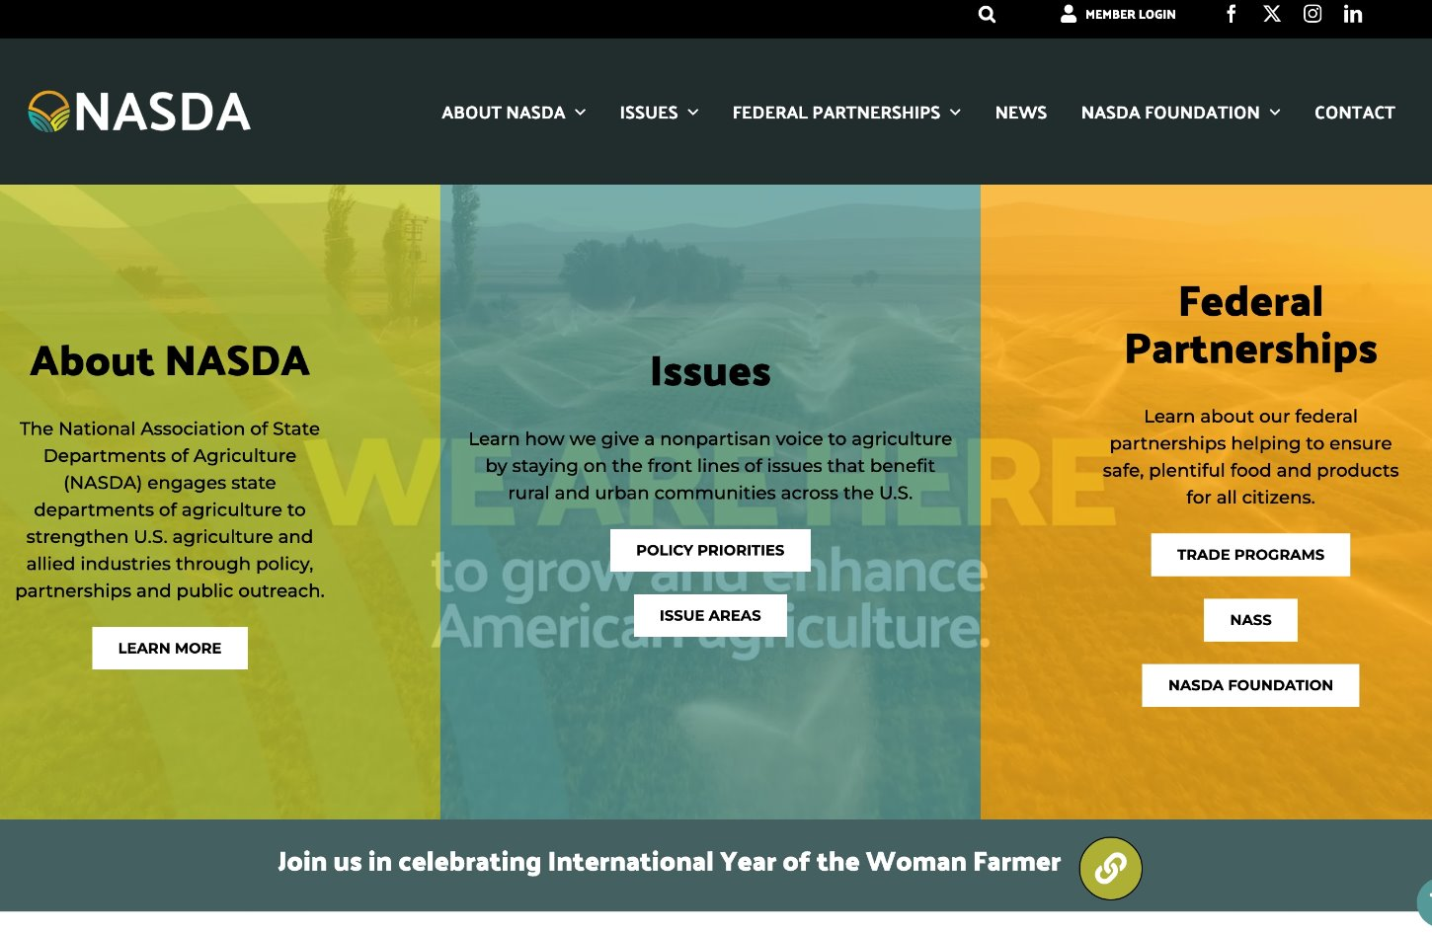
National Association of State Department of Agriculture (NASDA)
www.nasda.org

Slide 43
NASDA Website Navigation
Selections | Results
About NASDA | NASDA Members, State Agriculture Departments, NASDA Staff, Our Partners, Affiliates, Events, Regional Associates and Diversity and conclusion at NASDA
Issues | 2026 Policy Priorities, Farm Bill, Issue Areas, NASDA Policy Statements and Letters, Comments & Testimonies
Federal Partnership | International Trade Programs and NASS
News | News/Articles
NASDA Foundation | Project, Programs, Resources About US and Foundation
Contact | Operator can complete form for NASDA newsletter and obtain NASDA contact information

Slide 44
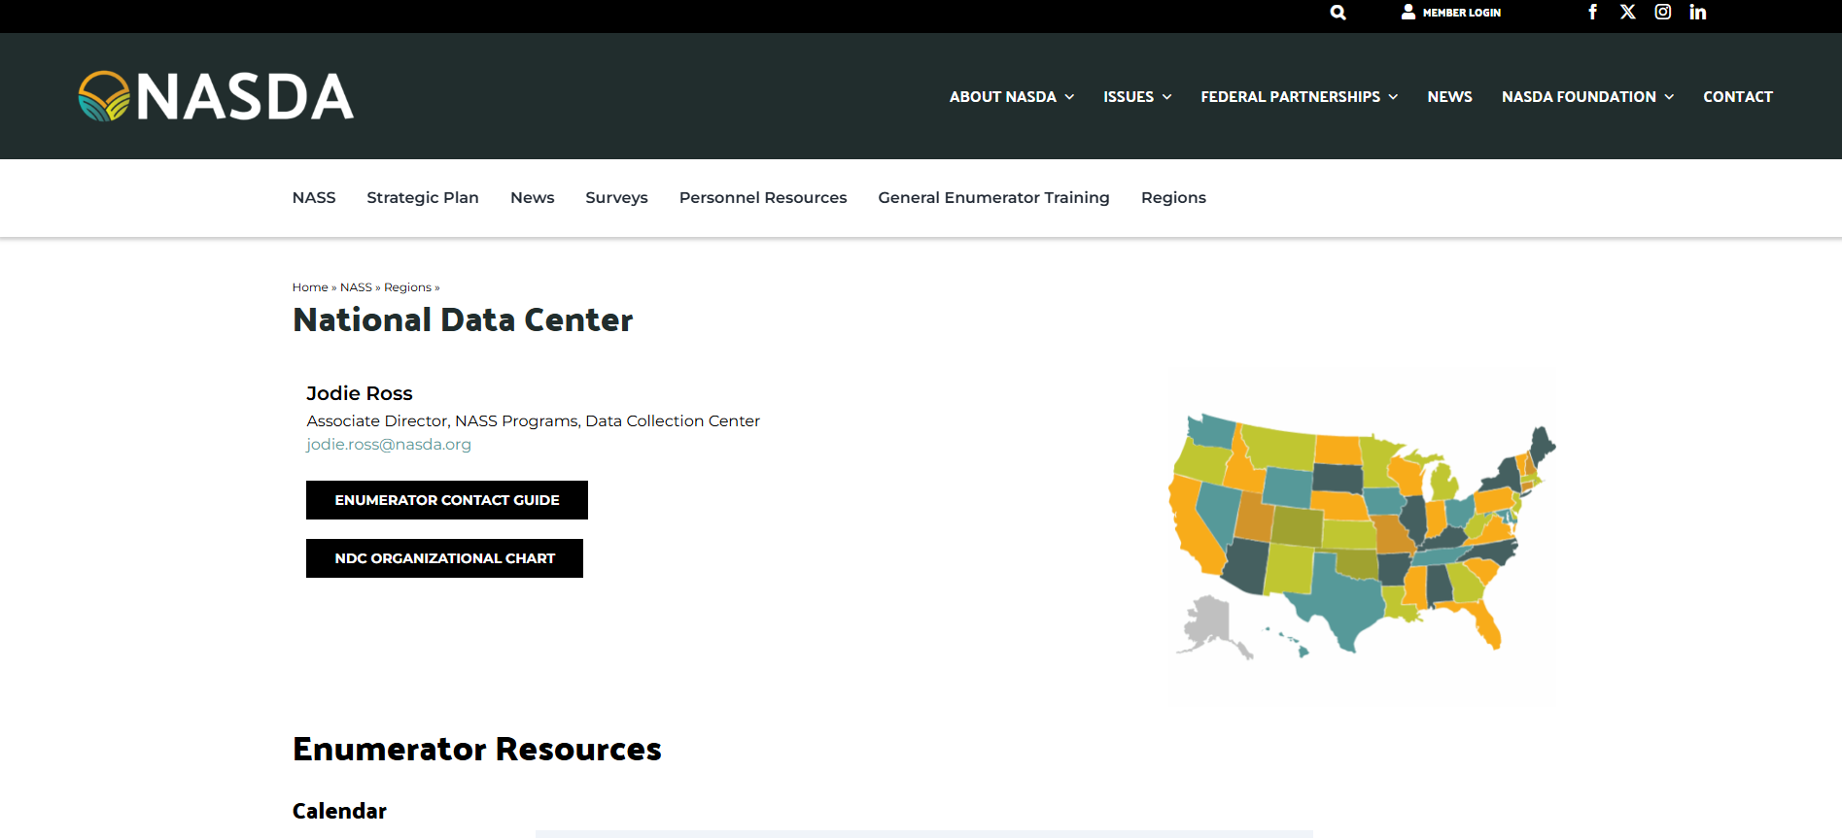
National Data Center (NDC)
https://www.nasda.org/nass/regions/data-collection-center/

Slide 45
NDC Website Navigation
Selections | Results
Frequently Used | Project Codes
Active Surveys | Data being collected
Archived Surveys | Inactive surveys. No data collection
Publications/Releases | NASS publication and Quick Stats
Helpful Enumerator Resources | Who's the target and agriculture definitions
Tips and Tricks | Reluctant Respondent Tips, Phoning Tip and Encouraging Response
Manager/Coach/Trainer Resources | FIPS Codes
Training Resources | Surbey Training Material NOT listed on the NDC website

Slide 46
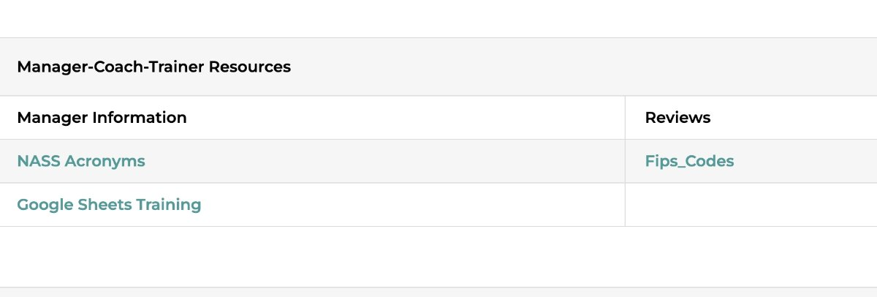
FIPS Codes
FIPS codes are the 2-digit code for the state you're working in.
Enumerators are instructed to use FIPS code (along with the POID) when requesting assistance.
Some common FIPS codes are:
  Alabama-01
  Arkansas-05
  Kansas-20
  Missouri-29
  Oklahoma-40
  Tennessee-47
  Texas-48

Slide 47
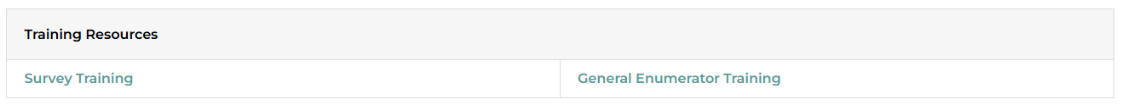
Training Resources
Accessing Survey Training
  From the Training Resources sub-section, locate the Survey Training selection.
  Click Survey Training to view all available training materials.
  Review the training modules.

Slide 48
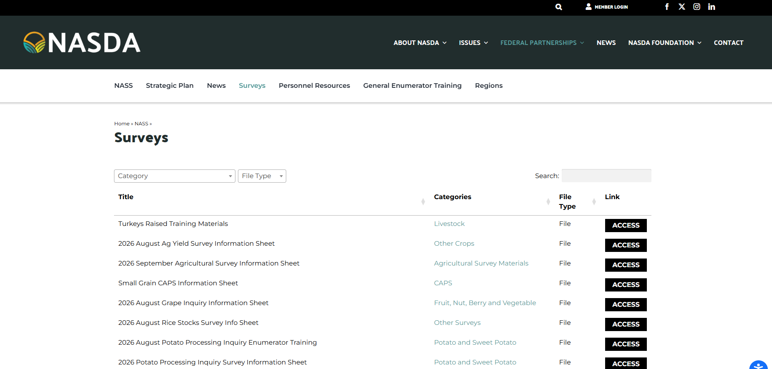
Survey Training
If training material is not found on the NDC website, it can be located under the Survey tab from the menu at the top of the website.
Enter the specific survey in the search box to locate it.
All associated surveys will generate.
Click ACCESS to open the training material.

Slide 49
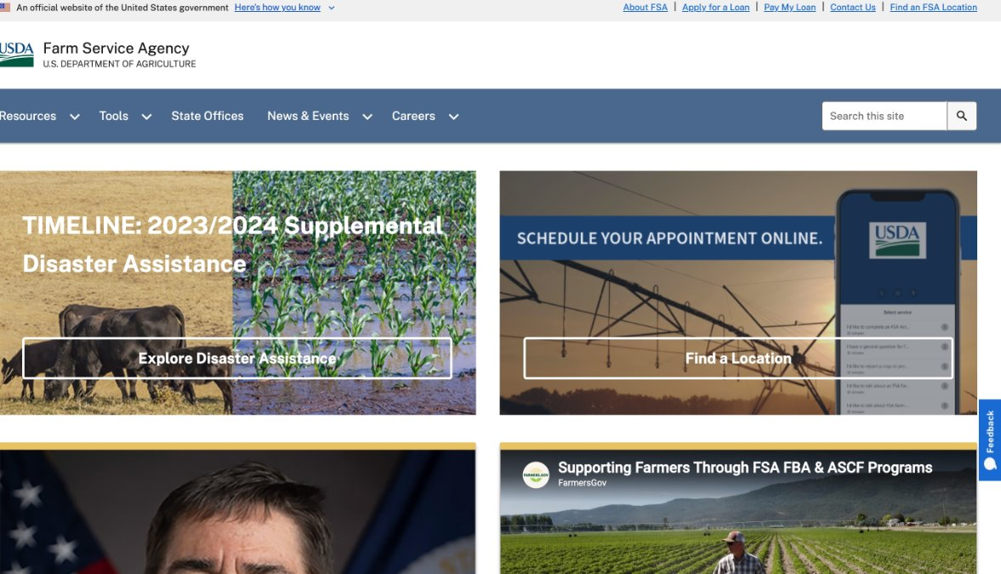
Farm Service Agency (FSA)
www.fsa.usda.gov

Slide 50
FSA Website Navigation
Selections | Results
Programs & Services | Information on Farm Loans, Disaster Assistance, Conservation Programs, Commodity Programs, and Farm Storage Facility Loans
Farm Records | Access information about farm and tract records, producer records, acreage reporting, and farm ownership updates
eForms | Download and complete commonly used FSA forms, including CCC and AD series forms
Disaster Assistance | Find emergency assistance programs, Livestock Indemnity Program (LIP), Emergency Assistance for Livestock, Honey Bees and Farm-Raised Fish (ELAP), and disaster recovery resources.
Farm Loans | Learn more abou direct and guaranteed loans, eligibility requirements, loan servicing, and beginning farmer programs
Conservation Programs | Information on the Conservation Reserve Program (CRP), Grassland CRP, and other conservation initiatives
County Offices | Search for local USDA Service Centers and Farm Service Agency county offices by state or ZIP code
News & Announcements | View the latest FSA news releases, program deadlines, policy updates, and fundng opportunities
Program Deadlines | Review enrollment periods, acreage reporting deadlines, loan application deadlines, an disaster assistance deadlines
Farmer.gov | Access self-service tools for acreage reporting, farm records, applications, eAuthenticaion, and other online producer services
Resources & Fact Sheets | Find program fact sheets, handbooks, frequently asked questions, and educational materials
Contact Us | Locate national and state office contract information and customer service resources

Slide 51
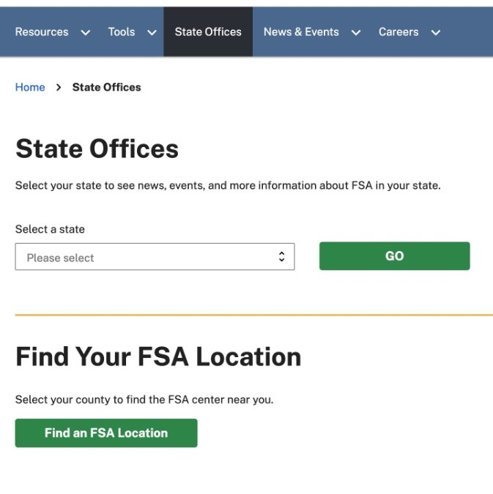
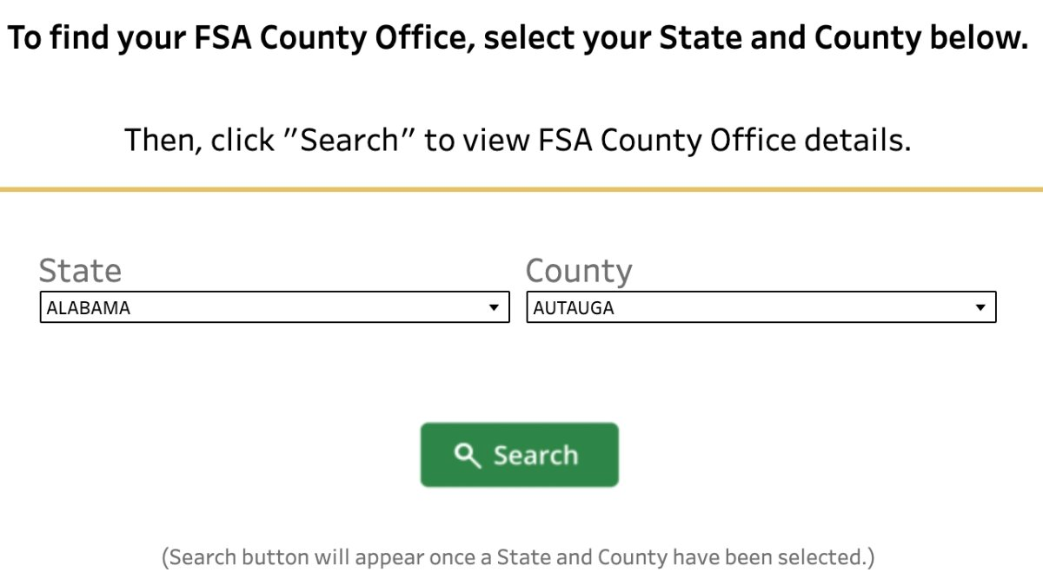
FSA State Offices
Click the State Office tab to search for an FSA County office or phone number
Enter the State and County where the land is located

Slide 52
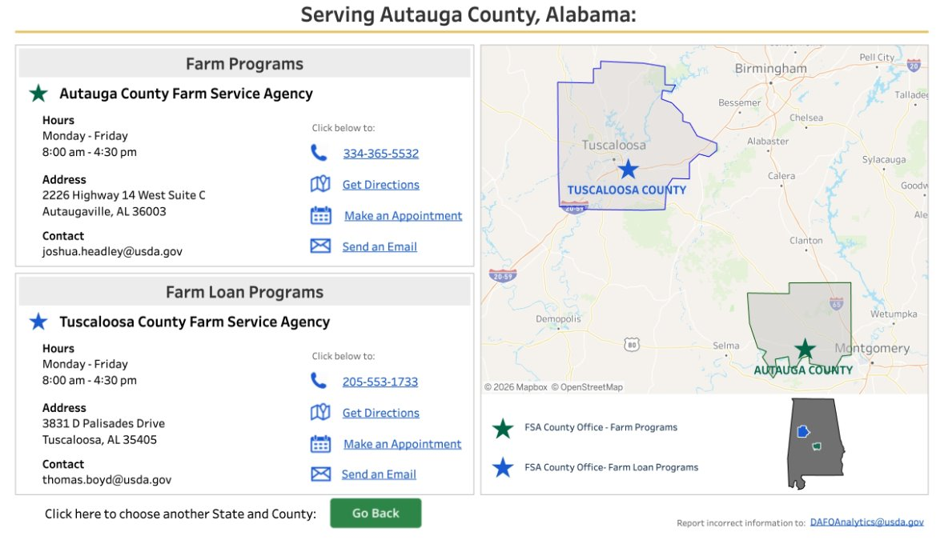
FSA State Offices Results
Provide the numbers to the operator as needed.

Slide 53
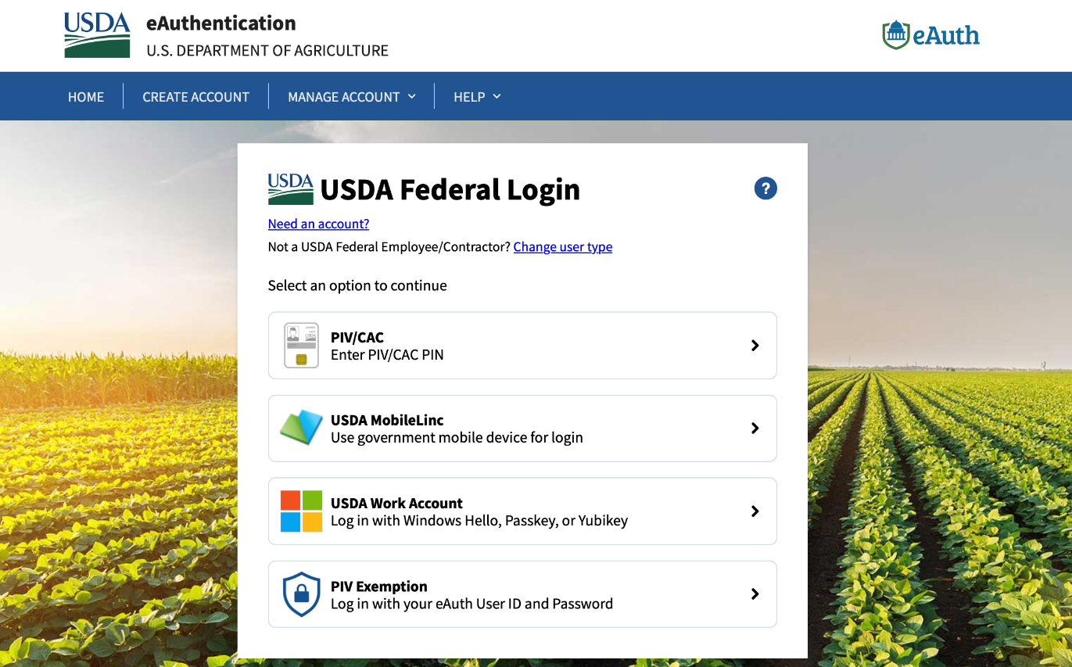
Finding Your Login
As a non-Federal employee, you must change user type to get to the correct login.

Slide 54
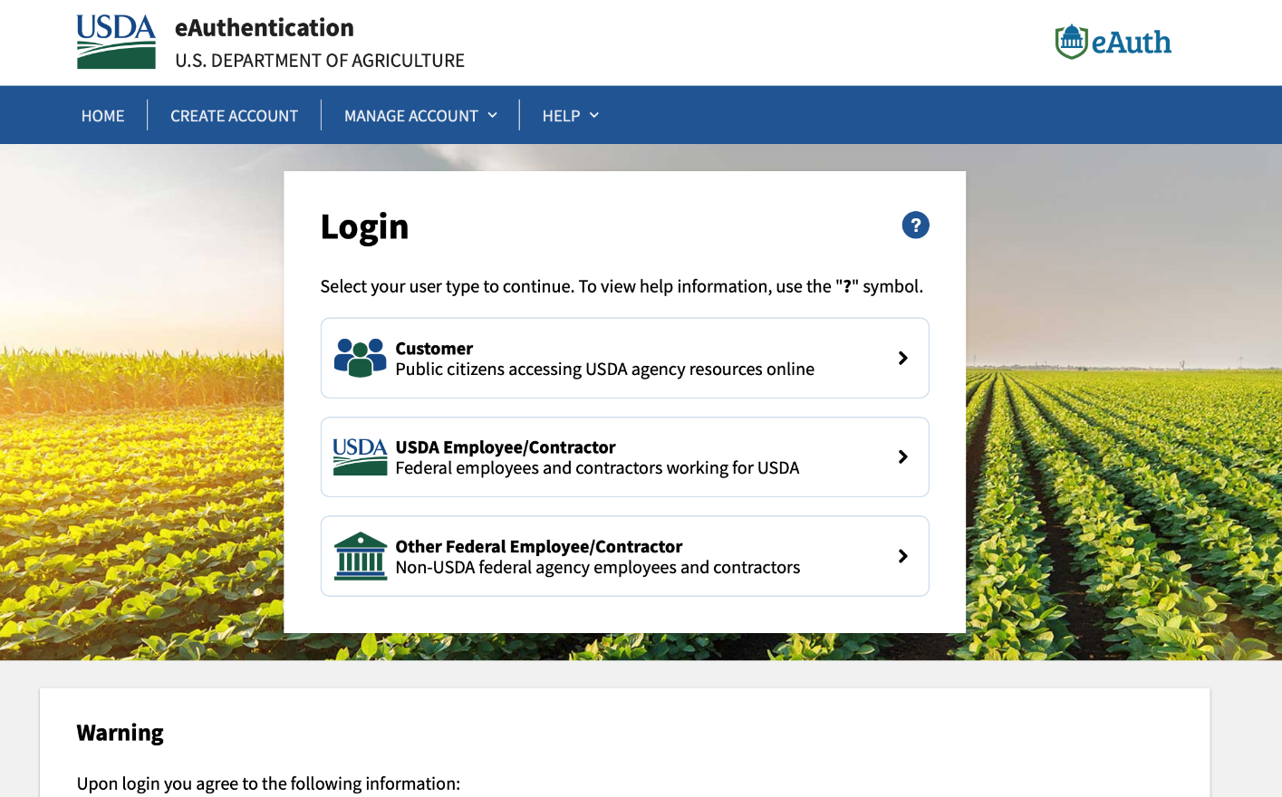
Finding Your Login
The eAuth Login for NASDA is always Customer type.

Slide 55
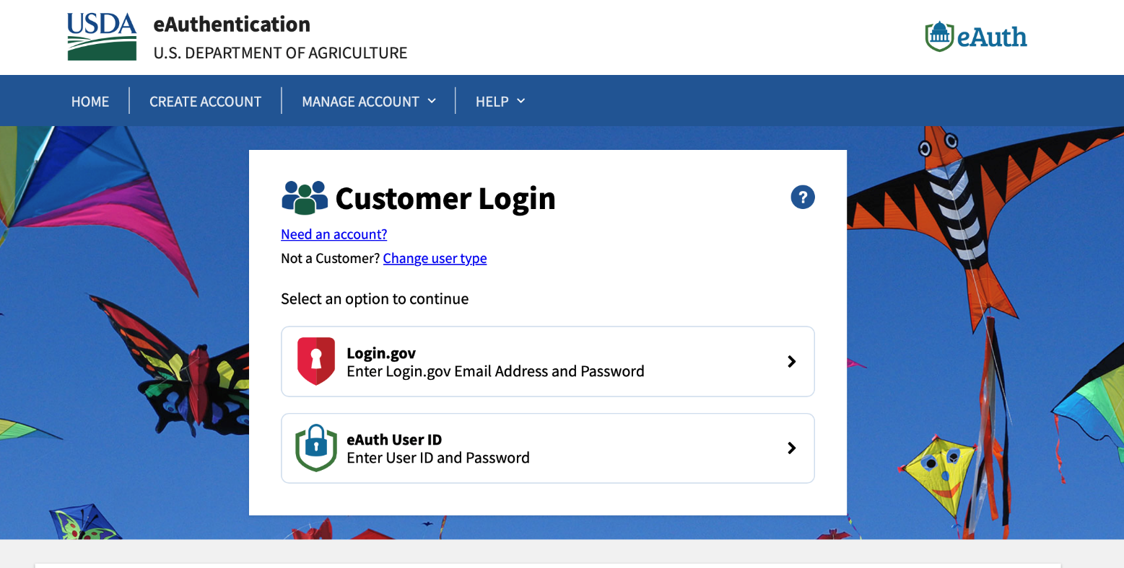
Finding Your Login
If you see this page, you are at the correct login.

Slide 56
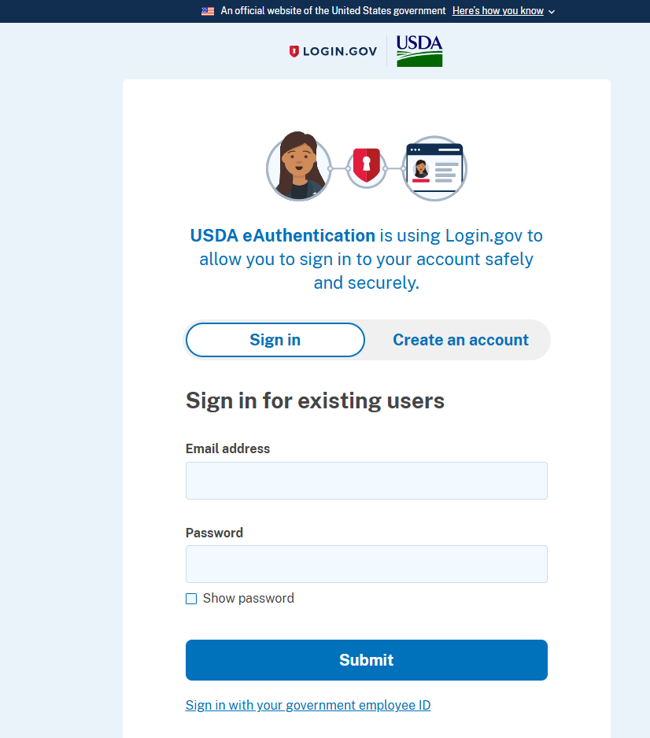
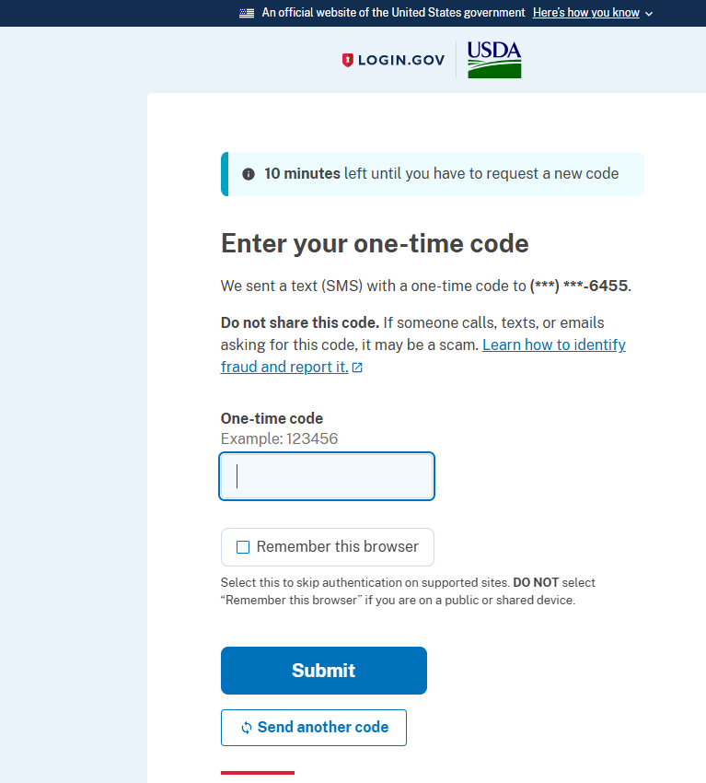
READI Navigation: Logging In
Sign in with your nasda.org email and password.
Select Submit.
Enter your one-time code that will be sent to your phone number.
Select Submit.

Slide 57
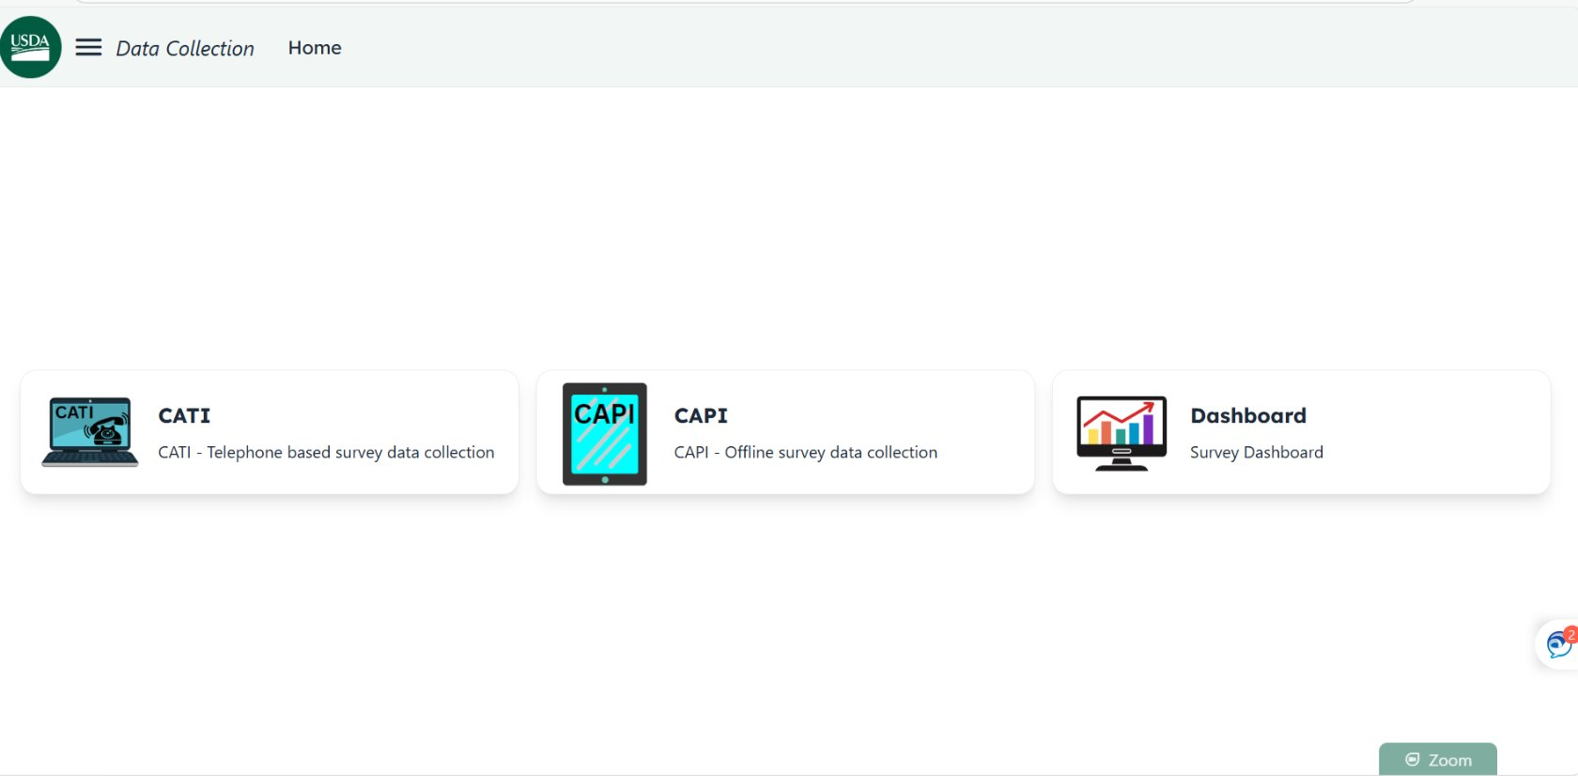
READI Navigation
This is the first screen you will see after logging into READI.
Select the CATI tab.
Do not click the CAPI or Dashboard tabs.

Slide 58
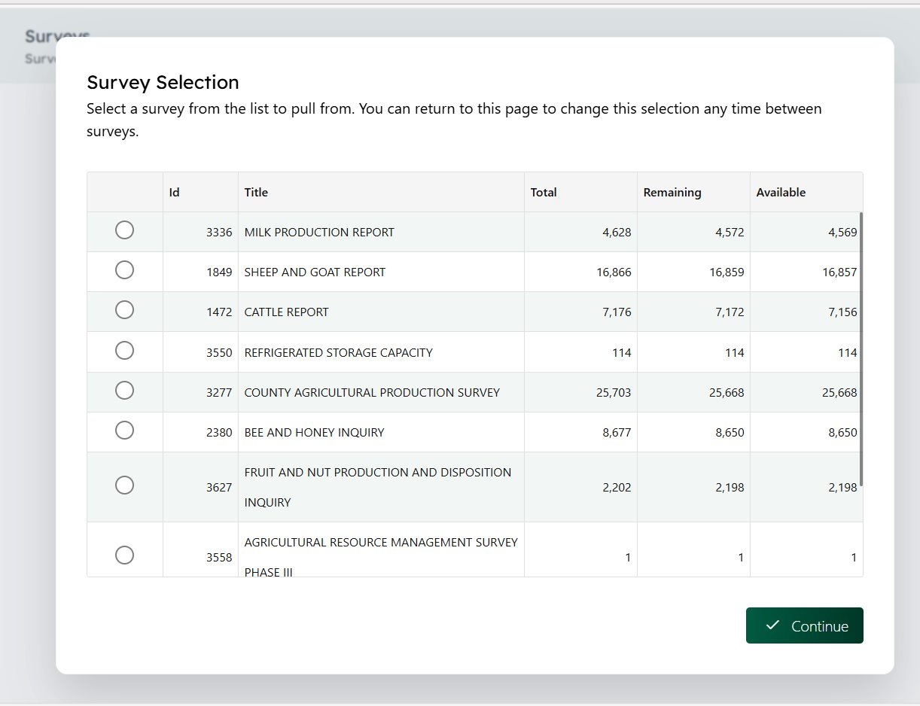
Survey Selection
The Survey Selection list will automatically open.
Select anywhere outside of the Survey Selection list to close it.
The next screen will display the message: "Go. Ready to fetch a new sample!'

Slide 59
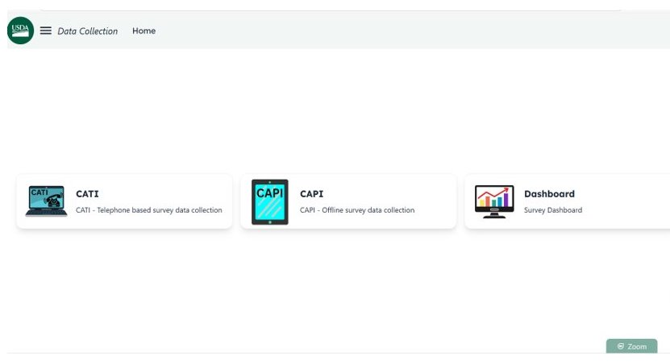
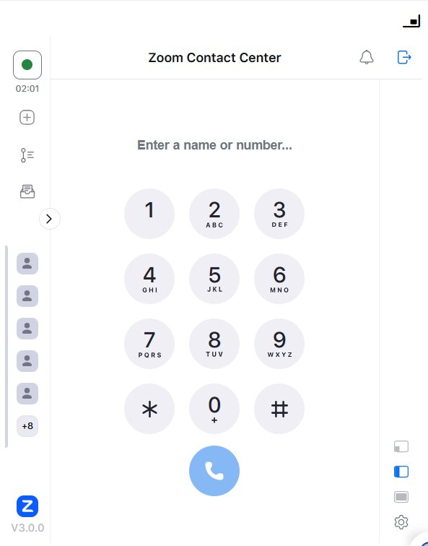
Accessing Zoom
To minimize Zoom click icon in the top right corner.
Select the Zoom tab on the bottom right corner to access the Zoom dial screen.
Zoom sessions sometimes expire after a few days.
Log out of Zoom and sign back in.

Slide 60
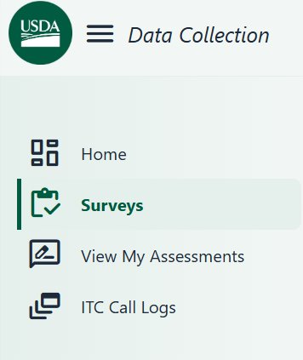
Accessing the ITC Call Logs
Select the hamburger icon to show/hide the drop-down menu.
Select ITC Call Logs.

Slide 61
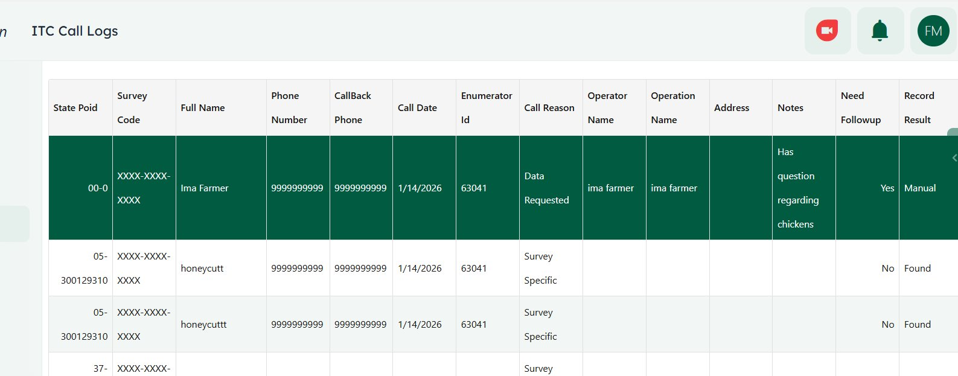
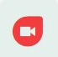
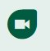
Accessing Incoming Call List
Incoming calls not Active
Incoming calls Active
Click the Zoom button on the top right corner to be added to or removed from the incoming call list.

Slide 62
Additional Access to Ready/Not Ready
This option can be used if more notes need to be added after completing a survey.
You must switch to READY once you have submitted the survey.

Slide 63
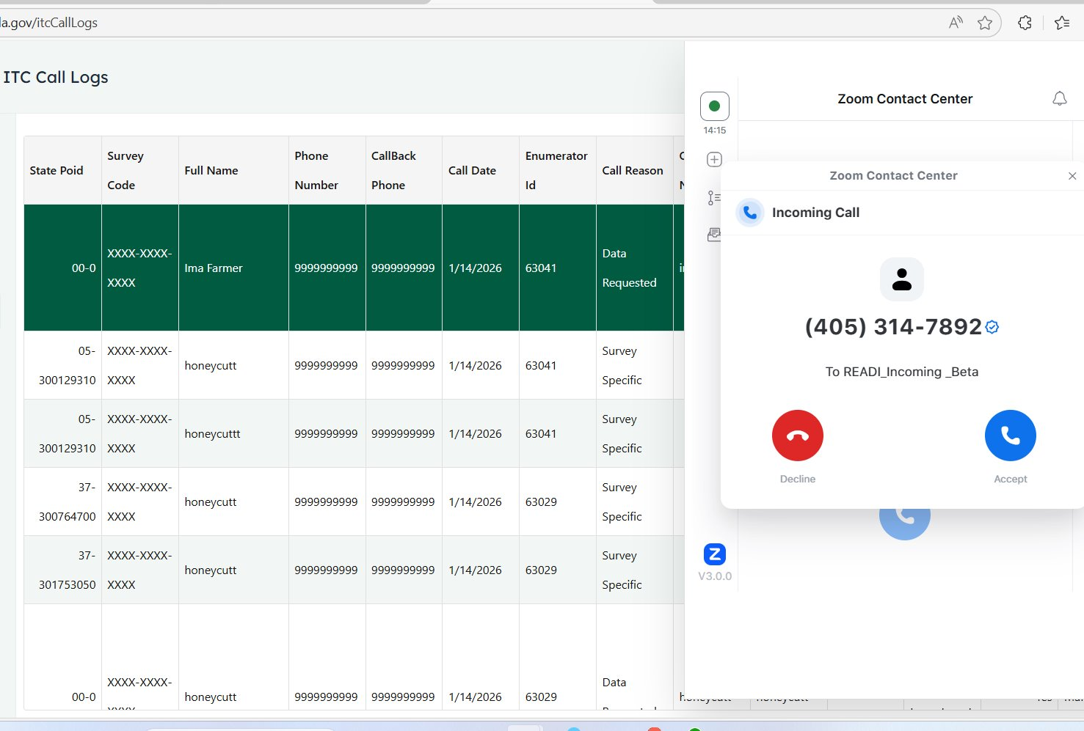
Receiving Incoming Calls
Once actively added to the Incoming Call List, incoming calls will appear on the Zoom screen to decline or accept calls.
Click accept and minimize the Zoom Contact Center screen.

Slide 64
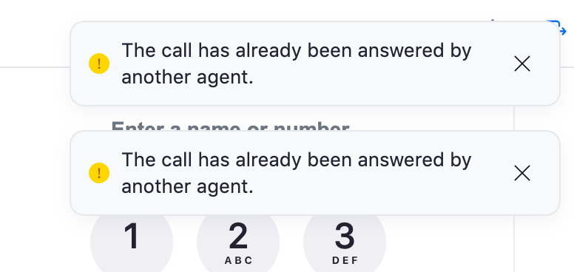
How are Calls Answered?
Zoom will notify you if the call has already been answered by another agent.

Slide 65
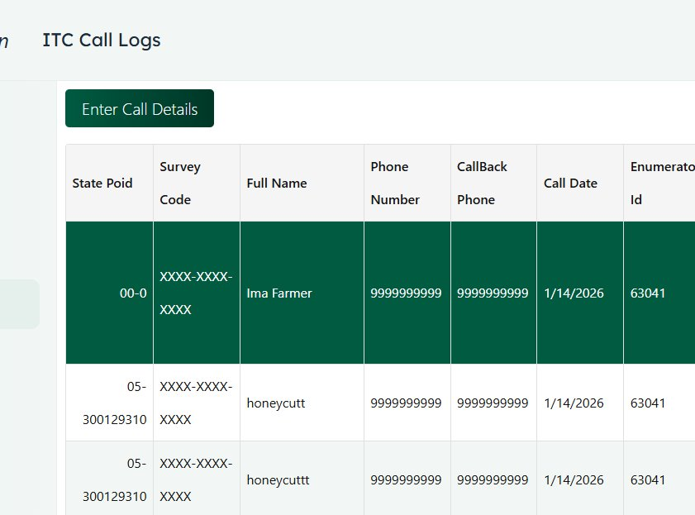
Call Details
The Enter Call Details is placed at the top of the ITC Call Logs list.
It provides immediate access to log incoming call information.

Slide 66
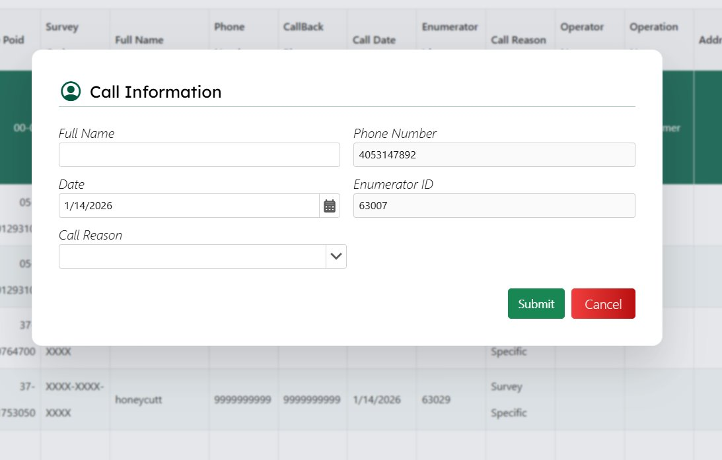
Entering Call Details
Enter the operator's full name.
Select the appropriate call reason.
Click Submit to save the information and begin processing the call.

Slide 67
Call Information
Enter the target's full name
Phone number is automatically filled in
Date is automatically filled in
Enumerator ID automatically filled in
Select the best option for the call reason

Slide 68
“Call Reason” Selections
Selection | Reason
Data Request | Needs data or information
General Inquiry | Verifying who NASS is
Survey Specific | Completing survey, Refusals, Out of business, Mailed in, Survey Code
Other Issue | Any other issues
USDA Concern | Any concerns with agencies within USDA
Notes:
Today we will cover everything related to call reason=survey specific. The other options will be covered tomorrow.

Slide 69
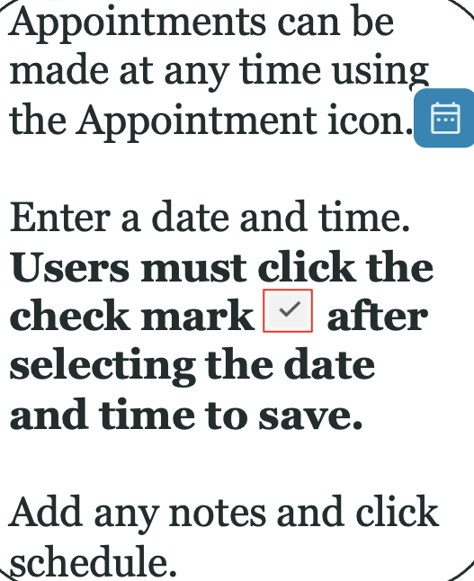

Making Appointments

Slide 70

Appointment Selections
Select a day by double clicking the date
Enter preferred callback number
Enter any detailed or helpful notes
Click Schedule to finish setting the appointment

Slide 71

Appointment Scheduled
Once the appointment is scheduled, it will appear in the next screen by that survey under the Record Result column.

Slide 72
Searching for Records
Search Type | Results
By Name | All "John Doe" from different states
By Phone Number | Specific target will appear
By Address | Specific target will appear
By EDR Code | Specific record will appear
NOTE: At times you may have to use all search types to make sure you the correct target is operation is selected.

Slide 73

Search Screen
The Search screen is the primary tool used to locate surveys and records quickly.
By searching using identifying information such as a respondent's name, phone number, address EDR code, or State Poid, operators can efficiently access survey records, verify respondent information, and provide timely assistance.

Slide 74

Search Results Example: Last Name Only

Slide 75

Search Results Example: Phone Number

Slide 76

Survey Specific Option
To complete a survey, you must select Survey Specific on the Call Reason menu.

Slide 77

Completing a Survey Cont.
In the search box, enter the operator's name or operation name.
Once the records pulls up, double-click the POID to access the dial screen.

Slide 78

Confirming Your Selection
A confirmation box will appear, giving you the option to cancel or confirm if the selected survey is correct before proceeding.

Slide 79

Dial Screen
Select to start survey.
The dial screen will appear after confirming your selection.

Slide 80

Complete the Survey
If the operation is selected for more than one survey, it will give you the option to complete the second one AFTER completing the first one.

Slide 81

Escalation Status
The Escalation Status helps monitor survey progress.
The different colors provide a quick visual reference for the current state of each survey record.
This helps prioritize follow-up actions.

Slide 82
Escalation Status Meanings
Color | Status | Meaning | Enumerator Action
Green | Active | Survey is Active for data collection | Continue collecting data as needed
Yellow | Approaching Deadline | Survey is nearing its due date | Prioritize contact attempts and update notes
Red | Survey is Closed | Survey has ended or is inactive | Click on POID to get inactive message

Slide 83

Handling Inactive (Red) Escalation Status
What happens?
  When a record displays the red escalation status, clicking on the POID opens a confirmation message indicating that the survey has been identified as inactive.
What to do next?
  Review the message
  Click Confirm
    Once confirmed this cannot be undone
  Complete notes
Best Practices
  Verify respondent
  Enter detailed notes
  Save before exiting

Slide 84

Documenting Inactive Surveys
After confirming an Inactive survey, the system will automatically open the Notes window.
This is where any detailed notes should be entered. e.g. Call back to complete survey.

Slide 85
Call Detail Selections
Selection | Reason
Data Request | Needs data or information
General Inquiry | Verifying who NASS is
Survey Specific | Completing survey, Refusals, Out of business, Mailed in, Survey Code
Other Issue | Any other issues
USDA Concern | Any concerns with agencies within USDA

Slide 86

Call Back Information
The following “Call Reason” selections will open the CallBack Information screen
  Data Requested
  General Inquiry
  USDA Concern
Enter CallBack Information with clearly detailed notes.

Slide 87
USDA Concerns/Questions Examples
Agency | Concerns
Farm Service Agency (FSA) | Inquiries regarding farm loans, disaster assistance programs, commodity operations, and conservation incentives.
Risk Management Agency (RMA) | Questions about federal crop insurance policies, premium adjustments, or risk mitigation resources.
Agricultural Research Service (ARS) | Technical concerns or data request related to ongoing agricultural research, crop sustainability, and livestock solutions.
Food and Nutrition Service (FNS) | Inquiries regarding Federal nutrition assistance programs.
Forest Service (FS) | Questions about public land management, forestry data, conservation efforts, or national forest permits.
Rural Development | Inquiries concerning community infrastructure grants, rural housing loans, and business development programs.
Funding | General questions regarding budget allocations, financial eligibility criteria, and application deadlines for USDA financial assistance.

Slide 88
Feedback from Management
Feedback Source | Purpose
Weekly Performance Reports | Review team and individual inbound/outbound productivity, trends, and performance metrics
Power Bi Dashboards | Analyze call volume, call results, calls by enumerator, and operational trends to support data-driven decisions
Call Monitoring & Assessments | Evaluate professionalism, survey accuracy, active listening, probing techniques, and compliance with procedures
Coaching & Development | Provide constructive feedback, recognize achievements, establish performance goals, and create improvement plans for continuous growth

Slide 89

Weekly Team Performance Example
The Weekly Team Performance Report provides managers and coaches with a snapshot of overall team productivity, efficiency, and call outcomes during a reporting period.
This report helps identify performance trends, coaching opportunities, and areas where additional support or training may be needed.

Slide 90

Weekly Team Outbound Performance Example
The Weekly Team Outbound Performance Report provides managers and coaches with a summary of outbound calling activity during the reporting period.
This report measures team productivity, calling efficiency, and respondent contact outcomes to ensure surveys are progressing as scheduled.
Monitoring outbound performance allows managers to identify trends early, provide targeted coaching, improve contact rates, and ensure USDA-NASS surveys are completed accurately and on schedule.

Slide 91

Weekly Team Inbound Performance Example
The Weekly Team Inbound Performance Report provides managers with a summary of all incoming calls handled by the team during the reporting period.
This report measures responsiveness, call handling efficiency, and overall service provided to respondents who contact the National Data Center.
Every inbound call represents a respondents who has taken the initiative to contact USDA-NASS.
Providing timely, professional, and accurate assistance helps improve respondent satisfaction, increases survey completion rates, and supports the collection of reliable agricultural statistics.

Slide 92

Weekly Individual Performance Example
The Weekly Individual Performance Report provides a detailed view of an individual enumerator's productivity, efficiency, and survey outcomes during a reporting period.
This report helps managers recognize accomplishments, identify coaching opportunities, and monitor progress toward performance expectations.
Individual performance reports promote accountability, encourage continuous improvement, and provide data-driven coaching.
By reviewing performance metrics regularly, managers can help enumerators strengthen their interviewing skills, improve respondent engagement, and contribute to the collection of accurate, high-quality agricultural statistics.

Slide 93
What is a Usable, Refusal, Other?
Actions | Results
Usable Complete | Good data, Out of business. Sometimes partial interviews probe for as much detail as possible.
Refusals | Data that is NOT counted as useable
Other | This includes call outcomes that are not categorized as Usable, Refusals, Busy, Voicemail, No Answer, Wrong Number, Hung Up, Disconnected, Appointment, or Mail in/Internet. It also includes inbound calls marked with an outcome of "Other".

Slide 94
Power BI Charts and Tables
The Power BI charts and tables provide more data.
It displays data:
  Individually
  By Survey
  By Date
  By Team

Slide 95

March ITC Inbound Calls
The ITC Inbound Calls Dashboard provides a real-time and historical view of incoming all activity for the National Data Center.
It enables managers to monitor call volume, identify peak calling periods, and evaluate trends that support staffing and operational decisions.
Understanding when and why respondents call helps ensure timely assistance, improves survey participation, and contributes to the collection of accurate, high-quality agricultural statistics.

Slide 96

Inbound Calls per Hour Power BI Chart

Slide 97

ITC Individual Report Inbound Call by Date

Slide 98

ITC Individual Inbound Call by Date Table

Slide 99

ITC Inbound Calls All Surveys

Slide 100

Power BI Calls by Enumerator

Slide 101
Assessments
An assessment is completed multiple times a month by your manager or coach.
Manager or coach monitors calls to verify interviews are being conducted correctly.
Enumerator can review assessments in READI.
Enumerators can also receive a call or email from their manager or coach to improve and encourage performance.

Slide 102
ITC Timecard Documentation
Accurate ITC time reporting is essential for tracking a variety of project codes, budgeting, and workload distribution. Each time ITC-related work is completed, your timecard must clearly indicate the time that was spent on working ITC.
Proper documentation helps both NASDA and USDA NASS accurately monitor labor costs and allocate funding across various projects.

Slide 103
ITC Timecard Requirements
Timecard Requirements | Actions
Identify ITC Work | Record "ITC" in the notes/comments section of each day ITC work is performed.
Record Time Daily | Enter your time at the end of each workday to ensure your records are accurate and complete.
Use Quarter-Hour Increments | Report all work time in 15-minute (0.25 hour) increments in accordance with timekeeping guidelines.
Document Survey and Project Codes | Keep a record of all survey names and corresponding project codes worked on throughout the day. Reference the NDC Website under ‘Frequently Used’
Allocate Time appropriately | If multiple surveys, divide your hours amount the applicable project codes based on time spent. When exact times are unavailable, use your best professional judgement to estimate the allocation as accurately as possible.

Slide 104
Why Accurate Timekeeping Matters
Accurate ITC time reporting:
  Supports effective budget management.
  Ensures labor costs are charged to the correct projects.
  Improves reporting accuracy for NASDA and USDA NASS.
  Provides reliable data for project planning, staffing and funding decisions.

Slide 105

Recording ITC Time in iSolved
Record start time and end time in quarter increments.
If the duration is long, there was more than one call on that specific survey. E.g. more than one call on Cattle.
Enter project code.
Enter ITC in the notes box.

Slide 106

Recording ITC Time in iSolved
Record start time and end time in quarter increments.
If the duration is short, there was only one call on that specific survey. E.g. more than one call on Cattle.
Enter project code.
Enter ITC in the notes box.

Slide 107
Recording Outbound ITC Time in iSolved
Record start time and end time in quarter increments.
The duration will auto calculate once you put your time in.
Enter project code.
If outbound calling, a note is not needed.

Slide 108

Timecard Error: Incorrect Increment
Error: Time not rounded to the nearest quarter hour.
  What this error means:
    Employees must record work time in 15-minute increments (:00, :15, :30, :45).
    Time entered outside of these increments (such as 1.43 hours) will generate an error.
  How to identify the error:
    The issue description highlights the problem: "Time not rounded to the nearest quarter hour."
    The Hours column (circle in red) displays the incorrect time entry that needs to be corrected.

Slide 109
How to Correct the Error
Open timecard.
Locate the highlighted entry.
Round the time to the nearest quarter-hour increment.
  Examples:
    1.43 changes to 1.75
    3.10 changes to 3.25
    2.37 changes to 2.50
Save the correction and verify the error has cleared.
Tip: Always review the HOURS column before submitting a timecard to ensure all the entries are in 15-minute increments.

Slide 110
Timecard Error: Wrong Project Code
Error: Wrong project code entered.
  What this error means:
    A PC (Project Code) identifies the current survey that is being worked on.
    This error occurs when hours are entered using an incorrect, invalid, or unautorized Project Code.
  How to identify the error:
    The Timecard Issues report will display "Wrong PC"

Slide 111
How to Correct the Error
Open timecard.
Review project code and make sure it is correct.
Replace incorrect project code with the correct one
Save the correction and verify the error has cleared.
Tip: Always review the project code before submitting a timecard to ensure all the entries are allotted to the correct PC.

Slide 112

Inbound Waiting Calls
The Inbound Waiting Calls alert is automated notification that helps ITC leadership monitor call queue activity in real time.
The ITC Manager and the Associate Director will receive notifications if there are more than 5 or more calls in the queue.
Real-time queue alerts allow ITC leadership to respond proactively to increase all demand.
These alerts act as an early warning system, allowing leadership to intervene before long wait times affect respondent service and survey completion.

Slide 113
Monitoring Active Calls
The Active Engagements screen displays:
  Caller status
  Call direction (Inbound/Outbound)
  Queue name
  Start time
  Current call duration
  Phone number
  Engagement ID

Slide 114

Agent's Status
The Agent Status dashboard provides ITC managers with a real-time view of each enumerator's availability and current activity within the Zoom phone system.
This tool helps managers monitor staffing levels, manage call flow, and ensure respondents receive timely assistance.
Monitoring agent availability ensures the National Data Center can deliver consistent, high-quality customer service.

Slide 115
Zoom Contact Call Center Statuses
The ITC Manager uses the Zoom Contact Center to monitor incoming calls, track caller status, and determine the appropriate action for each caller.
Call Statuses | Meaning
Assigned | The call has been routed to an ITC enumerator and is actively speaking with the operator.
Callback | The operator has the callback option if all lines are busy. READI will automatically call the operator 3 times every 15 minutes. We leave a message the 1st time (you can tell if you are the 2nd or 3rd called by looking at the time (duration).
Queue | The operator is waiting in line for the next available ITC enumerator.

Slide 116

Why Your Work Matters
Every completed interview helps:
Farmers make production decisions
USDA develop agricultural programs
Congress make informed policy decisions
Researchers study agricultural trends
Agricultural businesses plans
Communities understand local agriculture
Every phone call counts.

Slide 117

Professionalism on Every Call
Professional callers demonstrate:
Courtesy
Active Listening
Clear Communication
Respect
Patience
Neutral Tone
Even difficult calls should end professionally.

Slide 118
Remember the 4 P's
With every interaction, we should always strive to demonstrate:
Politeness
Patience
Preparedness
Professionalism

Slide 119
Questions?
National Agricultural State Department of Agriculture
(202) 296-9680
4350 N. Fairfax Drive
Suite 910
Arlington, VA 22203
Twitter: @NASDANews
Instagram: @NASDANews
Facebook: @NASDADC
www.nasda.org

